Slide 1

Semi – Supervised well log correlation
Saurabh Sinha
AASPI 2022
Notes:
This presentation was first given on November 23, 2021 as my PhD defense
Thank you all for coming.

Slide 2
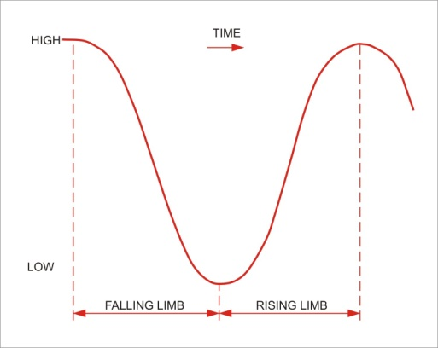
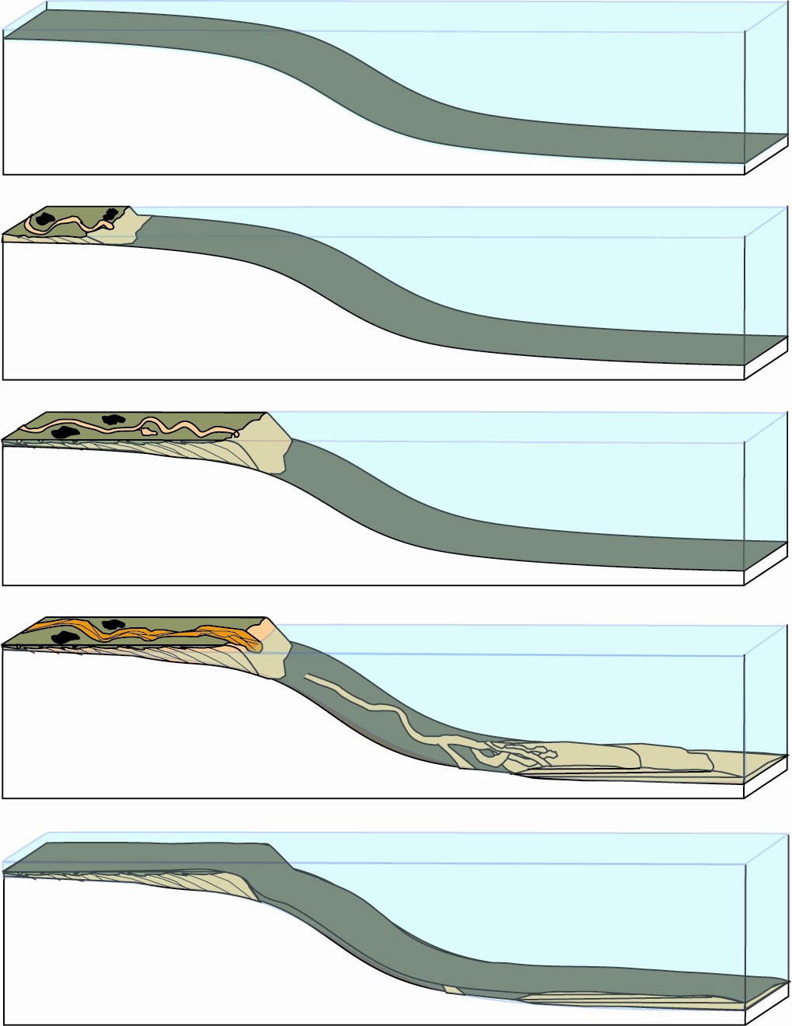
Motivation
Shoreline moves seaward: shelf
becomes exposed and eroded.
Falling sea level
Erosion Surface (sequence boundary)
“Lowstand systems tract”
Slatt, 2016
Notes:
In this image, borrowed from Dr. Roger Slatt, shows a typical depositional system for shales. It follows the condensed section-progradational ‘couplet’ which is majority of shale reservoirs in US.
The first step:
On the falling limb of the sea level curve ( upper right), the shelf becomes exposed and the depositional system thus obtained is called a lowstand systems tract or LST

Slide 3

Motivation
Deposition over 2MM years
shoreline
Shoreline moves landward;Sands
deposited along shoreline, but
mud across shelf-slope-basin.
Rising sea level
Organic-rich condensed section
“Transgressive systems
tract”
Slatt, 2016
Notes:
On the rising limb of the sea level curve ( upper right), the condensed section is obtained where the sea moves landward and hence organic rich shale is deposited landward or shelf/slope/ basin

Slide 4
Motivation
Deposition over 2MM years
Lower gamma ray (TOC)
High gamma ray (TOC)
“Highstand systems
tract”
Sharp erosive base
Well log characteristics
Progradation
Shoreline moves seaward
Rising sea level
Transgressive
Surface of erosion (TSE)
Condensed section
Slatt, 2016
Condensed section-progradational ‘couplet’
Notes:
At the highest point in the sea level curve , the deposition of sediments is prograding towards the basin . This whole sequence of erosion/ sequence boundary, the condensed section and the progradation is called a condensed section-progradational ‘couplet’.
The idea is to interpret this type of depositional sequence given the well log characteristics or an inverse problem for stacking patterns.

Slide 5
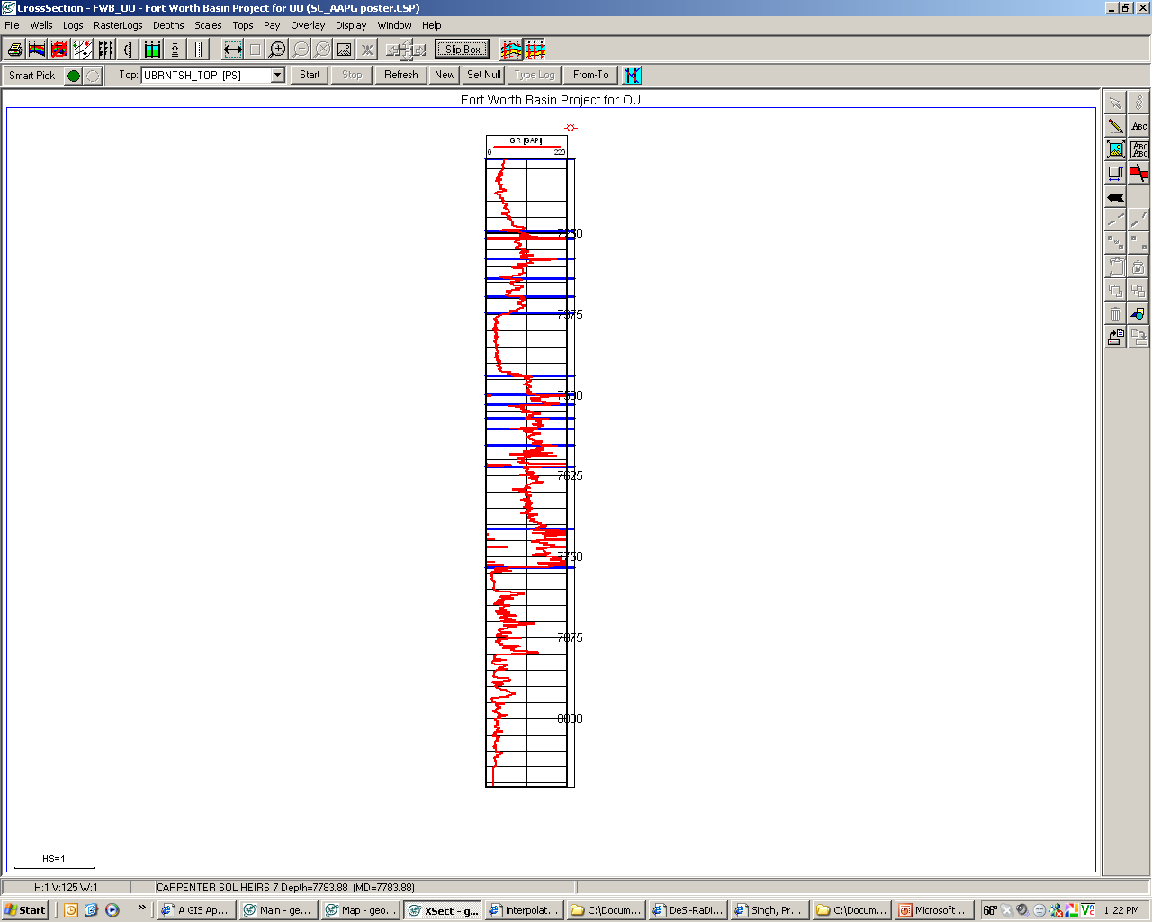
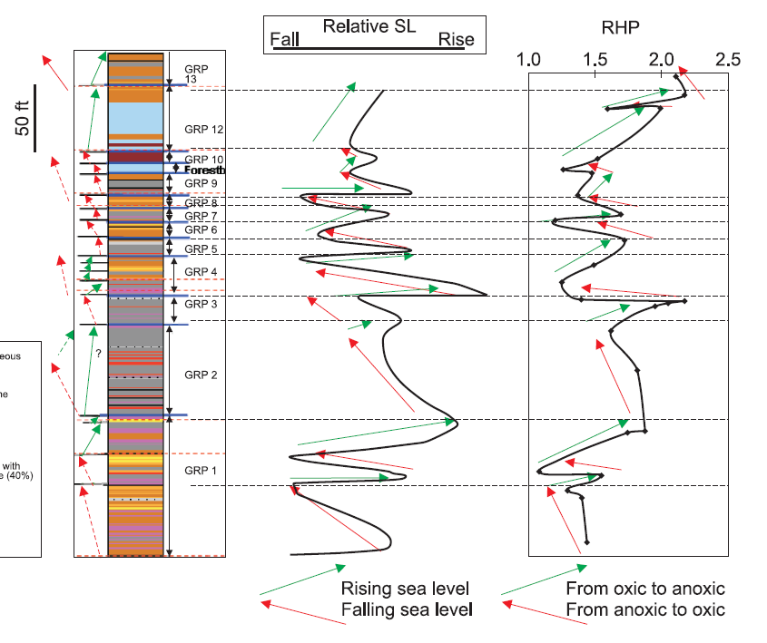
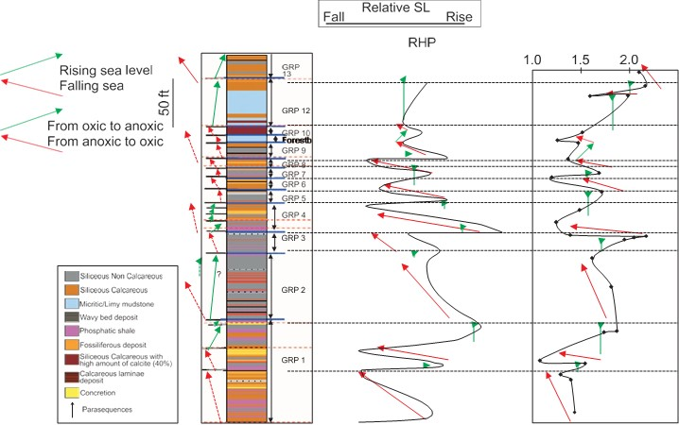
Motivation
Relative sea level
Well gamma ray (API)
Core gamma ray
Core mineralogy
Fall
Rise
0.0
250.0
0.0
1000.00
7250
Siliceous non calcareous
Siliceous calcareous
Forestburg
Forestburg
Forestburg
Micritic/Limey mudstone
Wavey bed deposit
7375
Phosphatic shale
Fossiliferous deposit
Siliceous calcareous with > 40% calcite
7500
Calcareous laminae deposit
2nd order (22m.y.)
Concretion
7625
Parasequences
7750
TSE
Takeaway : Gamma ray -> mineralogy -> petrophysics, geo mechanics, deposition
Singh, 2008
Notes:
Unconventional and why it matters ?
Similar analysis on a Barnett core where Singh (2008) correlated the cyclical sea levels interpreted from Gamma with mineralogy and also interpreted the second order parasequence. The mineralogy is bears high correlation with geomechanical parameters and also petrophyscial properties and hence production. The interpreted second order sequence is also shown in the end .

Slide 6
Motivation
Unconventional resource play property plays may contain 1000 or more wells
Assumptions:
10 picks per well
1 pick per minute
8 hours/work day
5 work days/week
Takeaway : Automation is a necessity, not a luxury anymore
Notes:
Estimated time taken by a human interpreter to manually pick formation top on well logs as the number of well logs increases. For a small number of wells such as
an offshore turbidite reservoir the interpretation can be done manually. However, for a typical shale play with a thousands of wells, it can thousands of interpreter-hours to generate the complete results.
This makes the manual interpretation of all the wells prohibitively expensive.
Figure above shows 5 parasequences to be picked per well; delineated by total 10 picks and the expert interpreter works 8 hours a day and makes one pick per minute. It can be observed that the time required to make such picks is prohibitively high and hence automation is a need , not a luxury anymore. Thousands of these wells are drilled and completed every year in North America alone and there are added data from digitized legacy wells.

Slide 7
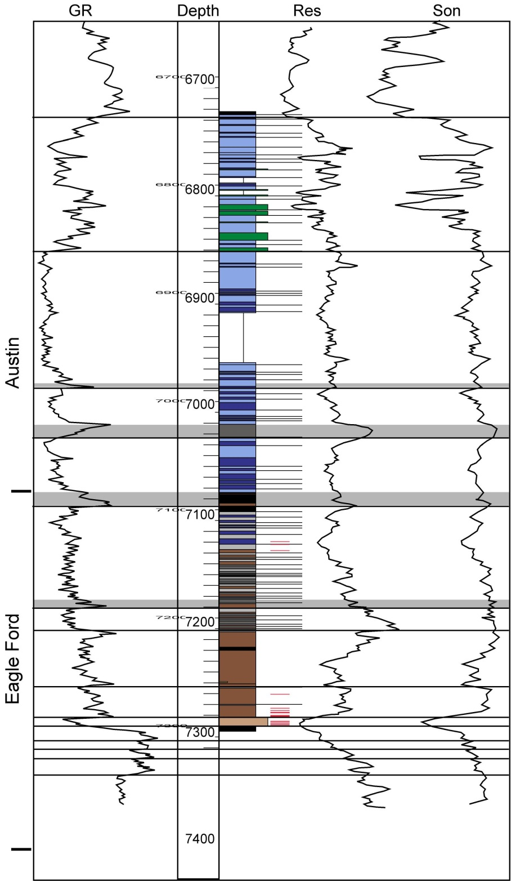

Previous attempts at automation of well log interpretation
CNN (most popular) – Limitations on features available in all wells
Adaptive window : Hard to design
Dynamic time warping (DTW) : Large search space requiring multiple “guide” wells
Segment and manually correlate : Doesn’t solve the problem in full
This chapter : Segment ( statistically) + Correlate ( Warping)
Takeaway :Segment and correlate
Buda
Notes:
CNN :
CNN requires more features to train. In the well log borrowed from Eagle ford shale (EFS), notice the lower + upper EFS section. It maybe hard to correctly identify this section in all the wells using the GR alone, it will be easy to pick the features on a combination of wells. Geologists often use some markers such as a prominent gamma ray peak to mark maximum flooding surface (MFS), a prominent carbonate or a condensed section progradation couplet. In terms of well logs and machine learning every well log is called a feature. More different features there are to train with, its easier to distinguish a sequence. However, all the features required to distinguish sequences are not always available. More often than not, for older legacy wells often there is only gamma ray log is available and hence CNN is not very effective. CNN also requires extensive training and the learned model is not always applicable to another shale play.
2. Why is adaptive window hard to design?
What looks like a simple problem of picking sequences is a extremely hard problem. The sequences themselves are varying in shape and thickness i.e., signal lengths. Hence, to capture the accurate parasequences properly, different window sizes need to be tested and a metric needs to be obtained to select optimum window size. This process is then to be repeated on all the wells and “one window size fits all the wells ” does not work.
3. DTW
DTW applies stretch and squeeze to the wells eliminating the need for same signal lengths. However, just like the adaptive window a well log with 10,000 samples for example is too large for the technology to work properly. A sequence lets say 100 samples thick requires either more features like CNN or lots of iterations like an adaptive window.
All these methods do not work due to two limitations :
The search space is too large
The number of features to distinguish these are too less ( only GR).
The solution :
Segment the well into different sequences first.
Then stretch and squeeze to match.
Which I shall now demonstrate with an example from the Barnett shale.

Slide 8
Area of study : Barnett Shale
Notes:
Image shows the Barnett shale and a type log from the area
A total of 106 wells distributed unevenly, the type log is shown by a yellow dot.
3. Major stratigraphy is also shown in the image : Marble falls limestone on the top followed by upper Barnett, , Forestburg is sandwiched between upper and lower Barnett and the lower Barnett sits on top of the Viola limestone.
4. Notice the different GRPs marked by red and the green arrows. Upward decreasing API intervals are shown in red and the upward increasing API intervals are shown in green.

Slide 9
Workflow
Notes:
Workflow adopted can be divided into five distinct parts:
Filter the bigger spikes : this is the pre processing step
Segment : to divide the well logs into smaller sequences
Correlate : use these
Fit , RANSAC
Obtain slopes and interpolate as a property

Slide 10
Segmentation

Slide 11
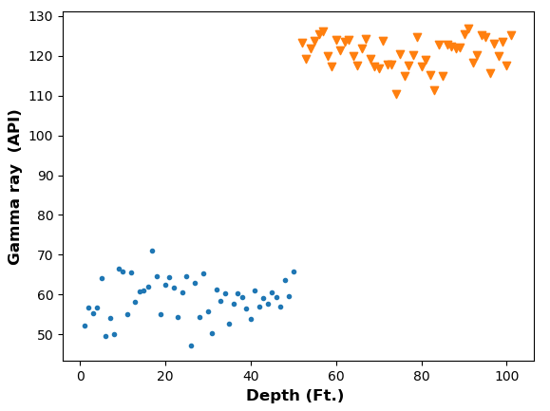
Segmentation
Build a null hypothesis and alternate hypothesis
Get likelihood estimators for both
Take a ratio of the likelihood estimators
Maximize for the location of first changepoint
Repeat in binary segmentation fashion
µ= 120 API
µ=60 API
Two gamma ray (GR) distributions with different means but same variance
Notes:
The idea behind segmentation is that a signal with distributional changes can be split at discreet changepoints where a changepoint splits the signal into two distinct segments. ( image pop)
In this example consider two gamma ray parasequences with different means but same variance. The problem of a changepoint analysis thus reduces to separate these set of blue and orange data points by placing a changepoint in between.
I removed the mathematics and equations behind the segmentation workflow on purpose. If anyone is interested , I have included an elaborate appendix on the full formulation from scratch.
I assume the signal to be normally distributed. As a normal distribution is completely defined by mean and variance, the changepoint detection must be able to detect the changes in mean and/or the variance. I only explain the changes in mean only.
Display bullet point 1 and continue :
1. Take a univariate discreet time series signal such as a gamma ray log
2. Build a null hypothesis and an alternate hypothesis for the case where

Slide 12
Segmentation of type log
From left to right : raw GR log, GR log with coarser segmentation , GR log with finer segmentation
From left to right : segmented GR log with a RANSAC fit, interpreted GRPs, slope of the GRPs
Notes:
Left image :
I show in this image a gamma ray log and the segmented gamma ray logs under different segmentation schemes for the type log. We can segmented the log in a coarser fashion for lower order sequences or a finer sequence for a higher order sequences. The choice depends on the interpreter and the flexibility is provided by the program. The results can later be merged if required.
Pop up the right image:
On the right is the fully interpreted well log by the machine. Notice that the gamma ray log is now segmented, the parasequences are now identified , marked by arrows the way an interpreter would do. For ease of interpretation , the arrows are color coded as:
Red : upward decreasing API
Green : upward increasing API
The third panel on the right shows the slope of these parasequnces which is telling us how fast or how slow a parasequence is being deposited vertically.
This part of the workflow is now complete. The same analysis is then performed on all the 106 wells in the area.
Now we shall focus on a much harder part of the analysis i.e., correlating these segments from one well to another in the whole area of interest. If we can do that, we can not only interpret the well logs but can also tie the analysis everywhere in the area.

Slide 13
DTW
Notes:
The job of correlating one well to another is done by the dynamic time warping or the DTW algorithm.
I now explain the idea behind the DTW algorithm.

Slide 14
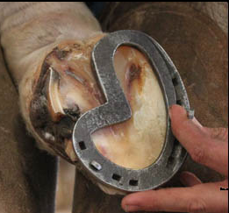
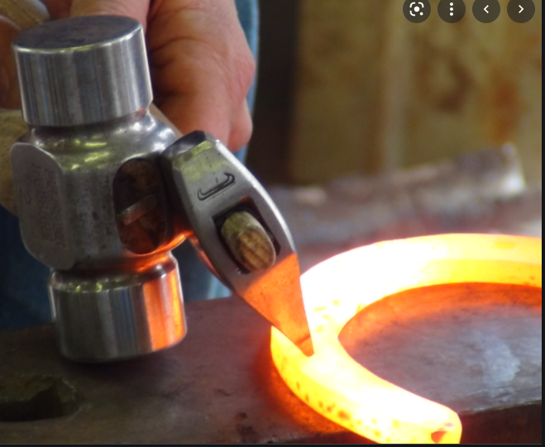
Dynamic time warping (DTW)
Notes:
Imagine a Ferrier trying to place a horseshoe on the hoof of the horse. The Ferrier has a horseshoe that he places on the hoof and then adjusts the shoe by applying heat on it. If a best match is found , the process ends, else the process continues where reheating is required and a match is obtained. Similar is the case of DTW.

Slide 15
Dynamic time warping (DTW)
Reference signal
Best warp path
Query signal
DTW illustration showing a reference and a query signal
Obtaining the best warp path or the DTW distance
Rabiner, 1978
Notes:
For a discreet one dimensional signal the DTW is applied as follows:
Just like the horseshoe example there are two signals required for DTW .
A template signal and a query signal. Template as the name suggests is the signal against which other signals are queried against. Just like the Ferrier heats the horseshoe and tries to get a match, we try to obtain the best match possible by stretching and squeezing the signal along a warp path and record the “effort” as a distance metric. The best optimal distance to obtain the match is the minimum of all distances. I exclude the mathematics on purpose but I have included a detailed appendix on the warping problem formulation and the solution in appendix in my dissertation.
Now let us see this in action and why it works best when combined with the segmentation.

Slide 16
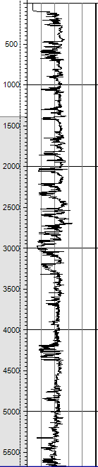
Dynamic time warping (DTW)
Segmentation dramatically reduces the search space
DTW finds the best match in the segments
Notes:
DTW alone is not very useful because it faces the same problem as the adaptive window. As the signal we are trying to cross correlate between the wells ( the GRP) is too small as compared to the whole well log. Hence, if segmented first, the DTW can be used to obtain the matches only in the segments and not the full well log and hence dramatically reducing the search space.
For example a typical well log with 1 sample per feet can have 10,000 samples in a well with 10,000 ft depth. We are looking for a signal 100 samples long in this well log. On the other hand, if the segment is only 500 samples long, it is much easier to find a 100 samples long sequence inside it.

Slide 17
DTW step 1 : Define pattern in the type (training) well
Type/training well
Test well
Segmentation of the type well and the template signal matched against itself
Best match when compared segment by segment to a test well
Notes:
The left image shows the segmented type well. The GR log which is already segmented and interpreted is shown in the left panel. We randomly select a GRP that we want to locate in the well. This is shown by the yellow arrow. The template signal is shown in the second panel in black. We stretch and squeeze this signal to every segment and obtain the distance metric as an attribute called DTW distance. We make the minimum of all these distances as one (TRUE) and rest all to zero (FALSE). It is not surprising the DTW distance is exactly zero when it is compared to itself providing a proof of concept that the algorithm is working correctly.
pop image 2. Now we take a random test well and apply the same analysis to the random test well. Notice that the algorithm correctly identifies the signal and highlights it. This time the DTW distance is not zero but finite. Thus the problem of cross-correlation is solved.

Slide 18
DTW step 2: Cross-correlate pattern on target (test) well
Type/training well
Test well
Notes:
The process is now repeated for a test well and the GRP is correctly identified. The problem of cross- correlation is thus solved.
The same process can be repeated for any one-dimensional signal.
We use this to delineate multiple GRPs over 106 wells in the area of study in Barnett shale.

Slide 19
Workflow
Notes:
Now we come to the last part of the work where we use the cross correlated attributes to build some cool images that geologists like.

Slide 20
Modeling : 3D property mapping
Notes:
We randomly select some GRPs in the lower Barnett, cross correlate them and use them to make 3D parasequnces model (GRP zone model). Shown in upper right corner.
Density porosity is then interpolated using Sequential Gaussian simulation (SGS) in one of the zones.
As the surfaces are automatically correlated it is not hard to make the zone model and hence the property model. If there are architectural elements available, similar analysis can be performed to bound the properties by facies model.

Slide 21
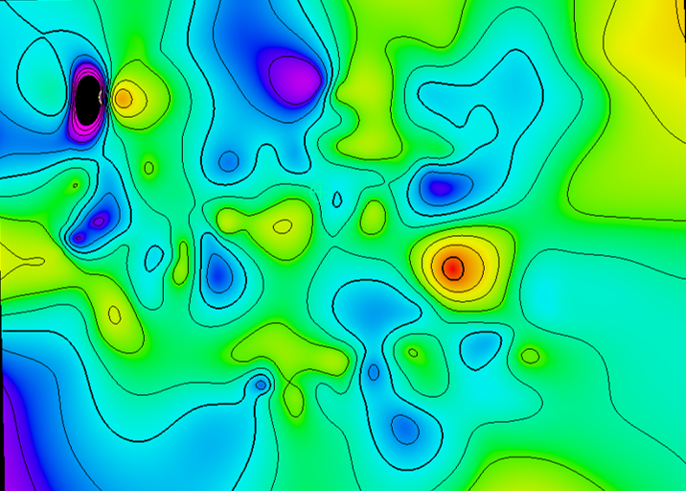
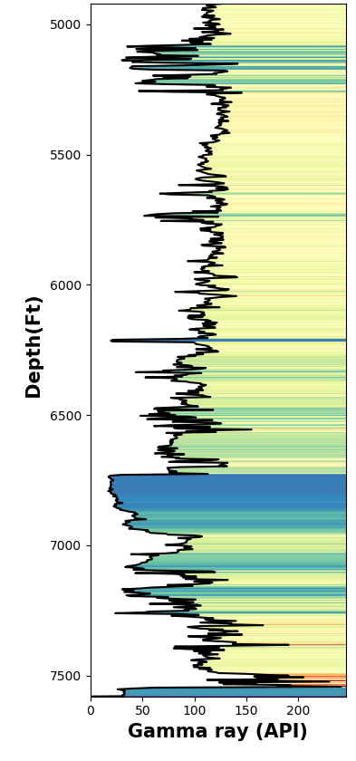
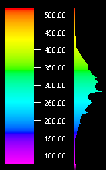
Modeling : 2D parasequence thickness maps
Thickness (ft)
100
0
Thickness(Ft.)
25,000 ft
Notes:
Similarly I show two parasequnces thickness maps by just subtracting the bottom- top.

Slide 22
The well log attributes

Slide 23
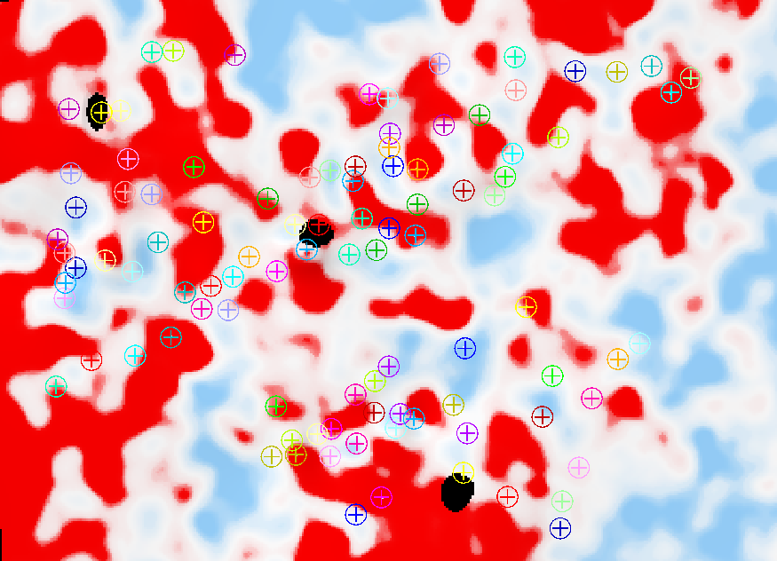

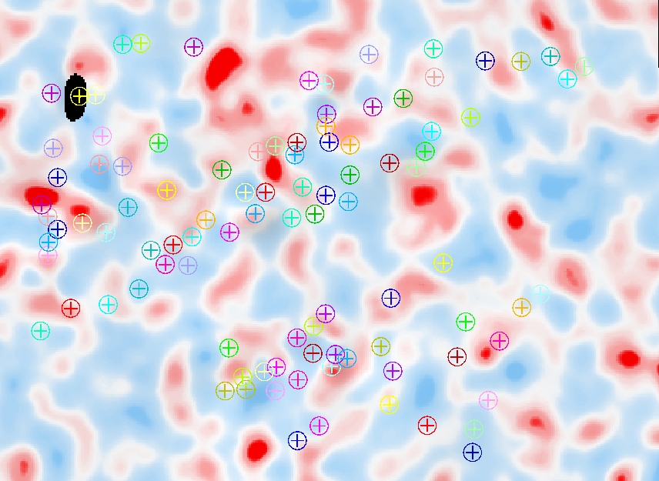
Modeling : 2D, parasequnces slope maps
Type log
Slope maps
Slope (API/ft.)
1.0
-1.0
25,000 ft
Notes:
The parasequence slope maps.
You can also attribute a high-frequency or rapid change in the character of GR signature (slope change) to the reservoirs' high vertical heterogeneity, which can be favorable or not in reservoir development.
The positive or negative slope values can indicate an aggradational, transgressive, or regressive sequence that may show relative changes in the sea level.
The value of slope (more positive or more negative) might be indicative of proximal or distal positions of the wells depending on slope values within the same stratigraphic interval. The value of slope will be a function of 1) thickness 2) GR values. Since distal wells contain higher amounts of clay mineral (thorium and Uranium dominant), the slope values should become more positive or negative depending on the clays present within the interval.
In calcareous shales and fine-grained limestone rocks, rapid changes in slope might be correlated to high cyclicity within the evaluated interval. These high cyclicity events are related in carbonates to ice-house deposits when cold weather dominated at the time of deposition and produced subaerial exposure of carbonate deposits. In contrast, carbonate deposits related to green-house stages display low cyclicity (low-frequency).

Slide 24
Segmentation and correlation : North slope Alaska
Notes:
Similar example from North slope Alaska, Notice the picks from a human interpreter and machine interpreted GRPs. Type well.

Slide 25
Segmentation and correlation : North slope Alaska
Notes:
Type and test well, correlation

Slide 26
Conclusions
Automation of geoscience workflows is now a necessity and not a luxury
Segmenting before correlating helps in improving the correlation

Slide 27
Thank you!

