Slide 1
AASPI Consortium meeting
January 12 & 13, 2022

Slide 2
Agenda
Hour 1:
8:00 Welcome and Introductions, 2021 summary, 2022 looking forward (Dr. Heather Bedle)
8:30 Seismic phase components from time-frequency analysis (Dr. Marcilio Matos)
Hour 2: AASPI Demos – new enhancements and other highlights
9:00 Vector plot functionality (Dr. Thang Ha, OU post-doc)
9:15 Overview of new enhancements and capabilities (David Lubo-Robles, OU PhD)
9:40 Common pitfalls in seismic interpretation (Kurt Marfurt)
Hour 3: Breakout Rooms
Hour 4: Student talks and Q&A
11:00 – David Lubo-Robles (OU PhD) - Quantifying the sensitivity of seismic facies classification to seismic attribute selection: An explainable machine learning study using SHAP values
11:15 - Emily Jackson (OU PhD) - Recent Gas Hydrate Studies at OU: An Overview and Proposed Future Work
11:25 - Bobby Buist: (OU PhD) – Using AASPI’s CNN Image Classifier with microCT scanned microfossils
11:35 - Dr. Saurabh Sinha (OU graduate)– Semi - supervised well log correlation
11:45 – Q&A

Slide 3
Agenda --Hour 3: Breakout Rooms (most of these talks will be available on our website)
Room 1 – Dr. Sumit Verma hosting
10:00 Talk 1: Multi-seismic attributes and petrophysical studies for a low-temperature geothermal field in the Netherlands (Dr. Shuvajit Bhattacharya and Dr. Sumit Verma)
10:30 Talk 2: A CO2-EOR study: Seismic attribute assisted illumination of early Paleozoic tectonics (Jozef Szypulski, UTPB MS) LIVE – not recorded
Room 2 – Dr. Bo Zhang hosting
10:00 Talk 1: A comprehensive comparison of generating seismic fault attribute using deep learning (Dr. Bo Zhang)
10:30 Talk 2: Shale resources fracability prediction (Dr. Bo Zhang)
Room 3 – Karelia LaMarca hosting
10:00 Talk 1: Sensitivity analysis of seismic attributes parametrization// Quantitative assessment of unsupervised machine learning techniques (Karelia la Marca, OU PhD)
10:30 Talk 2: Unsupervised ML applied to seismic characterization and deepwater elements characterization in Ceará Basin, Brazil (Dr. Karen Leopoldino Oliveria, Federal University of Ceará, Brasil)
Room 4: - Bobby Buist hosting
10:00 --Talk 1: Study on the parameterization response of the probabilistic neural networks for seismic facies classification (Diana Salazar Florez, OU MS)
10:30 – Talk 2: Generative adversarial network for facies and reservoir classification (Alex Vera-Arroyo, OU PhD)

Slide 4
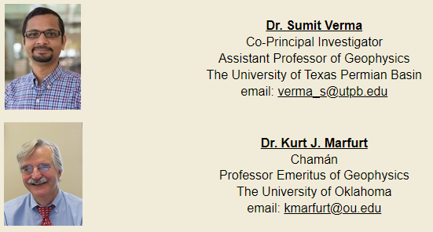
AASPI PIs

Slide 5
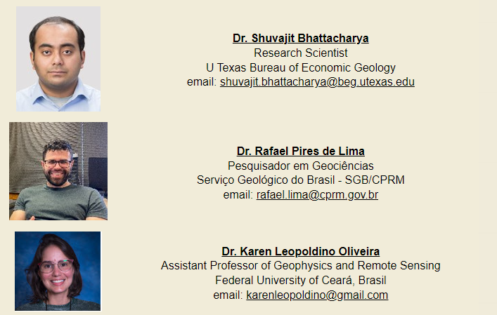
AASPI Affiliated Researchers

Slide 6
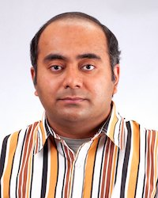
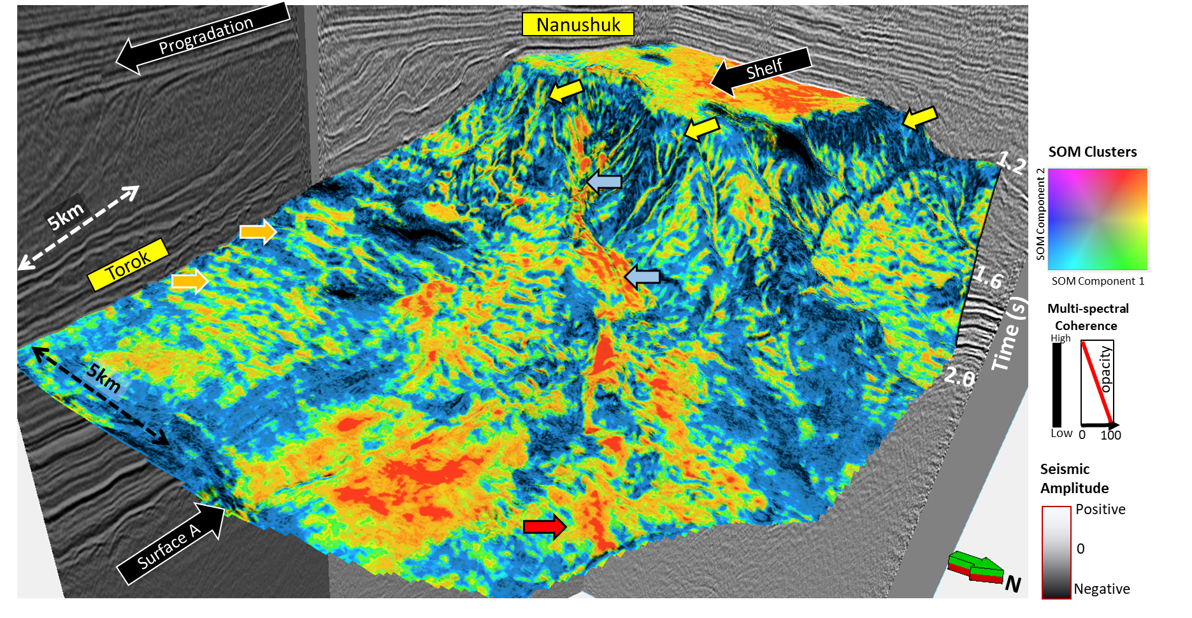
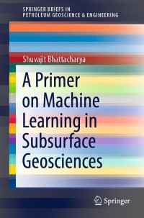
Shuvajit Bhattacharya- Bureau of Economic Geology UT Austin
Unsupervised learning for seismic facies classification
Book for newbies in machine learning and statistics
Seismic and petrophysics in carbon sequestration and geothermal energy
Bhattacharya, S., Verma, S., and Rotzien, J., 2020 and 2021

Slide 7
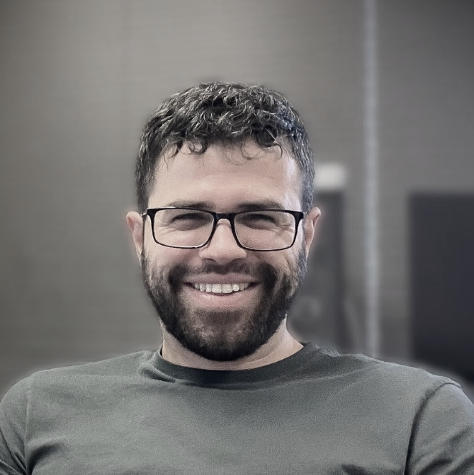
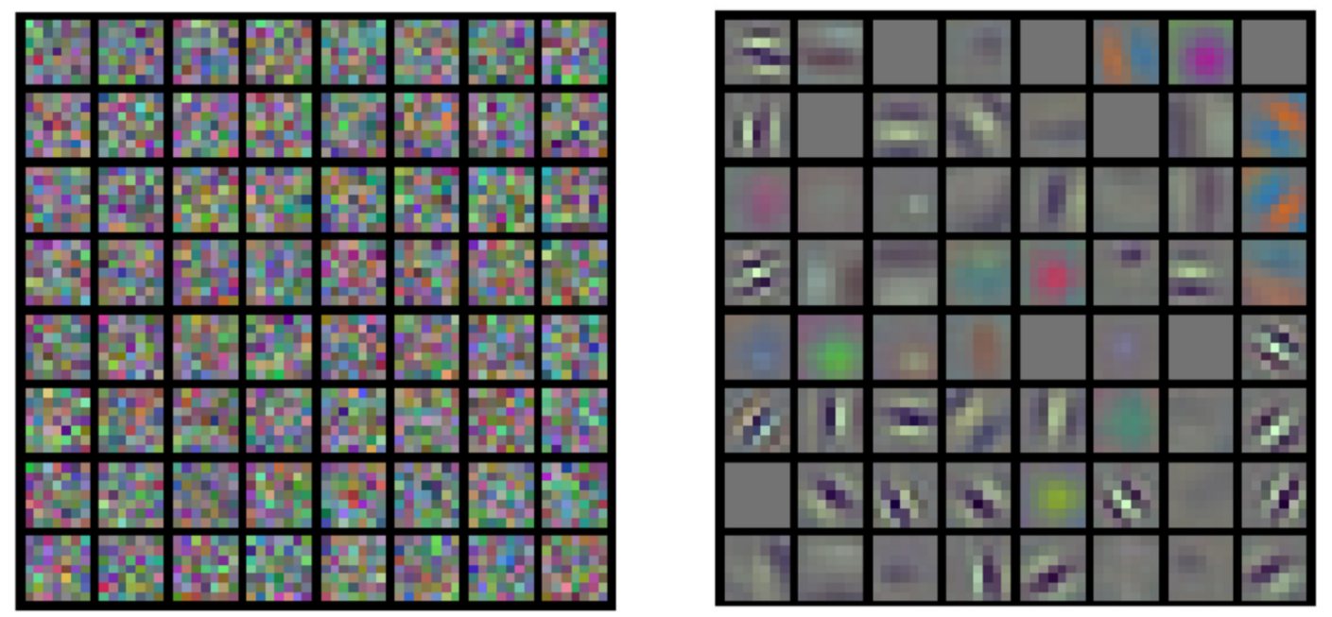
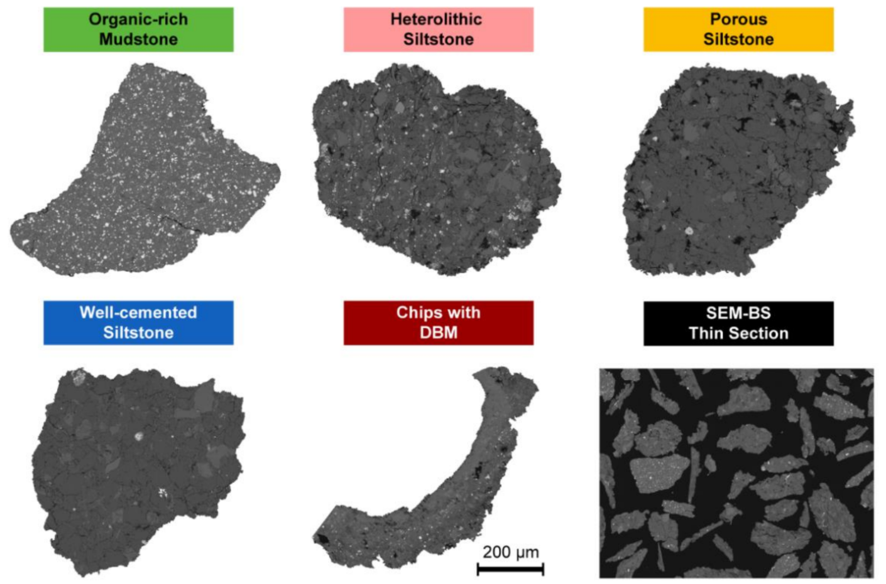
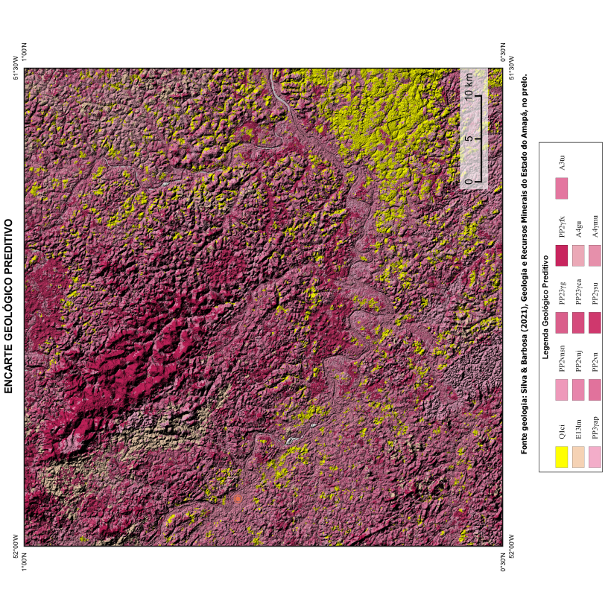
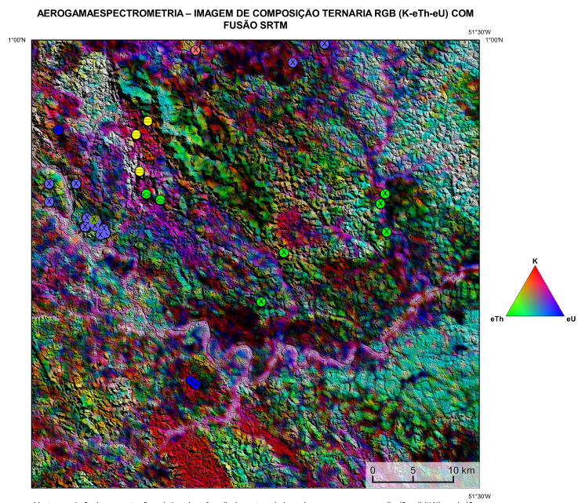
Rafael Pires de Lima - Geological Survey of Brazil
Transfer learning analysis for classification of thin section images
ImageNet is a good start
Image processing as aid in SEM drill cuttings interpretation
Geological predictive mapping with airborne and spaceborne remote sensing data
Becerra et. al (2021)
Pinto et. al (2021)
Notes:
Becerra, D., C. R. Clarkson, A. Ghanizadeh, R. Pires de Lima, F. Tabasinejad, Z. Zhang, A. Trivedi, and R. Shor, 2021, Evaluation of Reservoir Quality and Forecasted Production Variability along a Multi-Fractured Horizontal Well. Part 1: Reservoir Characterization: Energies, 14. https://doi.org/10.3390/en14196154
Pinto et. al, 2021, https://rigeo.cprm.gov.br/handle/doc/22542

Slide 8
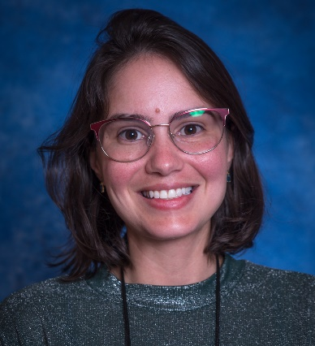
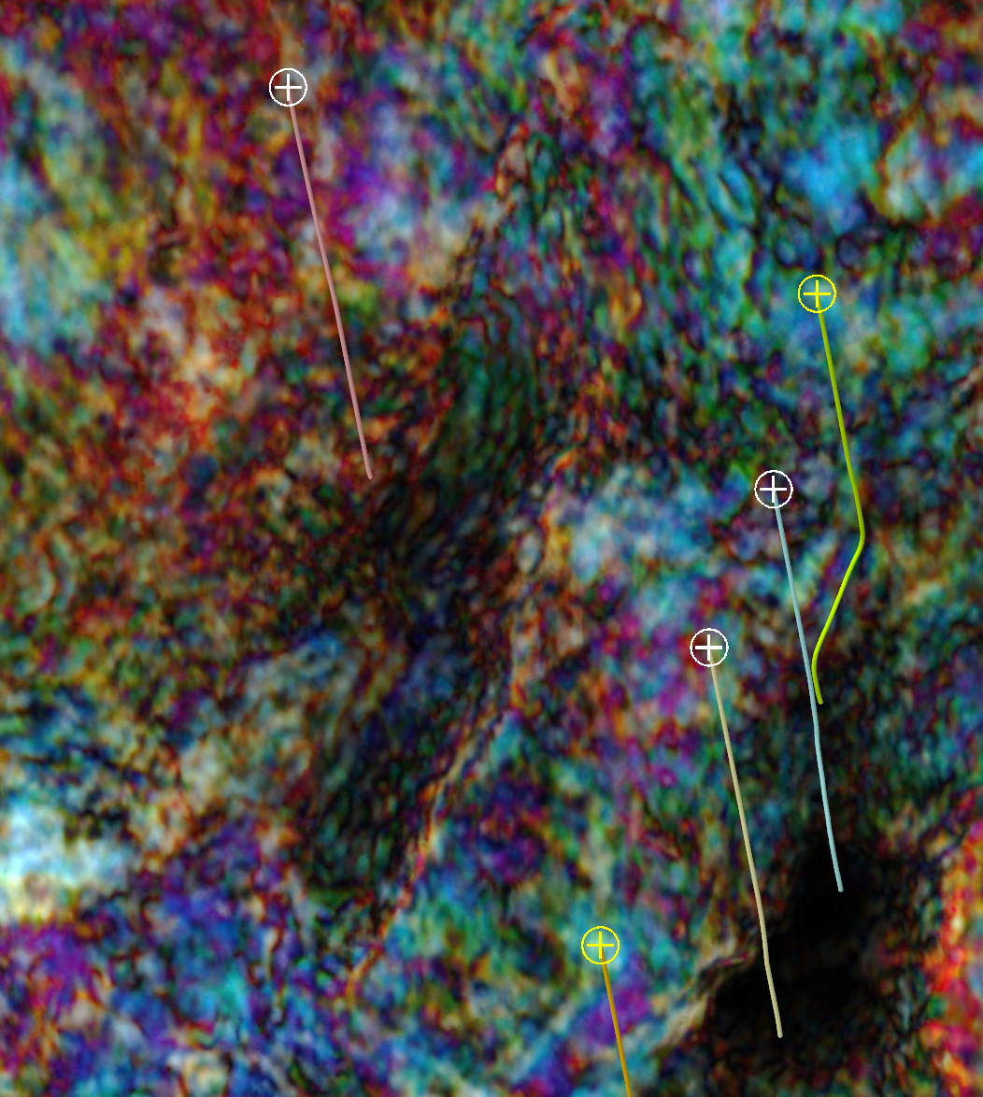
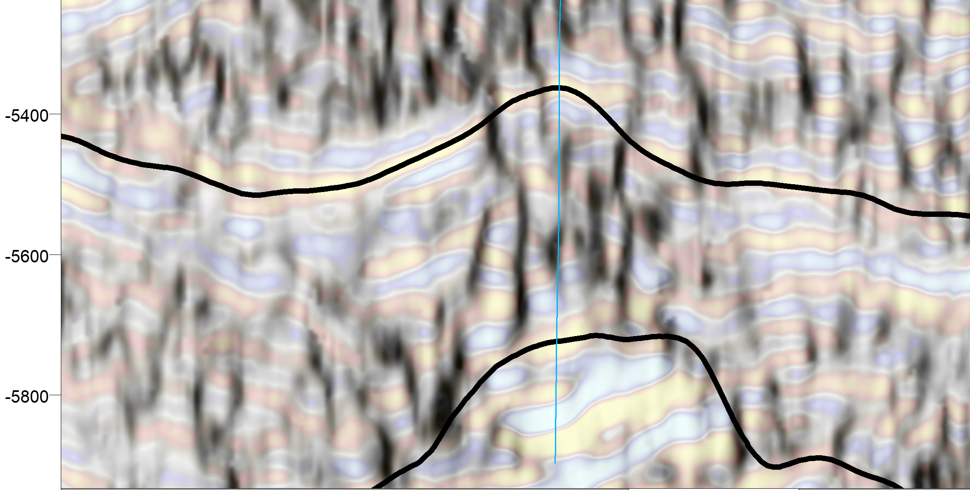
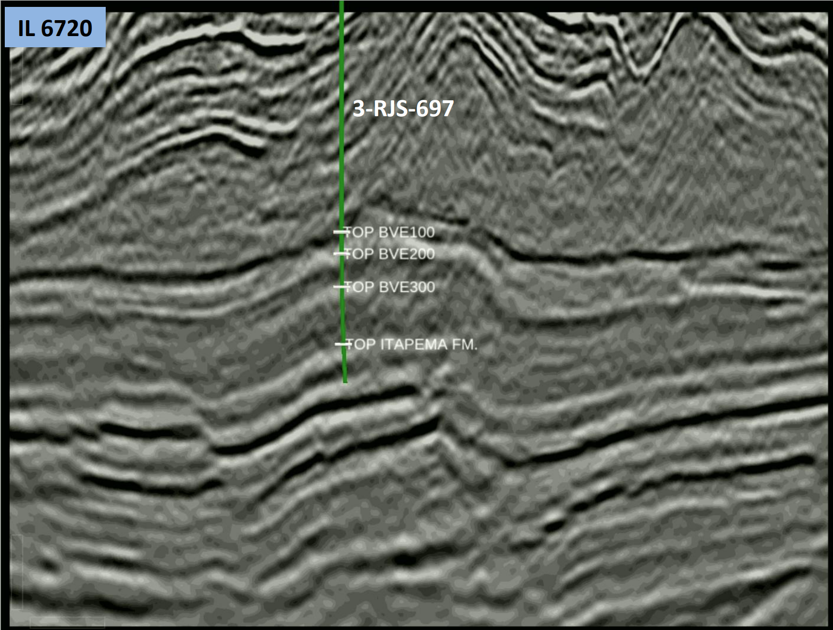
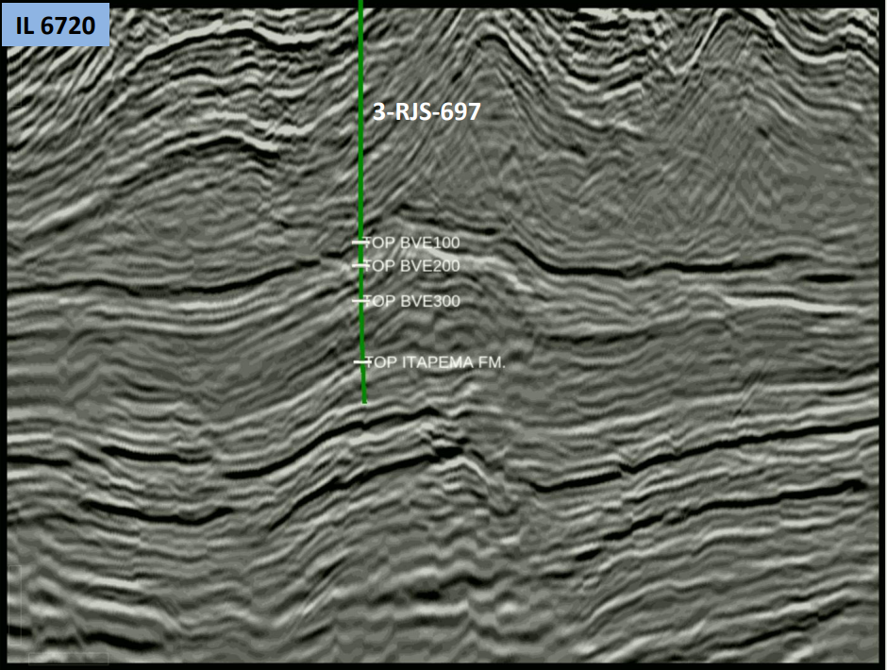
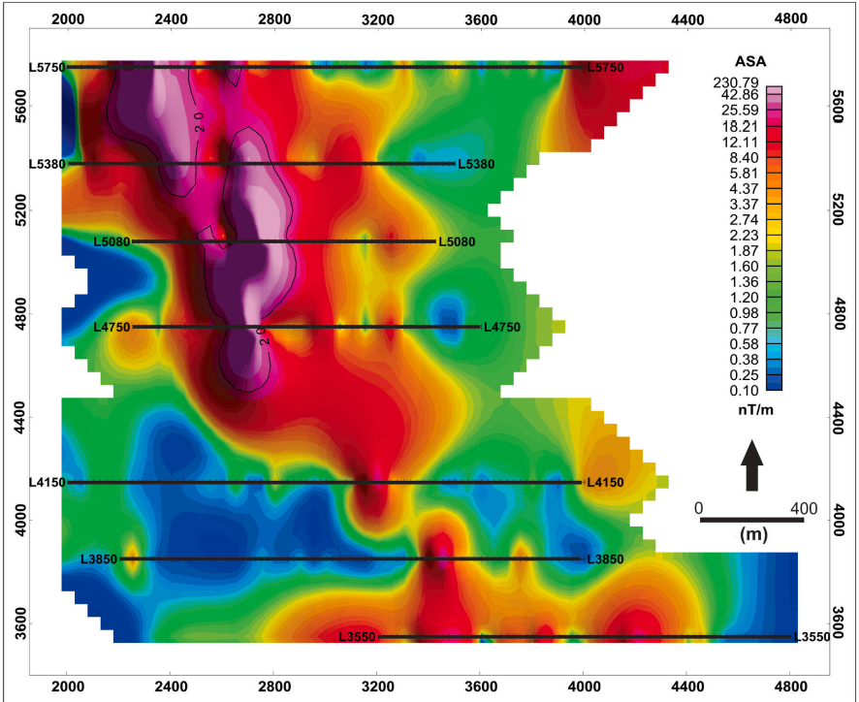
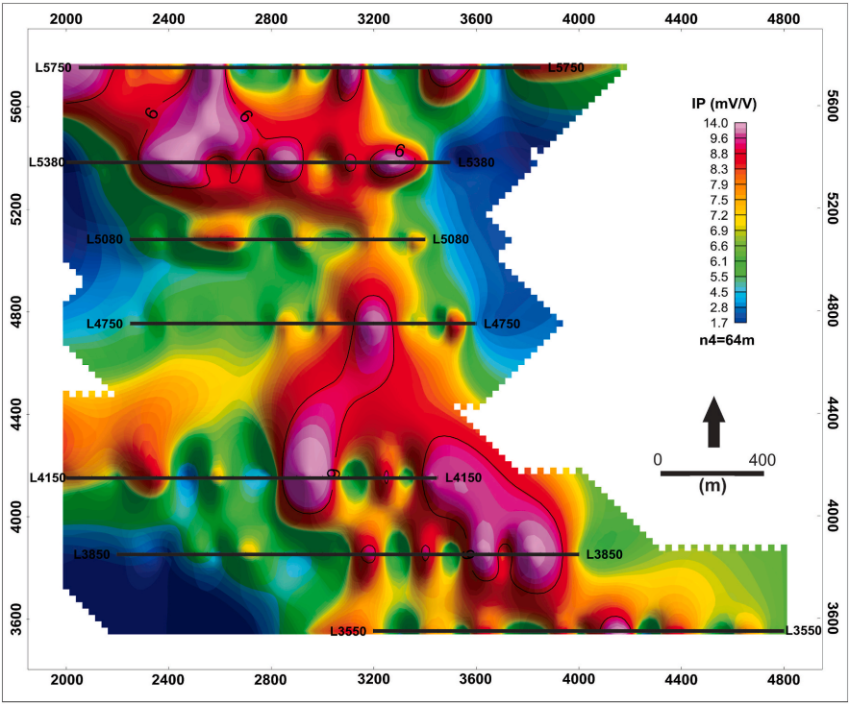
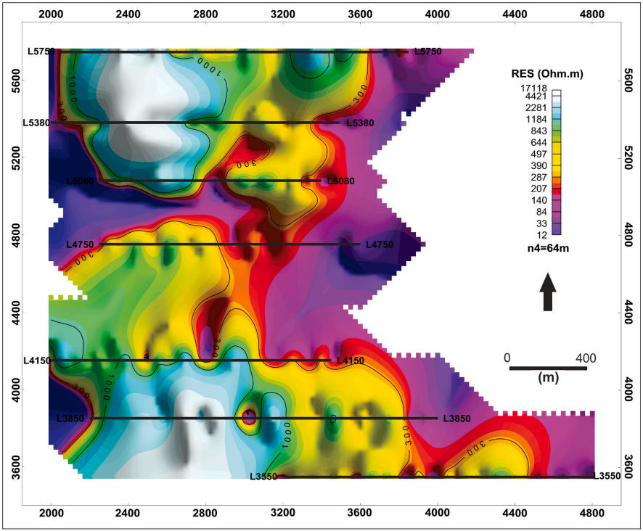
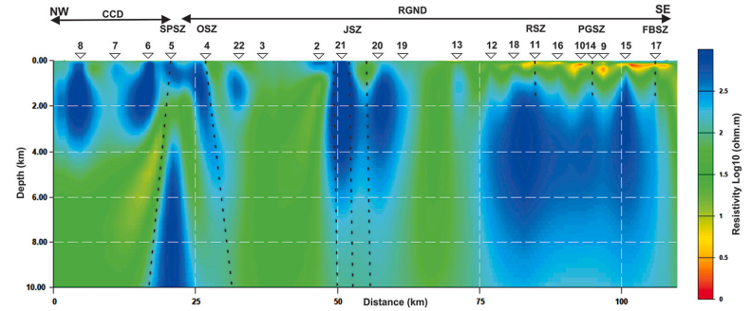
Karen Leopoldino Oliveira- Federal University of Ceará, Brazil
ML algorithms to improve the geological modelling of a Brazilian pre-salt oil field
Multiattribute analysis and ML techniques for interpretation and characterization of turbidite plays in the Brazilian Equatorial Margin
The Ceará Basin: a start point of view
Geological mapping with applied geophysics (magnetotellurics, magnetic, resistivity, and IP methods.
Castelo Branco et. al (2021)
Da Silva et. al (2021)
Notes:
Castelo Branco et al. (2021): https://doi.org/10.1016/j.jsames.2021.103525
Da Silva et al. (2021): https://doi.org/10.1016/j.jsames.2021.103624

Slide 9
Post-docs and visiting scholars

Slide 10
Our student researchers!
University of Oklahoma
PhDs:
David Lubo-Robles
Bobby Buist
Karelia La Marca Molina
Alex Vera-Arroyo
Emily Jackson
Marcus V. R. Maas
MS:
Ahmet Murat Alyaz
Ryan Forrest
Laura Lucia Ortiz Sanguino
Mario Ballinas
Diana Salazar Florez
BS:
Zach Williams
Joe Morrell
University of Texas – Permian Basin
MS:
Tania Babu
Sayan Ray
University of Alabama
PhD:
Yitao Pu

Slide 11
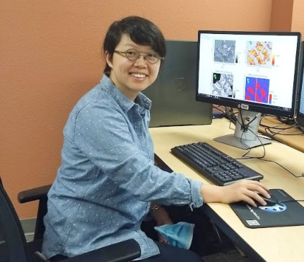
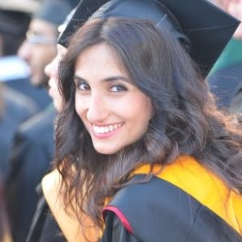
Completed
On Going
Sayan Ray
MS Geology [Spring 2022]
Thesis: Gravity data collection and analysis over Wink Sink, Winkler County, Texas
Jozef Szypulski
Element Petroleum III, LLC
MS Geology [Fall 2021]
Tania Babu
MS Geology [Spring 2022]
Thesis: Geophysical technologies applications to geothermal exploration in southwest Netherlands
Robert Hissong
SM Energy
MS Geology [Spring 2020]
Dr. Miao Tian
ML Researcher
Completed one project. In China now. May join again in July.
Esra Yalcin (Research Scholar)
PhD Geophysics@OU [Spring 2025]
Project: Channel characterization in the Upper San Andres Formation of the Midland Basin, Texas

Slide 12
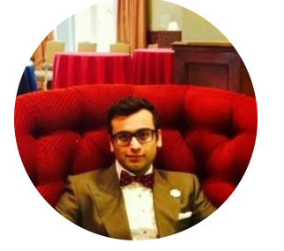
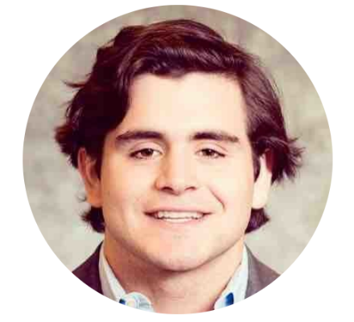
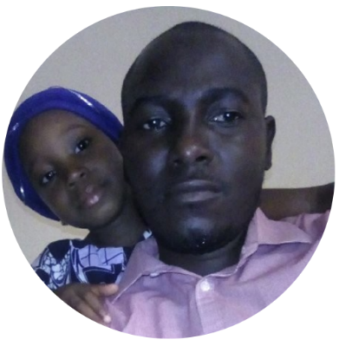
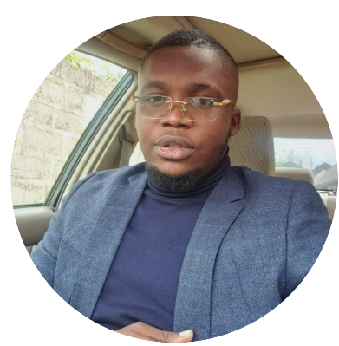
To Start
Saurabh Sinha
PostDoc
Starting February 2022
Project: Machine Learning
Alonso Alzua
MS Geology [Spring 2023]
Thesis: ~Seismic Attributes for Geothermal Energy
Aliyu Mohammed Kaura
Visiting Research Scholar
Starting January 2022
Project: Reservoir Characterization
Gongola Basin, Nigeria
Obinna Anyiam
MS Geology [Spring 2023]
Thesis: ~Reservoir Characterization Midland Basin

Slide 13
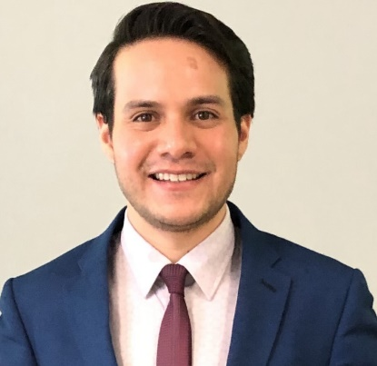
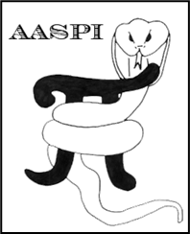
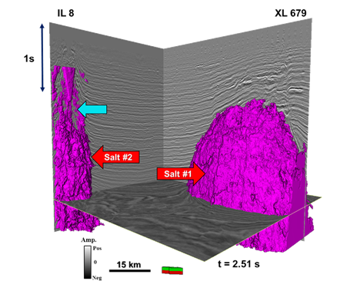
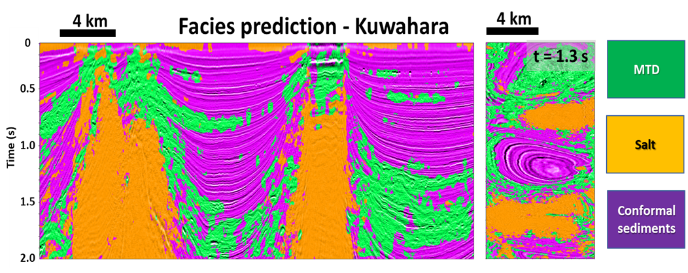
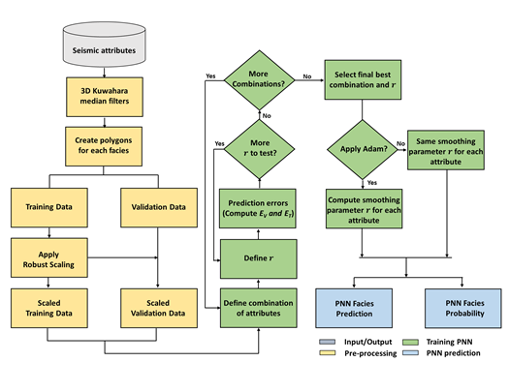
David Lubo-Robles
Ph.D. Candidate in Geophysics
Selected Publications:
Lubo-Robles, D., T. Ha, S. Lakshmivarahan, K. J. Marfurt, and M. Pranter, 2021, Exhaustive probabilistic neural network for attribute selection and supervised seismic facies classification: Interpretation, 9, no.2, T421-T441.
Lubo-Robles, D., D. Devegowda, V. Jayaram, H. Bedle, K. J. Marfurt, and M. J. Pranter, 2021, Quantifying the sensitivity of seismic facies classification to seismic attribute selection: An explainable machine learning study: Interpretation, in press.
Skills:
Machine Learning and Deep Learning
Seismic interpretation
Seismic geomorphology
Seismic attributes
Quantitative seismic interpretation
Python
Fortran 90
C++
Matlab
AASPI
Petrel
Hampson-Russell
(Lubo-Robles et al., 2021)
(Lubo-Robles et al., in press)

Slide 14
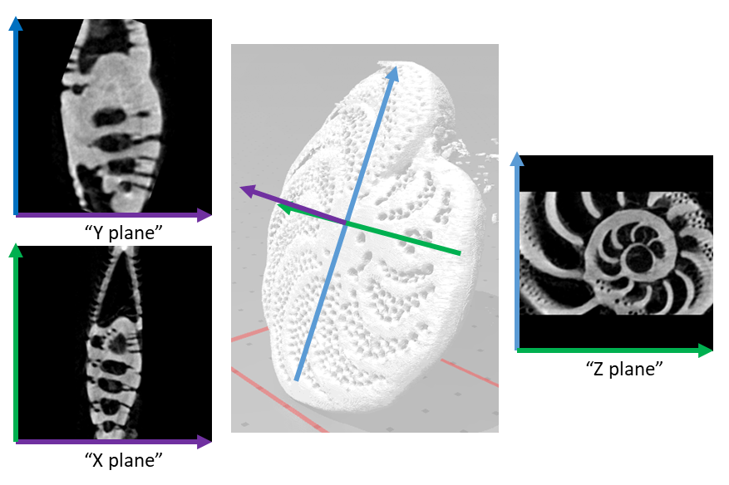
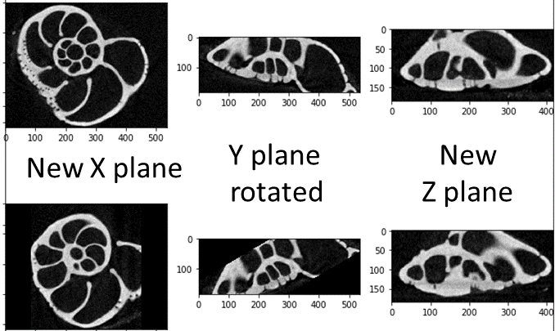
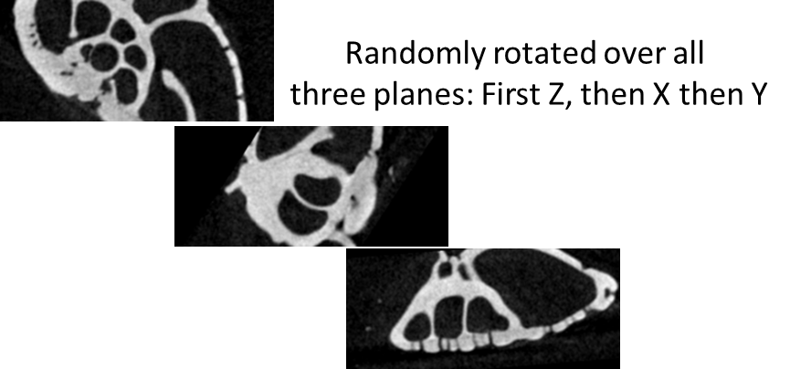
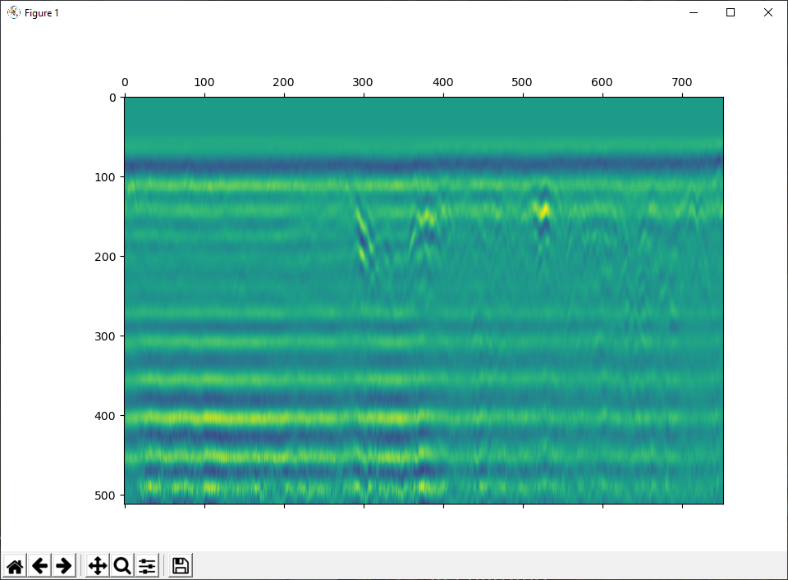
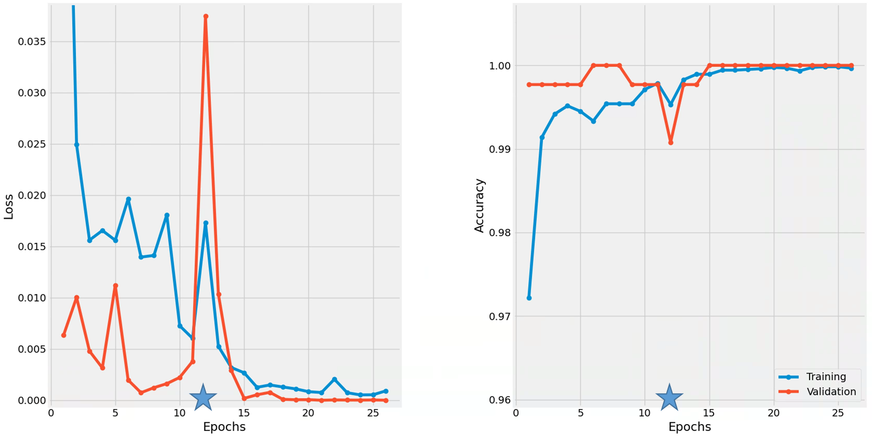
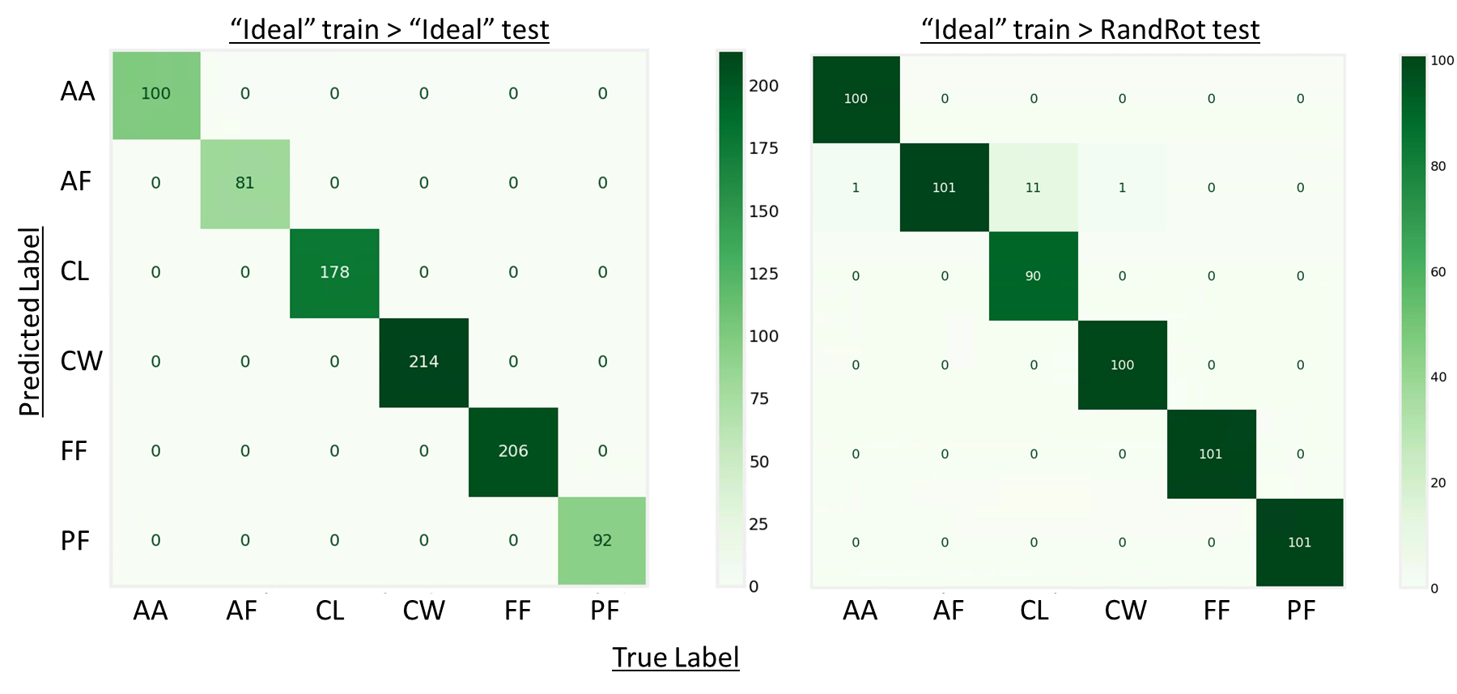
Bobby Buist – Geophysics PhD student
AASPI research!
Using microCT scanned micro fossils to create more robust training datasets for CNN models to ID fossils in thin section
“Ideal” images “Realistic” images
Applying seismic attributes (AASPI!) to GPR data
100% accuracy when tested with “Ideal”
98% accuracy when tested with “Realistic”
CNN model trained on “Ideal” images
Unprocessed GPR in AASPI

Slide 15
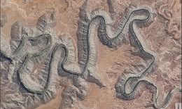
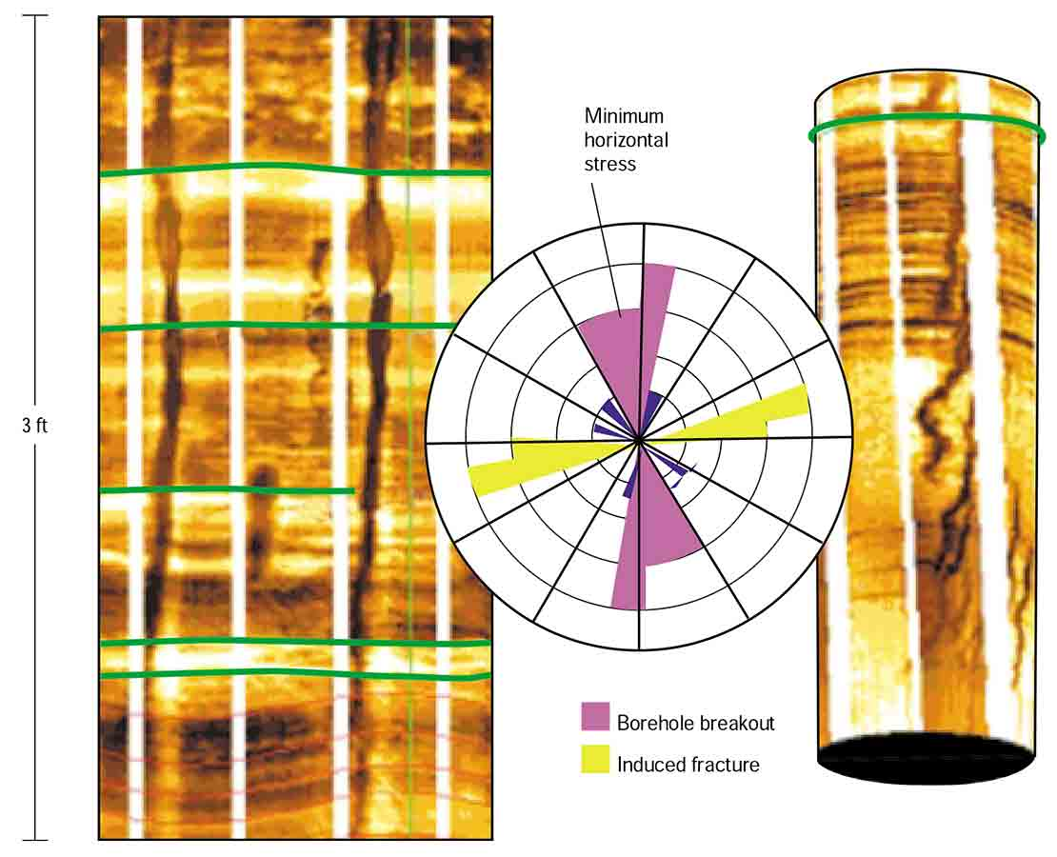
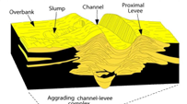
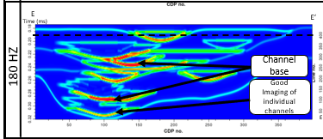
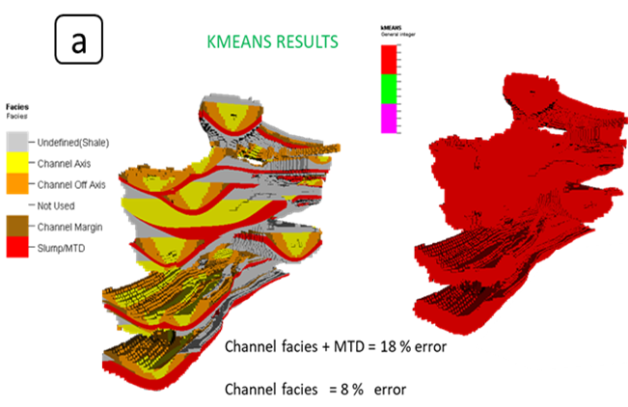
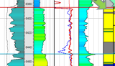
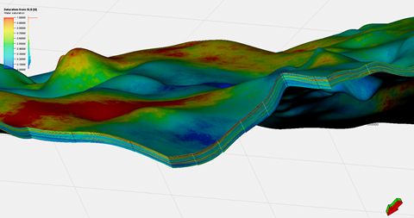
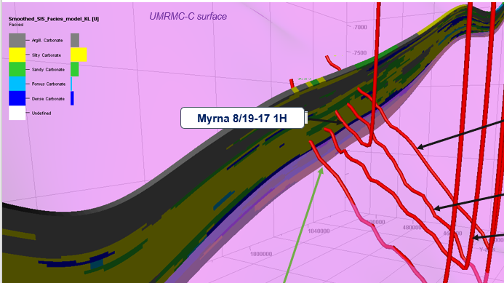
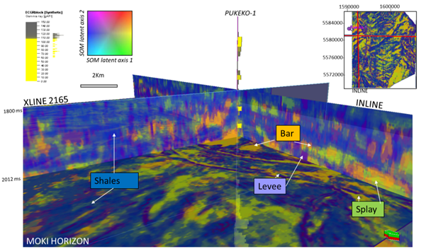
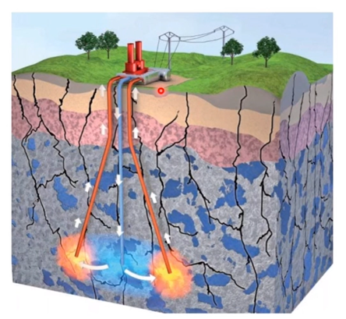
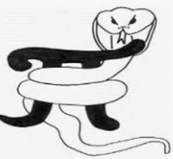
Karelia La Marca – PhD student in Geophysics -Graduate research assistant at AASPI and SDA
Ms. C in Geophysics at The University of Oklahoma
B.Sc.. Geology Universidad de los Andes- Venezuela
Work experience:
Volunteering:
PROJECTS/ RESEARCH with AASPI
Seismic attributes + ML (SOM & PCA) for Deepwater seismic facies: users vs machines
PAST
Skills
Seismic interpretation
Geomorphology
Core & Image logs
Deepwater
CURRENT
Attribute sensitivity analysis
Quantitative assessment of unsupervised Machine learning for seismic facies
Reservoir modeling & mapping
Well log analysis
Well placement
&LWD
Machine learning applications
FUTURE
Geothermal reservoir characterization: seismic attributes, ML, inversion, modeling.
Relevant publications
Deepwater seismic facies and architectural element interpretation aided with unsupervised machine learning techniques: Taranaki basin, New Zealand. 2021. K La Marca, H Bedle. Marine and Petroleum Geology, 105427
Sensitivity analysis of seismic attributes parametrization for interpretation of a multi-story deepwater channel system: Tres Pasos Formation, Magallanes Basin Chile. 2021. K La Marca, K Marfurt, H Bedle, L Stright, T Langenkamp. First International Meeting for Applied Geoscience & Energy, 1191-1195
Google scholar: Karelia La Marca
@Karelialm1
Notes:
Seismic interpretation
Geomorphology
Cores and Image logs (FMI, OBMI..) sedimentology and stratigraphy of clastics
Deepwater deposits
Well log analysis
3D reservoir modeling
Machine learning (mostly unsupervised)
Python applications

Slide 16
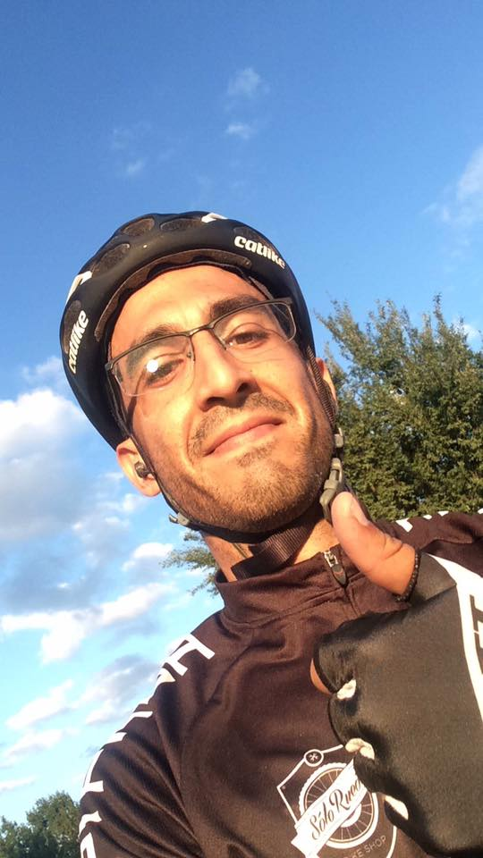
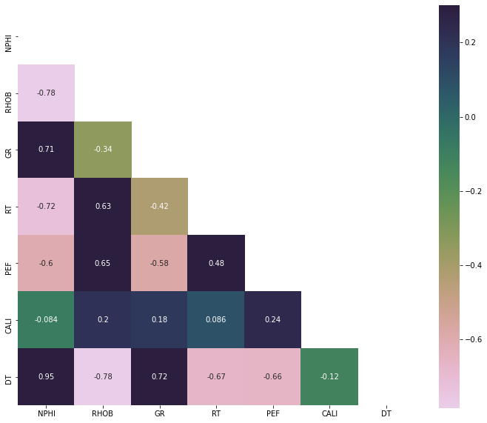
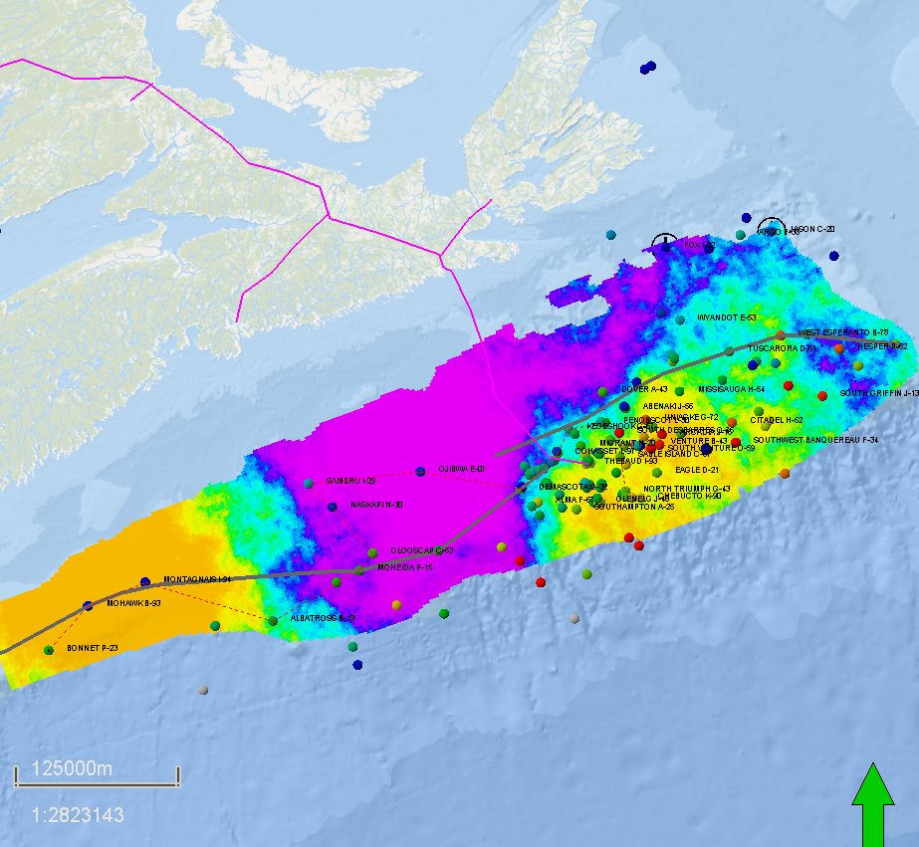
Alexandro Vera-Arroyo Ph.D. Student
Selected publications
Current work & Future plans
Vera-Arroyo, A. Bedle, H. 2022. Reservoir characterization using GANS and stochastic inversion of Ray reef (in review)
Vera-Arroyo, A. Bedle, H. 2021. Listric fault interpretation using a mixed model of CNN and human interpretation. (IMAGE 2021)
CO2 sequestration assessment of Scotian Shelf.
Unsupervised learning vs seismic inversion for reservoir characterization. 3D Real data and 3D synthetic examples.
Preconditioned CNN applied to salt tectonics and listric faults in the GoM.
Automatic fault characterization using ML techniques with a geomechanical application.
Reservoir properties prediction using borehole data – from Volve Equinor dataset

Slide 17
Emily Jackson, PhD Student in Geophysics
Rock and plant enthusiast, proud West Virginian/Marylander/Kentuckian
My Research Areas (so far!):
Identifying gas hydrates in seismic data in the absence of BSRs or other DHIs
Use kurtosis and skewness to measure attenuation of the seismic signal as a result of hydrocarbon presence
Past Research:
Depositional environments and regional correlation of Marcellus Shale in PA, WV, and OH
Skills:
Petrophysics/well log analysis
Geomechanics
Sedimentary structures/features
Seismic attributes
Geologic field work
Python and R, some basic machine learning techniques
Petrel, Petra
Illustrator
"If we knew what it was we were doing, it would not be called research, would it?" -Einstein

Slide 18
THE BEST
PhD Thesis provisory title: Machine Learning techniques applied to carbonate reservoir productivity prediction using seismic multi attributes and dynamic data from wells at Mero Field (Brazilian pre-salt, Santos Basin)
Marcus V. R. Maas (Petrobras)
Ph.D. Candidate in Geophysics (Dr. Bedle´s student)
BSc. In Geology (Universidade de Brasília, 2000)
MSc. In Economic Geology and Prospection (Universidade de Brasília, 2003)
Excellent wells (P.I > 300 , 40,000 bpd production, excellent permoporosity – Darcy scale)
A, C and X5
Well A
Well A
Well C
500 m
Well C
Anhydrite
Intrusion
Well X5
Well X5
7.5 km
Best reservoirs = Within or nearby Purple and Dark Blue facies
AASPI´s som3d output versus reservoir parameters
Inputs for som3d: Envelope, Sobel similarity, K1 and K2

Slide 19
Ahmet Murat Alyaz - M.Sc. Student in Geophysics – Dr. Heather Bedle
``INTERPRETATIONAL VARIATIONS OF SEISMIC ATTRIBUTE ANALYSIS AS COMPARED WITHIN THE TIME AND DEPTH DOMAINS``
Works in Thesis:
Background
BSc. Geophysics - Cumhuriyet Üniversitesi, Sivas, Turkey, 2014
Experience
Gas-Hydrate Project – Turkish Petroleum (2016-2018)
EMODNet – Geology 2&3 (European Union Project) in Dokuz Eylül Üniversitesi (2016-2018)
Geothermal Exploration – Electric and Electromagnetic Methods (2015-2016)
Automation Engineer (in HVAC industry) (2014-2015)
Laboratory Manager – Measurement and Control Sytems (2013-2014)
Laboratory Technician - Measurement and Control Sytems (2007-2010)

Slide 20
Ryan Forrest – M.S. Student in Geology
Background
B.S. Geology – University of Oklahoma '18
M.S. Engineering & Technology Management – Colorado School of Mines '21
Research Interests
Geothermal Reservoir Characterization
Petroleum Reservoir Characterization
Sequence Stratigraphy
Carbonate Geology
Machine Learning
Venture Development

Slide 21
Laura Ortiz-Sanguino M.Sc. Student in Geophysics 2nd year
Degrees and research experience:
Bachelors in geology | Universidad Industrial de Santander-Colombia | 2020
Undergraduate research Internship | AASPI | 2019
Research intern | Geophysical Insights | 2021
SOM for geomorphology
Past projects using AASPI:
Attribute analysis & unsupervised ML in North Carnarvon Basin example.
Fault definition using CNN fault probability, SOM and geobody generation | Collaboration with Geophysical Insights
Fault extraction
Current projects using AASPI:
Facies variability and architectural elements analysis: Case of study of the Midland and Central Basin Platform basins | Collaboration with Dr. Verma
Spectral decomp. Permian Basin

Slide 22
Mario Ballinas
Identification of Low Saturation Gas Using Unsupervised Machine Learning
Crossline 4935 with Amp 2 in red and Amp 3 in green and the Caravel-1 Well.
Near Stack -Amplitude Extraction Map of “Amp 2”
Currently using AASPI’s Self Organizing Maps and Random Forest algorithms with attributes extracted from 4 angle stacks
Area of Study in Canterbury Basin
Caravel-1 was a dry hole drilled due to being a bright spot with Structural conformance
Mission: Create a workflow that can successfully derisk Caravel-1 and other future prospects

Slide 23
Diana K. Salazar-Florez
Bachelor degree in Geology from the Universidad Industrial de Santander (Cum Laude, 2021).
Graduate student at University of Oklahoma (2022-2023).
Experience
Geology Intern at Repsol Colombia (2019).
Research Intern at the University of Oklahoma (2020).
Research projects
Application of seismic attributes for geomorphological characterization of fluvial reservoirs in the Llanos Basin, Colombia.
Seismic facies classification in the Gulf of Mexico applying Probabilistic Neural Networks (PNN).
Future projects
Faults and fractures prediction with machine learning.

Slide 24
UG Zach Williams – Petroleum Geology Senior
Also completed a BS in Geographic Information Science (GIS) at OU
Projects:
The Utilization of Machine Learning in The Characterization of Clinoforms
A Comparative Analysis of Listric Fault Picking
Senior Thesis over the utilization of AASPI software and attributes on UAV and LIDAR Data

Slide 25
2021: 9 Thesis and Dissertations

Slide 26
AASPI 2021 Annual Review Meeting
Overview of AASPI consortium organization, deliverables, tutorials, and work plans

Slide 27
AASPI Consortium Products
Software source code and executables
Software documentation
Published papers (Algorithms, applications and workflows)
Recorded oral presentations (English and Spanish!)
Software demos

Slide 28
Software Source Code and Executables
*Newest version will be released Jan 31st - please sign your AASPI commitment contracts ☺

Slide 29
2021 new AASPI capabilities

Slide 30
2021 new AASPI capabilities

Slide 31
2021 Enhanced AASPI capabilities

Slide 32
2021 Enhanced AASPI capabilities

Slide 33
2021 Enhanced AASPI capabilities

Slide 34
2021 Enhanced AASPI capabilities

Slide 35
Software Documentation

Slide 36
27 Published Papers

Slide 37
Oral Presentations

Slide 38
Software Demos

Slide 39
2022 R&D Plans
Task | Researcher
Build on November 2020 special issues of INTERPRETATION journal that provides a library of Funny Looking Things seen on seismic data | Heather Bedle, Sumit Verma, Shuvajit Bhattacharya
Record poststack data conditioning tutorial | Kurt Marfurt
Record aberrancy tutorial | Sumit Verma, Shuvajit Bhattacharya
Construct improved CNN data base for listric and other faults that provide poor coherence images | Alex Vera
Evaluate AASPI PNN for well log classification | David Lubo
Sensitivity analysis of attribute parametrization and multispectral amplitude gradients response to lateral changes in thin beds (channels, levees, fans, …) | Karelia La Marca
ML workflow evaluation for basement faults, fault zones | Diana Salazar
AASPI application to GPR data | Bobby Buist
AASPI application to LIDAR data | Zach Williams
Geothermal multiattribute and machine learning | Ryan Forrest, Karelia La Marca
Multiattribute analysis for mixed carbonate-siliciclastic environments: Permian Basin example | Laura Ortiz
Seismic attribute analysis for Geothermal Exploration | S Verma, S Bhattacharya, T Babu, V Pandey and C Mejia
A CO2-EOR study: Seismic attribute assisted illumination of early Paleozoic tectonics | Jozef Szypulski
A reveiw of amplitude based seismic attributes | Sumit Verma, and Thang Ha
Fault sealing capacity and fault slip potential for CO2 sequestration utilizing seismic attributes | Shuvajit Bhattahcarya and Sumit Verma
Multiattribute analysis and ML workflow for facies classification of Aptian carbonates, Santos Basin, Brazilian Pre-salt | Karen Leopoldino

Slide 40
Need to increase the consortium fee…
AASPI has maintained a flat $28k fee since 2008
If we had kept up with inflation, the cost would be at $36k in 2021
OU changed their tuition cost-sharing in 2018
Previous to FY18 - $4480/year
FY18, FY19 - $893 $10716/year
FY20 - $973 $11676
FY21, FY22 - $1051 $12612
FY23, FY24 - $1076 $12912
AASPI has also not raised the monthly stipend given to graduate students since 2008
I would like to adjust their salary to be CPI and cost-of-living adjusted. (This would have been an increase of $8000/researcher/year)
$8500/yr
increase!!!
Between tuition and stipend – we are looking at a $16,500 cost increase per student that is unrealized since 2008

Slide 41
How are other energy consortium fees handled?
UT BEG consortiums ~$50k/ yr 2-yr contracts
Univ Houston EAS $72k/ yr 3-yr
Previous OU (2020) $80k/ yr 1-yr
UT-Dallas (2009) $35/ yr 1-yr
CWP @CSM (previous) $45/ yr ?
When AASPI was formed it was the second least expensive consortium – and has not raised prices since…
I would like to gradually move us up closer to $35-40k, and then keep price with inflation/tuition.
I will send an email survey next week to company AASPI contacts to assess possibilities for 2023+

Slide 42
Thank you to our 2021 Sponsors

Slide 43
Thank you to our 2022 commitments ☺

Slide 44
Agenda
Hour 1:
8:00 Welcome and Introductions, 2021 summary, 2022 looking forward (Dr. Heather Bedle)
8:30 Seismic phase components from time-frequency analysis (Dr. Marcilio Matos)
Hour 2: AASPI Demos – new enhancements and other highlights
9:00 Vector plot functionality (Dr. Thang Ha, OU post-doc)
9:15 Overview of new enhancements and capabilities (David Lubo-Robles, OU PhD)
9:40 Common pitfalls in seismic interpretation (Kurt Marfurt)
Hour 3: Breakout Rooms
Hour 4: Student talks and Q&A
11:00 – David Lubo-Robles (OU PhD) - Quantifying the sensitivity of seismic facies classification to seismic attribute selection: An explainable machine learning study using SHAP values
11:15 - Emily Jackson (OU PhD) - Recent Gas Hydrate Studies at OU: An Overview and Proposed Future Work
11:25 - Bobby Buist: (OU PhD) – Using AASPI’s CNN Image Classifier with microCT scanned microfossils
11:35 - Dr. Saurabh Sinha (OU graduate)– Semi - supervised well log correlation
11:45 – Q&A

