Slide 1


Seismic Attributes - from Interactive Interpretation to Machine Learning
Kurt J. Marfurt (The University of Oklahoma)
Conditioning of Migrated, Stacked Data
Spectral Balancing and Bandwidth Extension

Slide 2
Data Conditioning
After this section you should be able to:
  Examine the spectrum of your data and determine whether subsequent spectral balancing can help
  Evaluate alternative bandwidth extension techniques using simple wedge models
Notes:
A list of learner objectives for the section on seismic data conditioning.

Slide 3
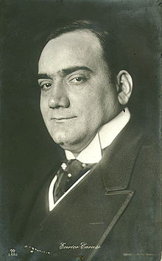

Spectral Balancing of Enrico Caruso (1916)
Original, before spectral balancing
https://www.youtube.com/watch?v=wPxKaFeEl9g
Digitally remastered, with spectral balancing
https://www.youtube.com/watch?v=e1gD37Gng8k
Sul mare luccica
L'astro d'argento
Placida è l'onda
Prospero il vento;
Venite all'agile
Barchetta mia;
Santa Lucia! Santa Lucia!
Con questo zeffiro
Così soave,
Oh, come è bello
Star sulla nave.
Su passeggeri,
Venite via;
Santa Lucia! Santa Lucia!
O dolce Napoli,
O suol beato,
Ove sorridere
Volle il creato,
Tu sei l'impero
Dell'armonia,
Santa Lucia! Santa Lucia!
Notes:
The objective of spectral balancing is to restore each spectral component to its ideal level, whether or not is was recorded that way. In general for seismic data, we desire a flat spectrum for all frequencies that are not contaminated by noise. This process has long been used to digitally remaster old music recordings. Enrico Caruso is arguably the best opera singer of all time, but the recording capabilities available in 1916 rendered a sound that was “tinny”. The remastered recording balances the low and high notes that were poorly recorded, while at the same time filtering out some of the “hisses” and “pops” common to old wax recordings.

Slide 4
Spectral Balancing
Original seismic amplitude
Spectral decomposition
Spectral magnitude components
Spectral phase components
Spectral balancing
Balanced seismic amplitude
Reconstruct
Balanced spectral magnitude components
Notes:
Flow diagram showing the workflow used in spectral balancing. First, the input data are decomposed into magnitude and phase components for a suite of frequencies representing the spectrum of the input data. The magnitude components are then adjusted to balance the magnitude spectrum, while the phase component are untouched. The new magnitude and original phase are them combined to reconstruct the original data. In general the magnitude and phase components are not written out to disk but rather manipulated internal to the program.

Slide 5

Adaptive whitening
Assume the signal s(t) is the convolution of a wavelet, w(t), with the reflectivity series r(t)
Assume the measured data is the signal s(t) plus noise n(t):
If we can estimate the spectra of the noise and of the wavelet, in frequency domain the deconvolution is
where S(f), N(f), are in general unknown but can be estimated by assuming the signal and noise are uncorrelated. Then S(f) is estimated by cross-correlating adjacent traces and S(f)+N(f) by autocorrelation of adjacent traces. If R(f) is white, we can assume W(f)≈S(f).
(Corrao et al., 2011)
Notes:
Adaptive whitening used by Corrao et al. (2011) assumes that we have a reasonable estimate of the spectrum of the seismic wavelet, W(f) and noise, N(f). The first step is to remove the effect of the wavelet spectrum through division by W(f). The signal and noise spectra are estimated by crosscorrelating adjacent traces. The component of the data that is in phase with a neighboring trace is s(t), while that which is not is n(t). If N(f)=0, no change to the spectral balancing is applied. However, as the noise increases (typically towards the edges of the bandwidth) the spectral balancing is progressively reduced. Balancing is then done by normalizing the power spectra.

Slide 6
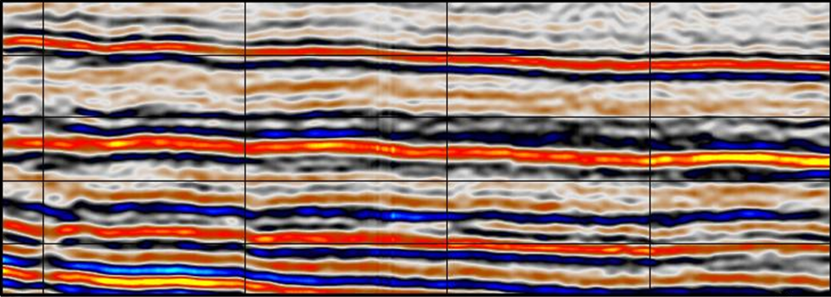
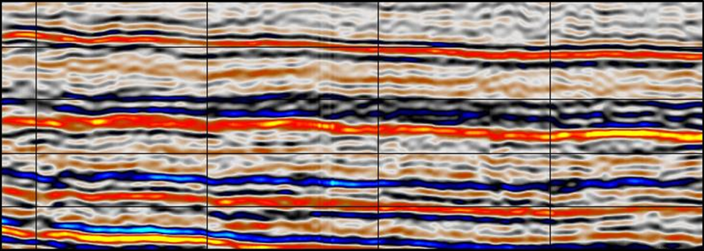
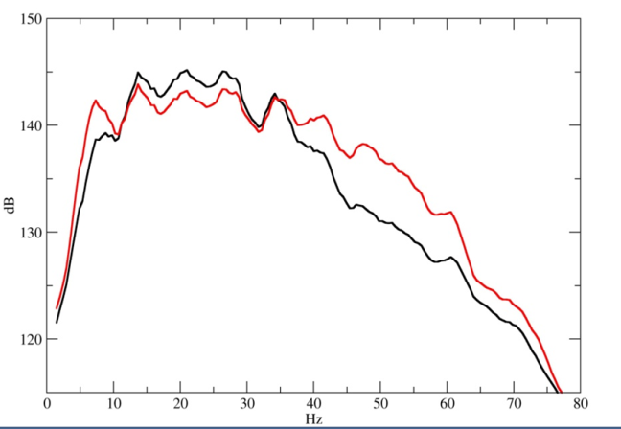
Adaptive whitening
Before
After
(Corrao et al., 2011)
(Corrao et al., 2011)
Notes:
A representative vertical slice through the input data before and filter adaptive whitening. Frequency spectral of the original data(in black) and whitened data (in red).

Slide 7
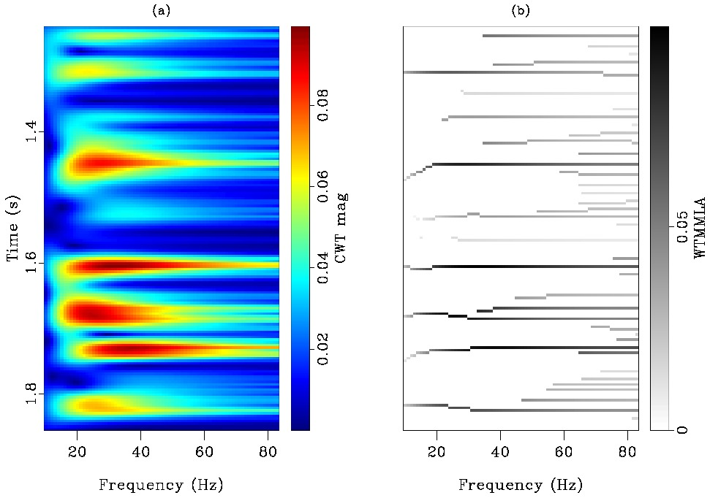
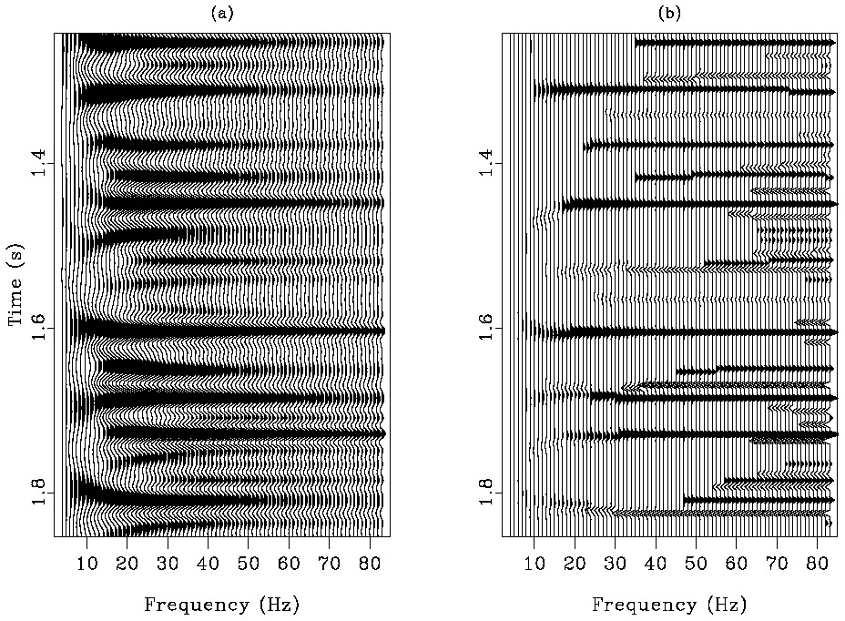
Spectral balancing using spectral components
CWT
Morlet wavelets
ICWT
reconstructed trace
CWT
magnitude
CWT voices
Reflectivity
Synthetic
CWT Magnitude
Pos
1.4
Σ
Time (s)
0
1.6
1.8
Neg
Pos
Neg
0
Pos
20
40
60
80
20
40
60
80
Amplitude
Amplitude
Frequency (Hz)
Frequency (Hz)
Neg
0
Pos
Amplitude
(Matos and Marfurt, 2011)
Notes:
This schematic shows how one can reconstruct the original signal by summing over the spectral components, or voices (soprano, alto, tenor, base). Through proper scaling, the original data can be reconstructed. (After Matos and Marfurt, 2011).

Slide 8
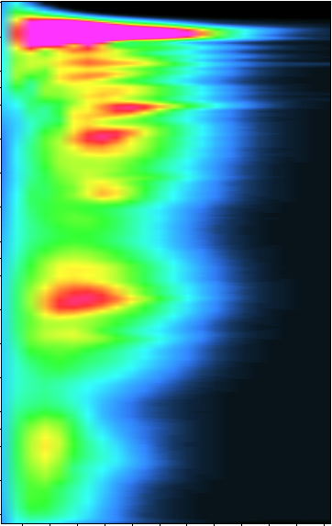
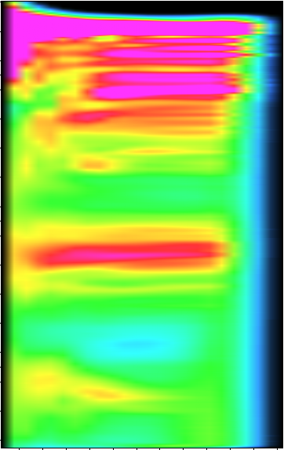
Spectral balancing using spectral magnitude components
Magnitude before balancing
Magnitude after balancing
Magnitude
0
High
1
Time (s)
0
2
3
20
40
60
80
100
120
20
40
60
80
100
120
Frequency (Hz)
Frequency (Hz)
Notes:
Spectral balancing of the NZP&M Kora3d survey. (a) Power spectra of the entire survey after three iterations of structure-oriented filtering. (b) Corresponding power spectra after spectral balancing, using a value of ε=0.01. Equation 4 provides the basis for time-varying spectral balancing using spectral components, a(t,f). As is the case with the algorithm described by Corrao (2011), balancing is done with power P(t,f) = a²(t,f). Within vertical running windows, we compute the average power over all traces and the peak power of the current trace for each spectral component computed. The noise is considered to be a user-defined fraction, ε, of the peak power. This algorithm avoids estimating the wavelet spectrum and instead assumes that the survey is sufficiently large and is either stratigraphically or structurally complex enough that the average reflectivity within the running window is approximately white. This assumption can be violated for small surveys imaging flat, nearly constant reflectivity geology.

Slide 9
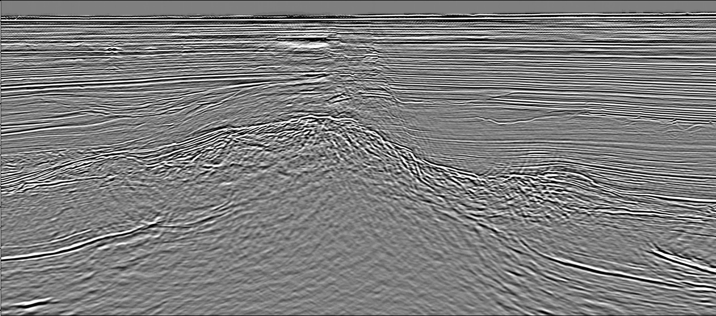
Spectral Balancing
5 km
0
1
Time (s)
2
3
Original data resample to 2 ms
(Marfurt, 2018)
Notes:
(a) A representative vertical slice through a seismic amplitude volume before spectral balancing. Red arrows indicate migration artifacts associated with operator aliasing. Because they are nearly vertical, these high-amplitude artifacts exhibit a lower apparent frequency. (b) The same vertical slice after spectral balancing, setting ε = 0.01 in equation 4. The low frequencies, below 5 Hz, are rejected, whereas those between 5 and 10 Hz are balanced and tapered, thereby suppressing the stronger steeply dipping migration artifacts indicated by the green arrows. Spectral components are balanced between 10 and 100 Hz, with tapers at the ends applied to the ranges 5 to 10 Hz and 100 to 120 Hz, thereby allowing us to resolve the thin beds indicated by the yellow arrows. Recall that the original data were sampled at Δt = 4 ms, such that the original Nyquist frequency was 125 Hz. Unfortunately, some low-frequency artifacts creep through in the zone indicated by the red arrows. Kora3D data courtesy of New Zealand Petroleum and Minerals (NZP&M). Used by permission.

Slide 10
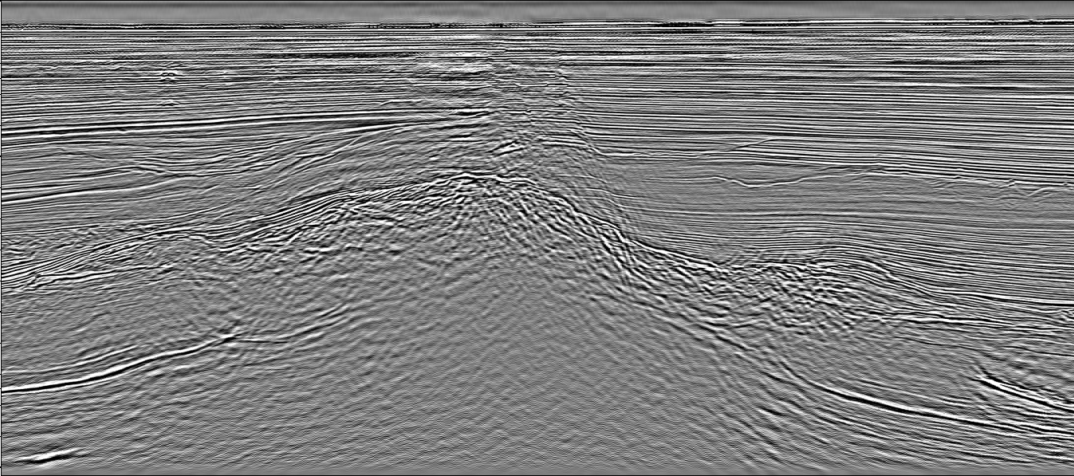
Spectral Balancing
5 km
0
1
Time (s)
2
3
After spectral balancing
(Marfurt, 2018)

Slide 11
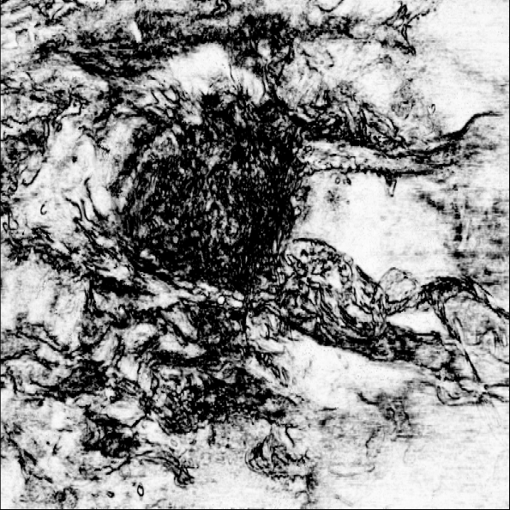
Coherence computed before spectral balancing
5 km
Coherence
1.0
0.6
A
A’
t=0.98 s
(Marfurt, 2018)
Notes:
Time slice at t = 0.98 s through coherence volumes computed from (a) the original seismic data volume (b) the amplitude data shown in Figure 2b after spectral balancing. The analysis window consists of five traces and 11 samples, or ±12.5 m by ±25.0 m by ±0.010 s. The dashed pink line indicates the location of line , shown in the previous vertical slices. Kora3d data courtesy of New Zealand Petroleum and Minerals (NZP&M) Used by permission.

Slide 12

Coherence computed after spectral balancing
5 km
Coherence
1.0
0.6
A
A’
t=0.98 s
(Marfurt, 2018)

Slide 13
  Poststack Data Conditioning of Migrated Data
  Spectral balancing
  Bandwidth extension
Notes:
In contrast to spectral balancing that attempts to flatten those components of the measured data that have an acceptable signal-to-noise ratio, bandwidth extension creates spectral components of the data beyond the limits of the original recording. To do so, all bandwidth extension algorithms are based on a model, with the sparse spike model used in predictive deconvolution being one of the most common.

Slide 14


Bandwidth extension using Mallat’s concept of spectral ridges
CWT
Morlet wavelets
CWT MML
ICWT
Shrunken Morlet
ICWT
reconstructed trace
CWT
magnitude
CWT voices
Reflectivity
Synthetic
CWT Magnitude
CWT MML
Pos
X
1.4
Σ
Time (s)
0
WTMMLA
magnitude
Σ
1.6
Pos
1.8
Neg
Pos
Neg
0
Pos
20
40
60
80
0
20
40
60
80
20
40
60
80
Amplitude
Amplitude
Frequency (Hz)
Frequency (Hz)
Frequency (Hz)
Neg
0
Pos
Amplitude
(Matos and Marfurt, 2011)
Notes:
Algorithmic details of most commercial implementations of bandwidth extension are closely guarded with key details not disclosed. Matos and Marfurt (2011) presented a simple method based on the inverse of the continuous wavelet transform. Figure 61 of Chapter 2 showed how one can reconstruct the original seismic data by summing over the voices. To extend the bandwidth, Matos and Marfurt (2011) pick the maxima (or ridges) of each spectral component and convolve them with a broader-band wavelet. This is somewhat like replacing Marfurt’s (band-limited) voice with Caruso’s broad-band voice, resulting in bandwidth extension to both the higher and lower frequencies. The underlying assumption is that the ridges of the original CWT components accurately represent the major impedance changes in the subsurface. For example, if one assumes a blocky reflectivity model, the corresponding sparse spikes measured by a vibrator sweeping from 10 to 80 Hz will occur at the same locations as in the case measured by a vibrator sweeping from 5 to160 Hz. This is the same assumption used in many time-variant deconvolution algorithms. Obviously, reflection events that fall outside the original bandwidth are never recorded and thus cannot be represented by a sparse spike, which means they cannot be reconstructed. After Figure ? of Matos and Marfurt (2011). Used by permission.

Slide 15
Bandwidth extension using inverse CWT “deconvolution”
5 km
0
1
Time (s)
2
3
Original data resample to 1 ms
(Marfurt, 2018)
Notes:
(a) A representative vertical slice through a seismic amplitude volume before spectral balancing. Red arrows indicate migration artifacts associated with operator aliasing. Because they are nearly vertical, these high-amplitude artifacts exhibit a lower apparent frequency. (b) The same vertical slice after spectral balancing, setting ε = 0.01 in equation 4. The low frequencies, below 5 Hz, are rejected, whereas those between 5 and 10 Hz are balanced and tapered, thereby suppressing the stronger steeply dipping migration artifacts indicated by the green arrows. Spectral components are balanced between 10 and 100 Hz, with tapers at the ends applied to the ranges 5 to 10 Hz and 100 to 120 Hz, thereby allowing us to resolve the thin beds indicated by the yellow arrows. Recall that the original data were sampled at Δt = 4 ms, such that the original Nyquist frequency was 125 Hz. Unfortunately, some low-frequency artifacts creep through in the zone indicated by the red arrows. Kora3D data courtesy of New Zealand Petroleum and Minerals (NZP&M). Used by permission.

Slide 16
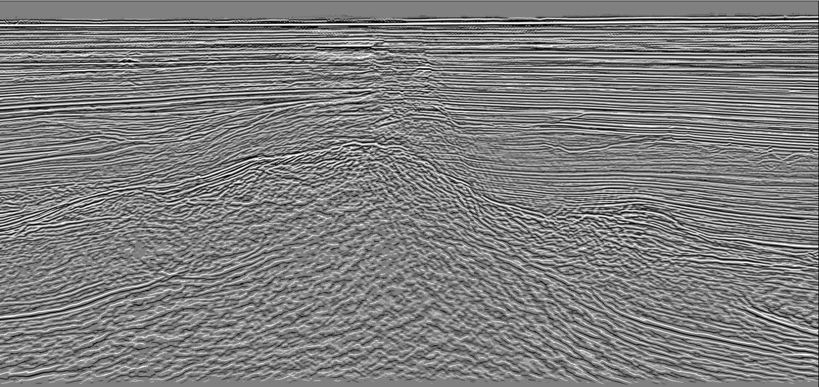
Bandwidth extension using inverse CWT “deconvolution”
5 km
0
1
Time (s)
2
3
After bandwidth extension
(Marfurt, 2018)
Notes:
An example of bandwidth extension based on the algorithm described in the previous figure, applied here to the same seismic survey shown in Figure 2. Kora3d data courtesy of NZP&M. Used by permission.

Slide 17
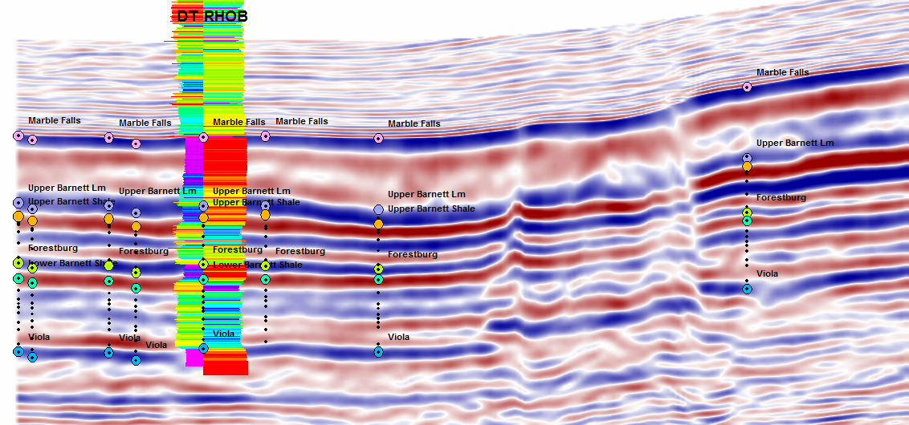
Original Seismic Amplitude for a Barnett Shale survey
1 mi
Amplitude
Positive
6000
0
6500
Negative
Depth (ft)
7000
7500
(Matos and Marfurt, 2011)
Notes:
An example of bandwidth extension applied to a survey acquired in the Fort Worth Basin, TX, using the CWT and sparse-spike inversion in the frequency domain. (a) The original seismic data, where a yellow arrow indicates the top of the lower Barnett Shale. (b) The same data, after replacing the wavelets used in a CWT spectral decomposition with a tighter temporal width, broader-bandwidth wavelet in the inverse CWT. (c) The results of a commercial bandwidth-extension algorithm, computed in the frequency domain by using a library of wavelet doublets, as described by Portniaguine and Castagna (2004). Figure courtesy of Marcilio Matos, Sismos. Used by permission.

Slide 18
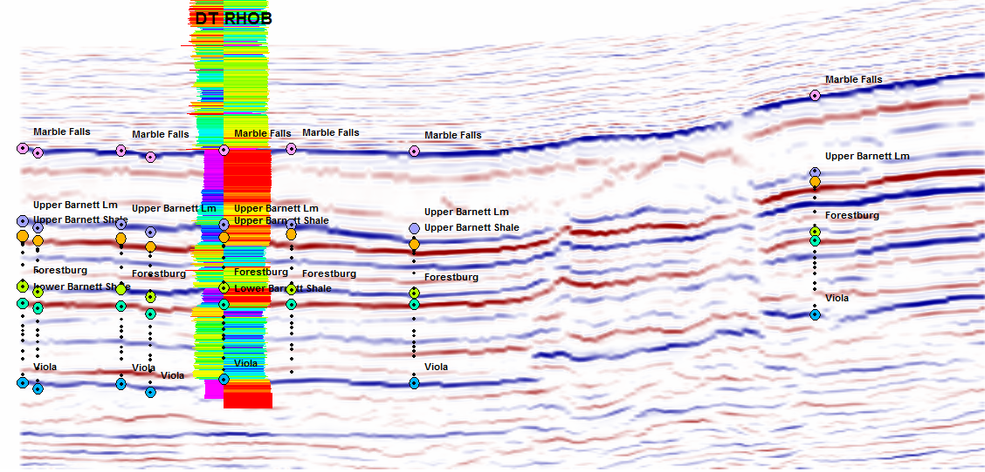
“Bandwidth extension” using the inverse CWT
1 mi
Amplitude
Positive
6000
0
6500
Negative
Depth (ft)
7000
7500
(Matos and Marfurt, 2011)
Notes:
The same data after bandwidth extension obtained by frequency domain sparse spike inversion using a basis function of reflection doublets (the algorithm commercialized by Fusion as “thinman”). (After Matos and Marfurt, 2011; Data courtesy of Devon Energy).

Slide 19
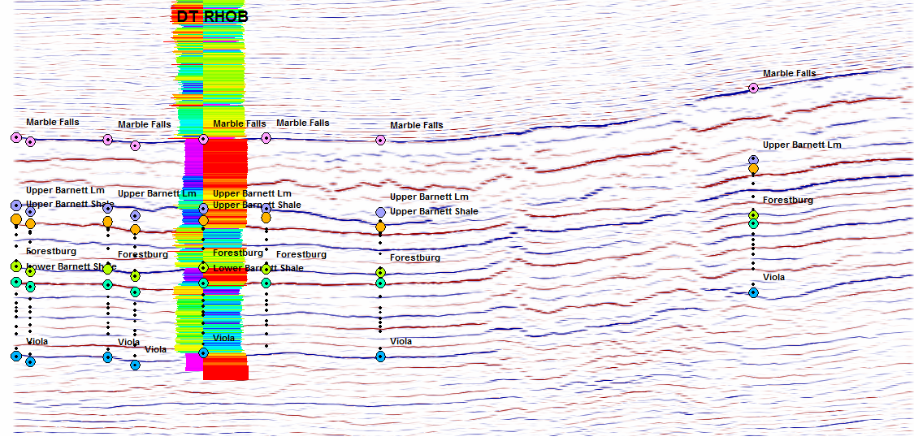
Bandwidth extension using a basis-pursuit algorithm
1 mi
Amplitude
Positive
6000
0
6500
Negative
Depth (ft)
7000
7500
4-19
(Matos and Marfurt, 2011)
Notes:
The same data after bandwidth extension obtained by rescaling the voices in the CWT. The Barnett Shale is at the level of the dashed yellow line. (After Matos and Marfurt, 2011; Data courtesy of Devon Energy).

Slide 20
Three simple wedge models
(Machado, 2018)
Notes:
Three simple wedge models. The bottom model is that used by Widess (1978) with reflectors composed of equal and opposite polarity. The middle model is composed of somewhat weaker reflectors exhibiting the same polarity. The reflectivity of the top model is the sum of the bottom two.

Slide 21
After spectral balancing
(Machado, 2018)
Notes:
Spectral balancing does a nice job of increasing the vertical resolution for all three models. However, it does not attempt to construct any frequency components beyond that originally recorded in the data.

Slide 22
After CWT-based bandwidth extension
(Machado, 2018)
Notes:
The same models after bandwidth extension based on concepts of Mallat’s spectral ridges. This algorithm works fine for reflectors that were already well-resolved. However, artifacts occur at higher (extended frequencies). Other bandwidth extension algorithms based on spectral decomposition adjust the magnitude component (sometimes by using octaves of the desired frequency) but keep the original phase, as we do for spectral balancing. The problem with the lower wedge is that we often construct a higher resolution 90° wavelet in the middle of the wedge rather than the desired 0° and 180° wavelets the define the top and bottom of the wedge.

Slide 23
Failure of CWT spectral ridge bandwidth extension
40 Hz spectral magnitude
40 Hz spectral ridges
(Machado, 2018)
Notes:
This figure illustrates the shortfall in the Mallat spectral ridge approach to bandwidth extension. The top image shows the periodic tuning in the spectral magnitude 40 Hz component. The bottom image shows the location of the corresponding spectral ridges. Unfortunately, the ridges do not line up with the desired top and bottom of the wedge models, giving us the artifacts seen in the previous image.

Slide 24
Review of Chung and Lawton’s (1995) thin-bed (wedge) models
m_{a}
m_{b}
m_{c}
m_{d}
Note that m_{c}=½m_{a}-½m_{b} and m_{d}=-¼m_{a}+¾m_{b}
(Chopra et al., 2023)
Notes:
Four wedge models described by Chung and Lawton (1995) where the thickness ranges from 0 to 50 ms at 1 ms increments and where (a) the reflectors are equal and opposite polarity, (b) the reflectors are equal and the same polarity, (c) the reflectors are unequal and opposite polarity, and (d) the reflectors are unequal and the same polarity. In this example, each wedge has been convolved with a 5-10-40-50 Hz Ormsby wavelet. For thin bed inversion the wedges in (a) and (b) are convolved with either a well tie source wavelet or with a statistical wavelet, thereby forming 101 basis functions that will be fit to the data at each sample.

Slide 25
Bandwidth extension based on thin-bed reflectivity inversion
Traditionally, we represent the response of geologic horizons as a system of spikes with an unknown coefficients
If we know the seismic wavelet, we can estimate the location, polarity, and amplitude of these spikes
We can then apply a bandpass filter to the spikes to generate a higher-resolution version of the seismic data
Alternatively, we can represent the response of geologic layers as a system of doublets with unknown coefficients
If we know the seismic wavelet, we can estimate the location, polarity, and amplitude of these doublets
We can then apply a bandpass filter to the spikes to generate a higher-resolution version of the seismic data
Solve using maximum likelihood least-squares?
Solve using basis pursuit

Slide 26
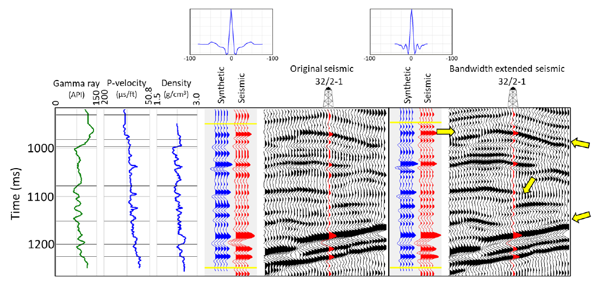
Bandwidth extension based on thin-bed reflectivity inversion
(Chopra et al., 2023)
Notes:
Correlation of well curves with seismic data. The blue traces represent the synthetics (generated with the wavelet shown above), whereas the red traces represent the seismic data (a) before, and (b) after bandwidth extension. The correlation coefficients for the ties were 0.745 for (a) and 0.756 for (b). Thus, there is a good correlation between the synthetic and red traces in the time window indicated for both data volumes but note the resolution of additional events after bandwidth extension indicated by the yellow arrows.
Figure 3 shows the correlation of well curves with seismic data.

Slide 27
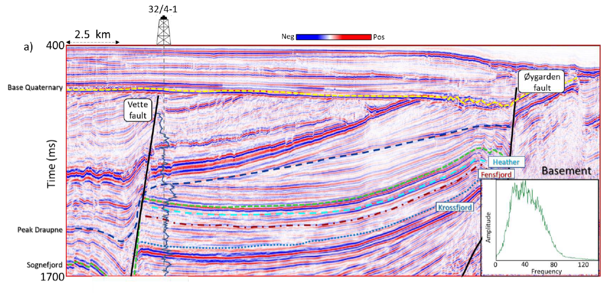
Original data
(Chopra et al., 2023)

Slide 28
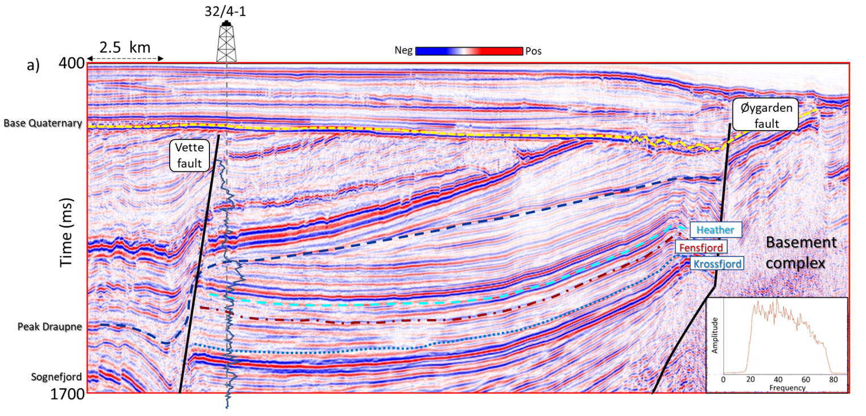
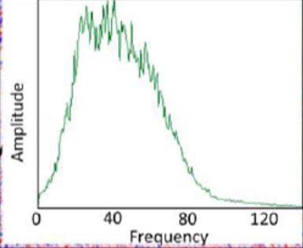
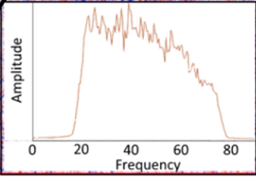
Data after spectral balancing
(Chopra et al., 2023)

Slide 29
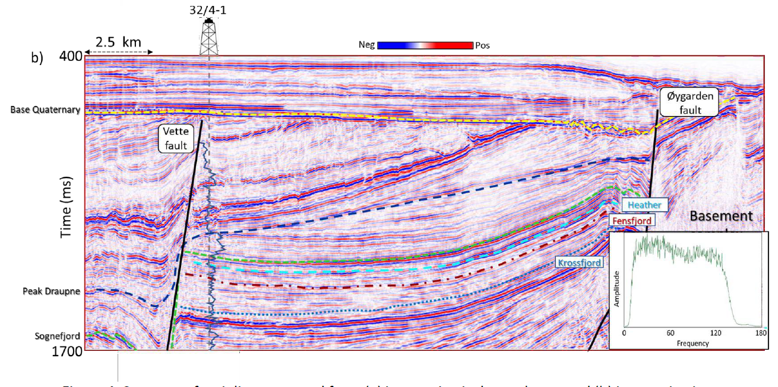
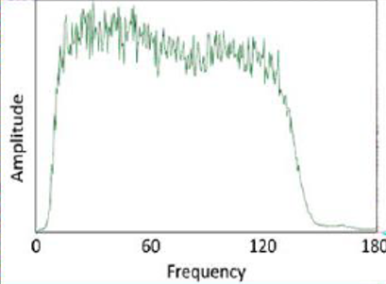
Data after inversion for doublets and bandwidth extension
(Chopra et al., 2023)

Slide 30
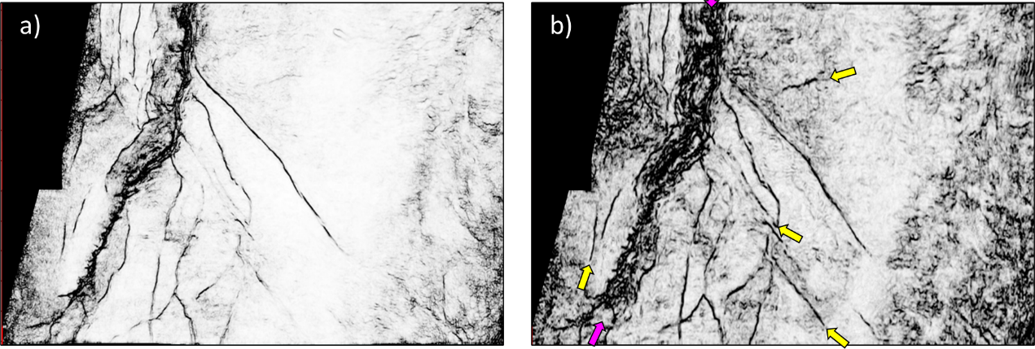
Coherence after bandwidth extension
Coherence on original data
Coherence
High
Low
(Chopra et al., 2023)
Notes:
Time slice at t=1.66 s through multispectral energy ratio coherence volumes computed from the (a) original seismic data, and (b) the same data after thin-bed reflectivity inversion and bandwidth extension shown in Figure 20c. Both data volumes were also subjected to structure-oriented filtering described later in this chapter.. Notice the superior definition of the lineaments in terms of their continuity and intensity seen on the display in (b). Some of the weak lineaments seen in (a) are better delineated in (b) indicated by yellow arrows. The fault damage zone indicated by magenta arrows is better defined in (b). (After Chopra et al., 2023).

Slide 31
Post Migration Poststack Data Conditioning – Spectral Balancing
In Summary:
Spectral balancing based on time-variant laterally constant operators results in amplitude friendly filters that do not negatively impact impedance inversion that use different wavelets for targets at different depths
There are several bandwidth extension algorithms in the marketplace. Most provide cosmetically appealing images that increase the bandwidth of resolved horizons but do not improve the resolution of thin layers that exhibit tuning phenomena
At present, it appears that model-based bandwidth extension algorithms using basis pursuit algorithms are the only ones that provide improved resolution of thin beds
Notes:
Summary comments on post-migration data conditioning of post-stack data

