Slide 1
Seismic Attributes - from Interactive Interpretation to Machine Learning
Kurt J. Marfurt (The University of Oklahoma)
Conditioning of Migrated, Stacked Data
Footprint Suppression

Slide 2
Data conditioning – Footprint suppression
After this section you should be able to:
Recognize the appearance of acquisition footprint and avoid interpreting it as signal
Apply k_{x}-k_{y} and other filters to partially suppress periodic footprint
Notes:
A list of learner objectives for the section on seismic data conditioning.

Slide 3
Causes of Acquisition Footprint
Aliased backscattered noise, e.g. ground roll and low-velocity shallow diffractions
Bin-to-bin variations in the distributions of offsets and azimuths that exacerbate AVO effects
Obstacles causing deviations from the desired regular geometry
Migration operator’s attempt to image steep dips with short horizontal wavenumbers

Slide 4
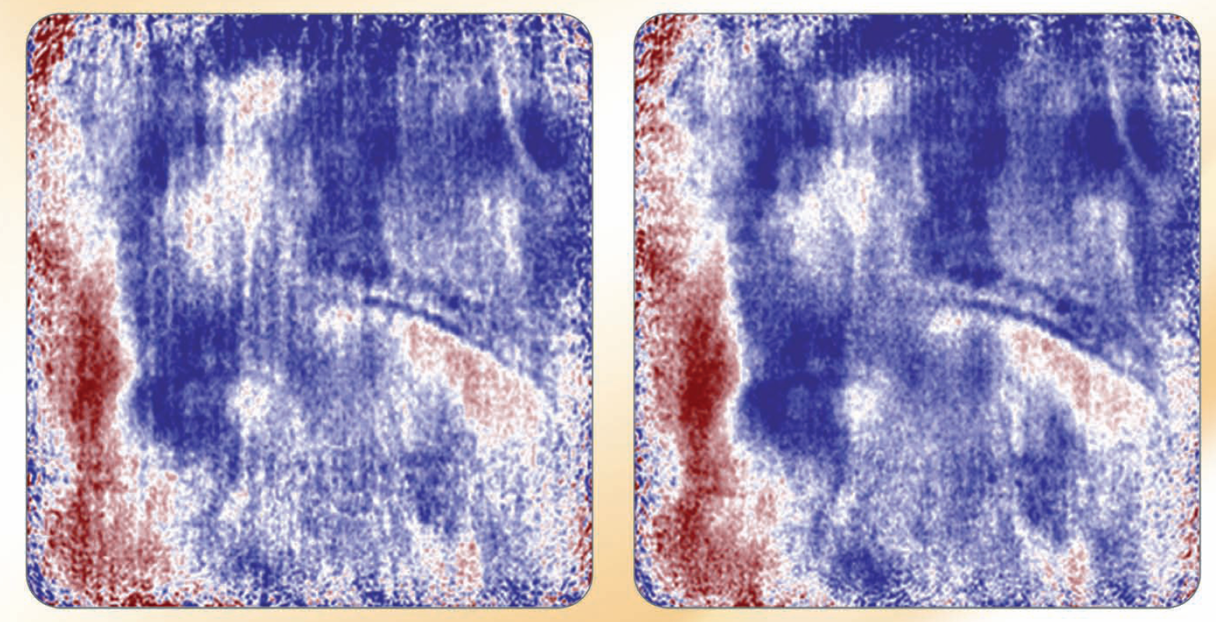
The best way to avoid footprint? Improve your survey design.
Impact of denser, single vibrators, vs. more widely separated vibrator arrays
4 sweeps per shot location
1 sweep per shot location. Double the shot lines!
CGG Veritas slip-sweep acquisition
CGG Veritas V1 acquisition
(CGG-Veritas ad. AAPG Explorer, July, 2009)
Notes:
Recently, several seismic acquisition companies have designed workflows that replace conventional vibrator arrays generating vertically stacked data with denser acquisition using single sweep vibrators. With concomitant deployment of wide-azimuth, denser geophone arrays, considerable improvement in data quality can be achieved within the same time frame at the same cost. The reason for the improvement is that much of our noise is not random, but rather coherent. Leakage of ground roll, airwaves, and other coherent noise cannot be suppressed through vertical stacking. By adding additional shot points, we exploit the fact the differences in moveout between reflections and diffractions of interest vs. coherent noise. The result is a decrease in acquisition footprint (and because the decreased bin size) increased lateral resolution. (The above advertisement from CCG-Veritas can be found in the July 2009 AAPG Explorer, page 17).

Slide 5
Reducing acquisition footprint by reprocessing the original common shot gathers

Slide 6
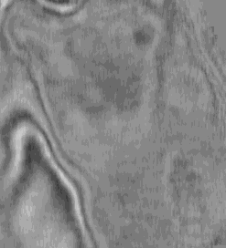
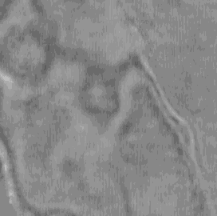
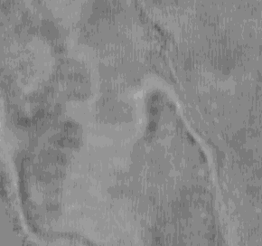
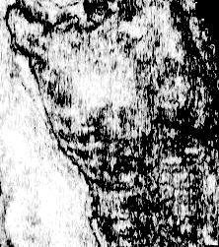
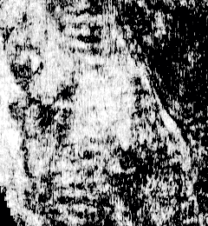
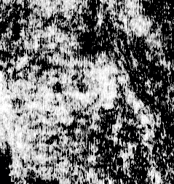
The next best way to avoid footprint? Improve your processing workflow.
Original data. Note the E-W acquisition footprint
Amplitude
Coherence
1272 ms
1316 ms
1332 ms
(Chopra et al., 2002)
Notes:
Time slices, at t = 1.272, 1.316, and 1.332 s, through (a) a seismic data volume and (b) the corresponding coherence volume. The acquisition footprint does not impede our ability to interpret the original seismic amplitude data, but it is exacerbated by the coherence calculation, in which we see wide east-west and narrow north-south artifacts. After Chopra (2002).

Slide 7
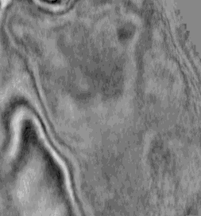
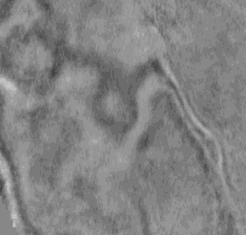
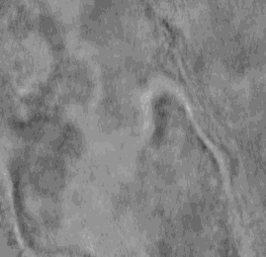
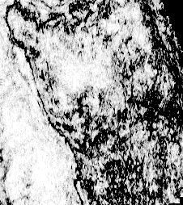
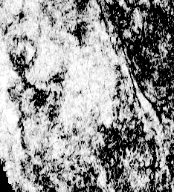
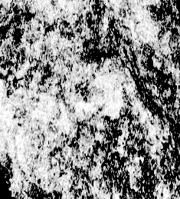
The next best way to avoid footprint? Improve your processing workflow.
After trace balancing, statics, and improved velocity analysis
Amplitude
Coherence
1272 ms
1316 ms
1332 ms
(Chopra et al., 2002)
Notes:
The same data slices as those shown in the previous figure, but displayed here after additional seismic processing (balancing, statics, and improved velocity analysis) to minimize the acquisition footprint. Although the impact on the original seismic data is minimal, we now are able to discern minor faults (indicated by gray arrows) and possible stratigraphic features (indicated by white arrows) that previously were masked by the acquisition footprint. After Chopra (2002).

Slide 8
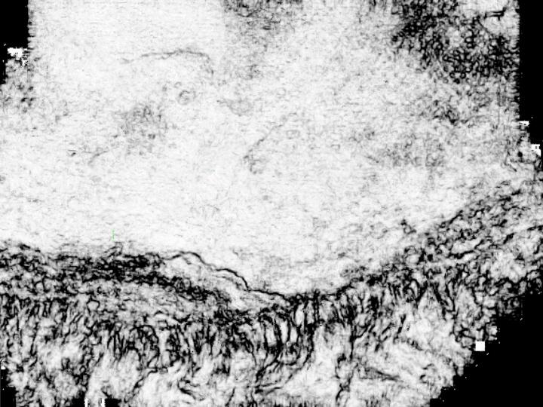
The next best way to avoid footprint? Improve your processing workflow.
Reduced footprint
Reduced footprint
A processing workflow that minimizes footprint
Vacuum Field, Delaware Basin
Poor resolution
Poor resolution
Poor resolution
Time = 0.940 s
(Famini et al, 2005)
Notes:
Comparison of a time slice, at 1.0 s, through coherence volumes generated for a survey from the Delaware Basin, New Mexico, USA. The coherence slice from original processing. After Famini (2005).

Slide 9
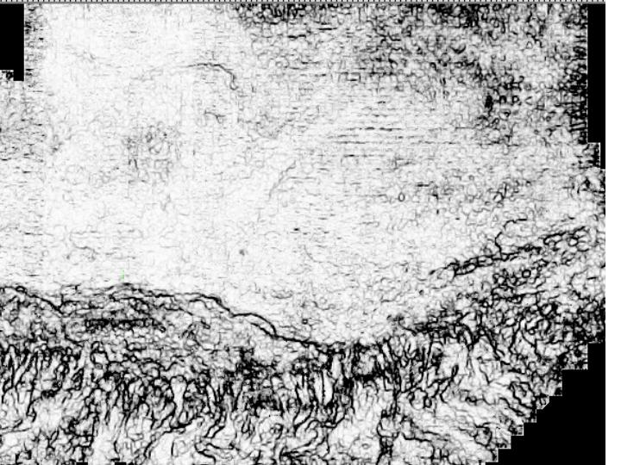
Coherence on reprocessed data
Vacuum Field, Delaware Basin
Stronger footprint
Stronger footprint
A processing workflow that maximizes resolution
Vacuum Field, Delaware Basin
Better resolution
Better resolution
Better resolution
Time = 0.940 s
(Famini et al, 2005)
Notes:
Comparison of a time slice, at 1.0 s, through coherence volumes generated for a survey from the Delaware Basin, New Mexico, USA. Coherence slice after careful reprocessing to improve lateral resolution. Note the trade-off between increased acquisition footprint in the northeast corner, indicated by the yellow arrow, and improved resolution in the Brushy Canyon slump features indicated by the green arrow. Unfortunately, in this example improving the lateral resolution of the geologic features of interest also exacerbated the acquisition footprint. After Famini (2005).

Slide 10
Observations
If the acquisition geometry follows a pattern, acquisition footprint will have periodic components
The amplitude and location of these components will change with depth (and generally heal at greater depths)
If we know the acquisition program and processing workflow, we can predict what this pattern will be
Attributes exacerbate the impact of footprint
Attributes may therefore serve as a means of characterizing footprint, allowing us to model it without knowing the details of acquisition and processing

Slide 11
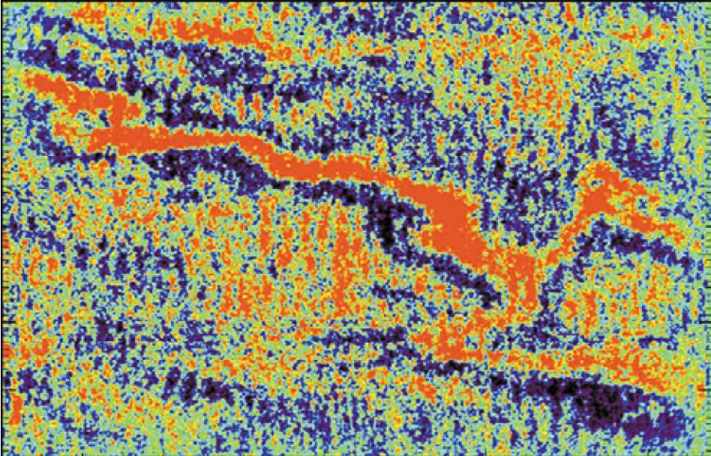
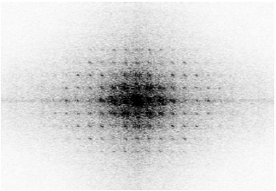
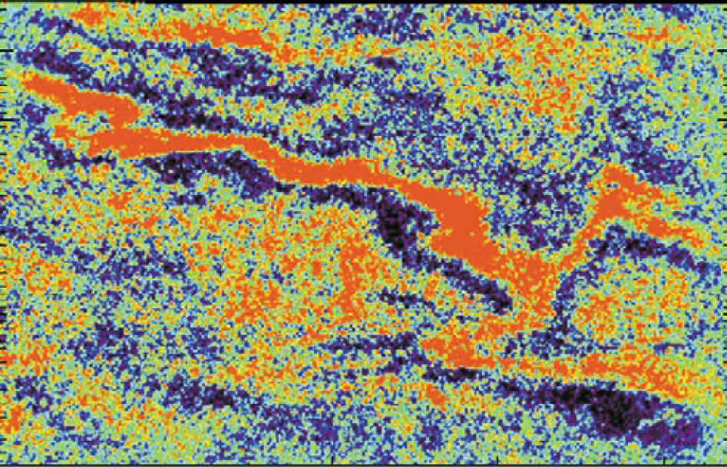
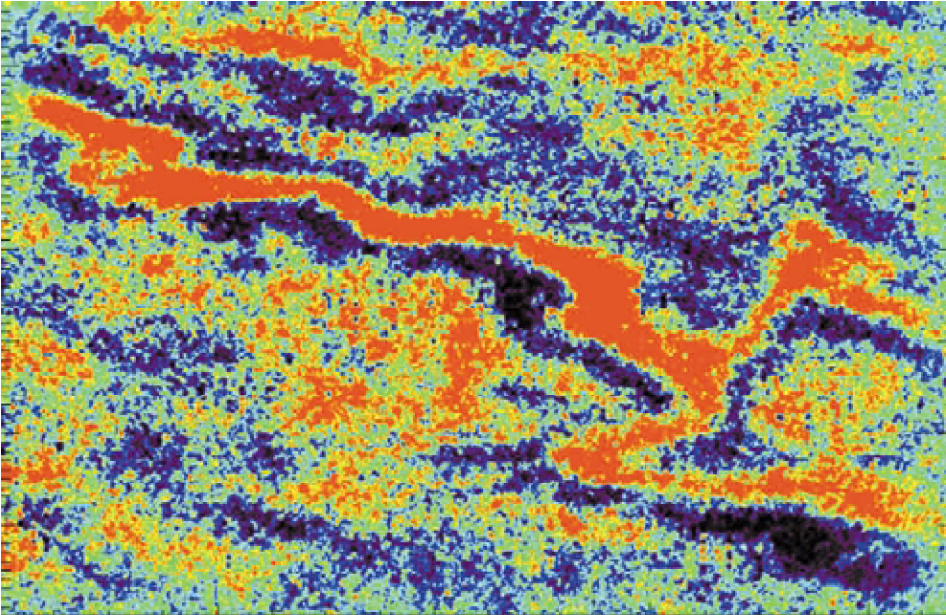
k_{x}-k_{y} filters based on knowledge of the acquisition and processing
k_{y}
k_{x}
Land data, Algeria
Data after kx-ky notch filtering
Original data
Data after adaptive filtering
t = 3.2 s
(Drummond et al., 2001)
Notes:
One of the first examples showing the advantage of k_{x}-k_{y} filtering of the migrated seismic data. The k_{x}-k_{y} pedestals were computed from knowledge of the source and receiver locations. Comparison of original data, data after k_{x}-k_{y} filter, and data after adaptive filtering. (After Drummond et al., 2001).

Slide 12
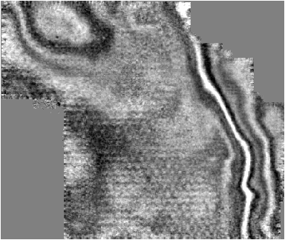
k_{x}-k_{y} pattern seen on seismic amplitude
A
A’
0.000
Amplitude
Positive
^{4 km}
0.250
A
A’
Signal
0
Time (s)
Footprint
0.500
Negative
N
Signal
Footprint
0.750
Central Basin Platform, TX
Seismic
amplitude
(Falconer and Marfurt, 2008)
Notes:
(Left) A vertical slice and (Right) time slice at t=0.5 s through a seismic amplitude volume acquired over the Central Basin Platform of west Texas, Note the strong periodic acquisition footprint that contaminates the data. Careful examination of the vertical slice shows that this footprint correlates to the steeply dipping artifacts cutting across the reflection events of interest. Without further access to the data, the two most likely causes are migration operator aliasing and/or aliased ground roll and shallow diffractions that have leaked through the processi

Slide 13
k_{x}-k_{y} pattern seen on seismic attributes
A
A’
0.000
Can we use coherence to characterize the footprint pattern?
Amplitude
Positive
^{4 km}
0.250
A
A’
Signal
Coherence
High
0
Time (s)
Footprint
0.500
Negative
N
Signal
Footprint
Low
0.750
Central Basin Platform, TX
Sobel filter
similarity
(Falconer and Marfurt, 2008)
Notes:
The same vertical section but now with a time slice at the same t=0.5 s level through the coherence (Sobel filter similarity) volume. Note the periodic pattern of the low coherence anomalies. Because coherence (and other attributes) are more sensitive to the footprint than the amplitude data, can we use it characterize the footprint pattern?

Slide 14
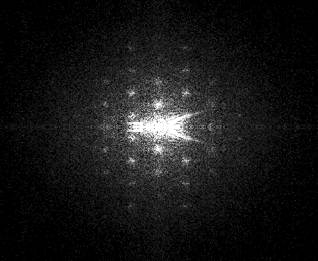
k_{x}-k_{y} magnitude spectrum of the seismic amplitude
k_{y} (cycles/km)
-.02
-.01
0
.01
.02
-.02
-.01
Blurred pedestals
0
Reflector response
k_{x} (cycles/km)
.01
.02
Seismic amplitude spectrum
(Falconer and Marfurt, 2008)
Notes:
In the next three figures, I present a footprint suppression workflow that can often (but not always!) be successfully applied to migrated data. Since the data were acquired using orthogonal shot and receiver lines, the footprint also has an orthogonal pattern. This pattern is quite visible in the k_{x}-k_{y} magnitude spectrum of the seismic amplitude data.

Slide 15
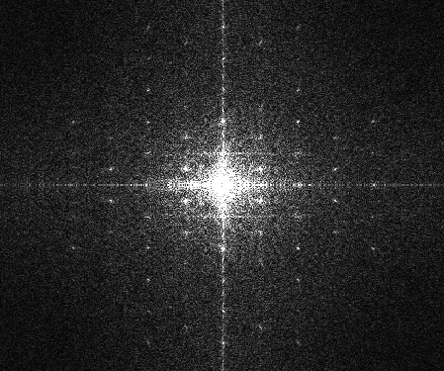
k_{x}-k_{y} magnitude spectrum of the Sobel filter similarity (coherence)
k_{y} (cycles/km)
-.02
-.01
0
.01
.02
-.02
-.01
Focused pedestals
0
Smaller Reflector response
k_{x} (cycles/km)
.01
.02
Attribute spectrum
(Falconer and Marfurt, 2008)
Notes:
This periodic footprint pattern is exacerbated by the edge-sensitive attributes. The goal is to identify high magnitude k_{x}-k_{y} noise components. The most direct workflow is to construct a suite of notches based on these pedestals, apply it to the magnitude spectrum of the seismic amplitude data shown in the previous figure, and then reconstruct the data.

Slide 16
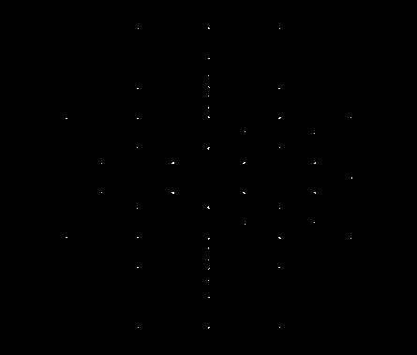
k_{x}-k_{y} magnitude spectrum after application of an LoG sharpening filter
k_{y} (cycles/km)
-.02
-.01
0
.01
.02
-.02
-.01
Sharpened pedestals
0
Muted reflector response
k_{x} (cycles/km)
.01
.02
Sharpened attribute spectrum
Using Laplacian of a Gaussian (LoG)
(Falconer and Marfurt, 2008)
Notes:
A pitfall in k_{x}-k_{y} filtering is that we may reject desired signal as well as undesired noise. For this reason, the noise characterization should be as focused as possible. By applying a Laplacian of a Gaussian filter to the previous image, we can sharpen the location of the footprint pedestals. Care must be taken near low wavenumber components about k_{x}=k_{y}=0. For example coherence anomalies associated with unconformities and other stratigraphic features that are nearly horizontal will give rise to low wavenumber anomalies. In this example, we have applied a simple mute to the lowest wavenumber components. The footprint at these components will therefore not be addressed.
In the next steps, we will apply the picked pedestals to the original seismic amplitude k_{x}-k_{y} magnitude spectrum, reconstruct a model of the seismic amplitude noise, and adaptively subtract it from the the original x,y amplitude data.

Slide 17
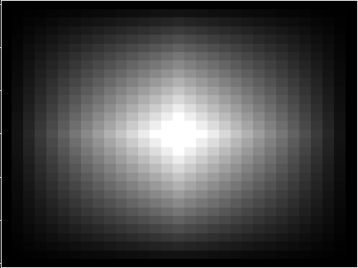
Modeling the seismic noise using 1D and 2D basis functions
A
A’
α₄
Six 1D weighting functions approximating a continuous curve (each with a coefficient α_{k} )
α₃
Amplitude
α₅
α₂
α₆
α₁
L
distance
A 2D weighting function
α_{k}
L
L
(Falconer and Marfurt, 2008)
Notes:
This image shows how one can represent a curved pink line by the linear combination of sixed (dotted yellow) raised cosine basis functions which add to give the dashed yellow line. The mathematical problem is then to estimate the six coefficients, alpha, that represent the hundreds of data measurements on the pink line. For footprint suppression, we will model the noise response using 2D Gaussian basis functions, as shown in the lower left of this figure.

Slide 18
Modeling the seismic noise using 2D basis functions
α₁
α₂
α₃
α₄
α₅
α₆
α₇
α₈
α₉
α₁₀
α₁₁
α₁₂
α₁₃
α₁₄
α₁₅
α₁₆
α₁₇
α₁₈
α₁₉
α₂₀
α₂₁
α₂₂
α₂₃
α₂₄
α₂₅
α₂₆
α₂₇
α₂₈
α₂₉
α₃₀
data
noise fit to data
noise estimate
(Falconer and Marfurt, 2008)
Notes:
In this workflow, the basis functions consist of 36 2D raised cosines. These raised cosines are cross-correlated with the noise prediction obtained by the inverse kx-ky filter applied to the amplitude data represented by the previously defined noise filter mask. The resulting image is least-squares fit to the original amplitude time slice. Notice that it has a basket-weave pattern.

Slide 19
Details of adaptive subtraction
The goal of the algorithm is to minimize the error between the original data, d, and a weighted version of the noise, n:
where w are 2D weighting functions, and α_{k} is the amplitude of the k^{th} control point.
Solving for α, we obtain:
where the small value β prevents division by zero in dead-trace areas.
(Falconer and Marfurt, 2008)
Notes:
Here is the arithmetic for those of you interested. d_{ij} is an input amplitude datum, w_{ijk} is the j^{th} raised cosine, and n_{ij} is the modeled noise after applying the mask to the k_{x}-k_{y} transformed amplitude data and reverse transforming back to x,y space.

Slide 20
Amplitude
data
Recompute attributes
for QC
k_{x}-k_{y} transform
amplitude data
Generate attributes
sensitive to footprint
Footprint
k_{x}-k_{y} mask
Mask amplitude data
Footprint-
contaminated
attributes
Footprint- free
attributes
Reverse kx-ky
transform
Generate smooth pedestal
filters (mask in k_{x}-k_{y} space) that best represent attribute footprint
Modeled noise
Apply vertical median filter
to enhance footprint
and suppress stratigraphic
features
Adaptively subtract noise
components from
original data
For each time slice,
characterize footprint
in k_{x}-k_{y} space
(threshold the peaks)
Filtered
data
(Falconer and Marfurt, 2008)
Notes:
Here is the workflow. It looks complicated, but thus is the world of seismic processing.

Slide 21
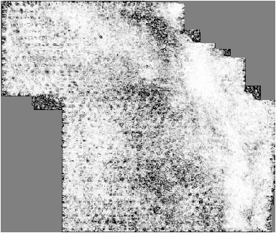
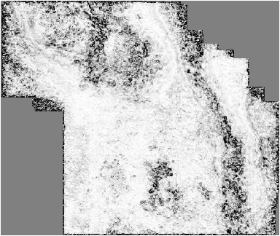
Application to a Central Basin Platform survey (west Texas)
Sobel Attribute
High
Low
t=500 ms
Time slices through Sobel filter similarity (coherence)
^{N}
Core
^{12,000 ft}
t=600 ms:
San Andres level
(Falconer and Marfurt, 2008)
Notes:
Images at t=500 and 600 ms. One of the targets is at the San Andres level. Footprint is strong at 500 ms, a little weaker at 600 ms, but strong enough to mask what we think are karst collapse features. The red dot shows the well location on the following slide.

Slide 22
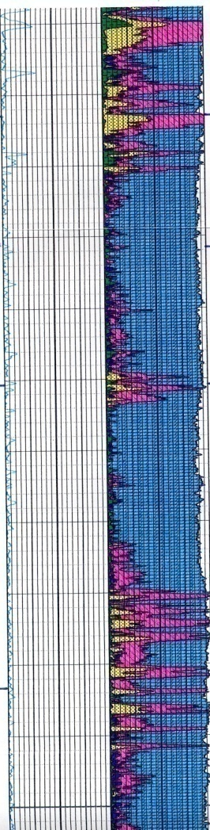
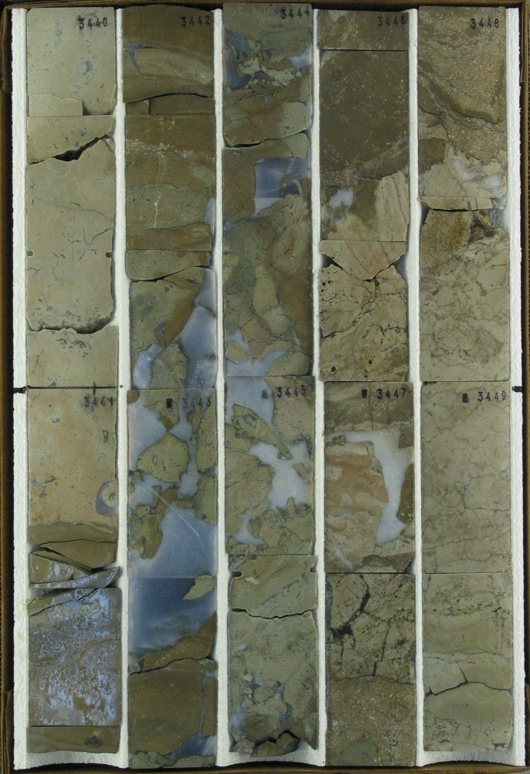
Karst forms the updip seal
Karst
Karst
1100
Top G4
Karst
0.6 m
Depth (m)
1150
Karst
Anhydrite
Top G3
Karst
1200
(Falconer and Marfurt, 2008)
Notes:
Note the anhydrite-filled karst seen in the well.

Slide 23
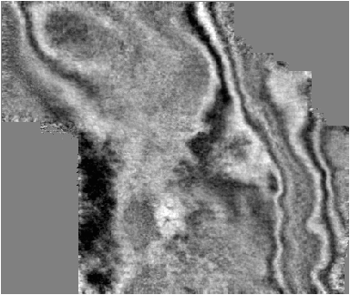
Application to a Central Basin Platform survey (west Texas)
Amplitude
Positive
0
Footprint
Negative
Footprint
Footprint
t=500 ms
^{N}
Time slices through migrated amplitude data volume
^{12,000 ft}
t=600 ms:
San Andres level
(Falconer and Marfurt, 2008)
Notes:
These time slices show footprint on the original amplitude data. One of the exploration targets is the San Andres level near t=600 ms, where we see strong footprint.

Slide 24
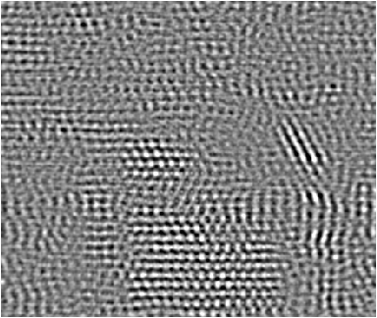
Details
Weights calculated from adaptive subtraction
Weighted noise to be subtracted from seismic data
Noise predicted from mask
x
=
t=500 ms
t=600 ms:
San Andres level
x
=
(Falconer and Marfurt, 2008)
Notes:
The top row of images at t=500 ms and the bottom row of images at t=600 ms shows on the left panels the noise predicted by applying the attribute-derived noise mask to kx-ky of the amplitude data and inverse transforming to x-y space to obtain a noise estimate. Note that noise is predicted even in the dead trace areas. The central panels show the weights applied to the predicted noise, while the right panels show the least-squares (adaptively) fit of the noise to the original amplitude data. This noise estimate will be simply subtracted from the original data.

Slide 25
Before footprint suppression
Amplitude
Positive
0
Negative
t=500 ms
^{N}
^{12,000 ft}
Footprint
t=600 ms:
San Andres level
Footprint
Footprint
Footprint
(Falconer and Marfurt, 2008)
Notes:
The two amplitude slices before footprint suppression.

Slide 26
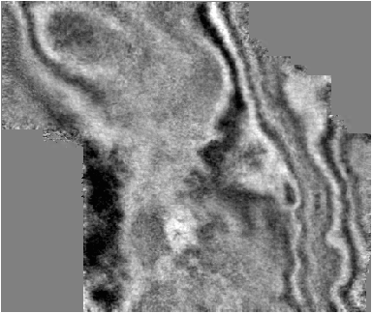
After footprint suppression
Amplitude
Positive
0
Negative
t=500 ms
^{N}
^{12,000 ft}
t=600 ms:
San Andres level
(Falconer and Marfurt, 2008)
Notes:
The same two amplitude slices after footprint suppression.

Slide 27
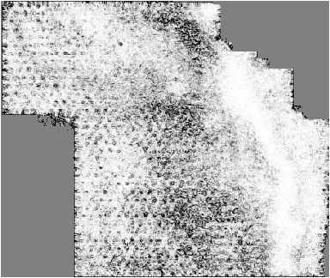
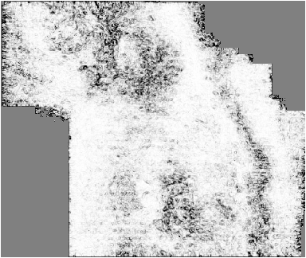
Before footprint suppression
Sobel Filter
High
Low
t=500 ms
^{N}
geology?
^{12,000 ft}
footprint
t=600 ms:
San Andres level
footprint
footprint
footprint
(Falconer and Marfurt, 2008)
Notes:
The two attribute slices computed from the seismic amplitude data before footprint suppression.

Slide 28
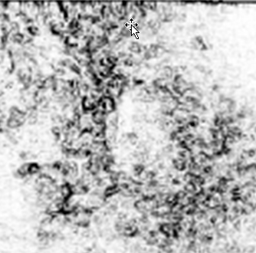
Before footprint suppression
Sobel Attribute
High
Low
t=500 ms
^{N}
^{12,000 ft}
t=600 ms:
San Andres level
(Falconer and Marfurt, 2008)
Notes:
The two attribute slices computed from the seismic amplitude data before footprint suppression. The insert on the left shows the target karsted area. What is karst and what is footprint?

Slide 29
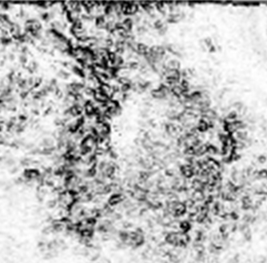
After footprint suppression
Sobel Attribute
High
Low
t=500 ms
^{N}
^{12,000 ft}
t=600 ms:
San Andres level
(Falconer and Marfurt, 2008)
Notes:
The two attribute slices computed from the seismic amplitude data after footprint suppression. The insert on the left appears more geological. While we can not assure that there is no footprint remaining in these images, we are confident that at least the periodic components of noise have been removed.

Slide 30
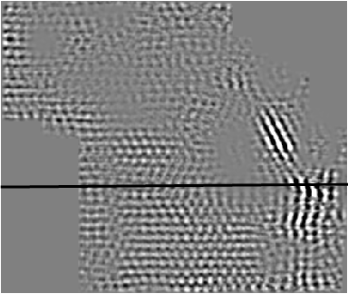
Pitfalls in k_{x}-k_{y} footprint suppression
A
A’
Time slice through “noise” at t = 0.5 s
(Falconer and Marfurt, 2008)
Notes:
A pitfall arises when we have steep dip. In this image, the green arrow indicates signal associated with steep dips going into the Midland Basin.

Slide 31
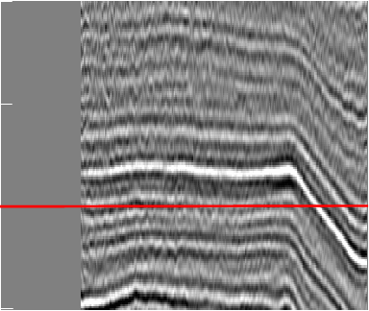
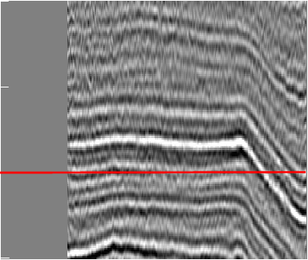
Pitfalls in k_{x}-k_{y} footprint suppression
A
A’
0.3
0.4
Time (s)
A
A’
0.3
0.5
Input data
0.4
0.6
Dipping reflectors
A
Time (s)
A’
0.3
0.5
“Noise”
0.4
0.6
Dipping reflectors
Time (s)
0.5
Filtered data
(Falconer and Marfurt, 2008)
0.6
Notes:
Further inspection shows removal of steeply dipping migration artifacts, but also part of the steeply dipping reflectors. The kx-ky components of the steeply dipping reflectors overlaps with the kx-ky components of the noise and has been removed! Applying such a filter on flattened volumes would be a potential workaround.

Slide 32
Alternative workflow examples: Footprint contamination on structural curvature
Seismic
amplitude
Amplitude
Positive
kx-ky filtering
workflow
Negative
SOF filtering workflow
t=0.8 s
Structure-
Oriented
filtered
volume
(Davogustto, 2011)
Notes:
One can cascade filters. Here, Davogustto has followed kx-ky filtering with structure-oriented filtering.

Slide 33
Alternative workflow examples: Footprint contamination on structural curvature
Seismic
amplitude
Most positive structural
principal curvature
Positive
k_{x}-k_{y} filtering
workflow
0
SOF filtering workflow
Negative
Structure-
Oriented
filtered
volume
t=0.8 s
(Davogustto, 2011)
Notes:
While not perfect, the resulting curvature images now lack much of the east-west and north-south artifacts seen on the original data. The NW-SW trending artifacts (green arrow) are still suspicious.

Slide 34
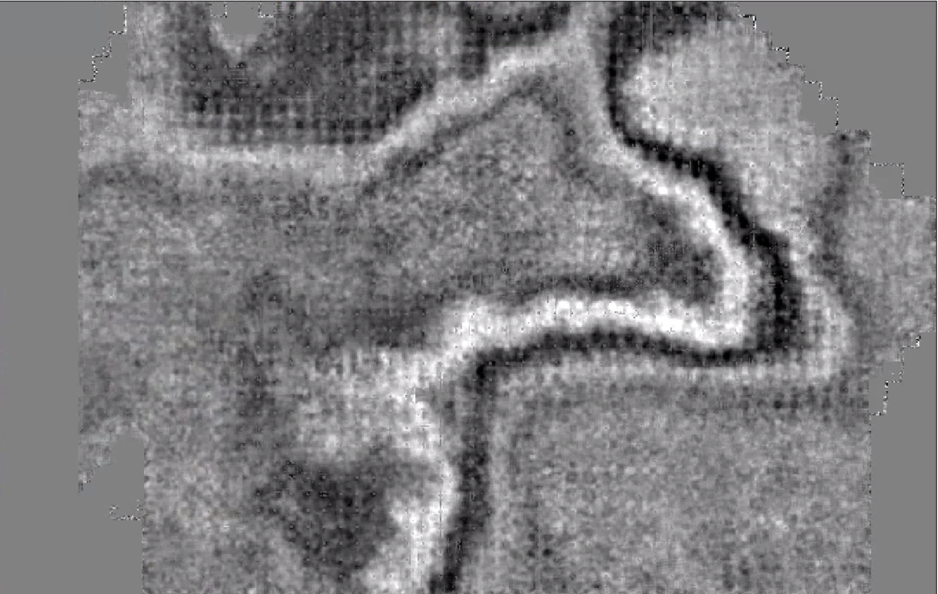
Original Amplitude Slice (t= 0.45 s)
Footprint suppression using k_{x}-k_{y} filters
Amplitude
Positive
2 mi
0
Negative
(Alali et al., 2016)
Notes:
(a) Time slice at t = 0.450 s through a seismic data volume acquired over Vacuum Field, NM, USA in the late 1990s. This part of the Delaware Basin has multiple objectives, with the shallow Yates horizon strongly contaminated by north-south and east-west acquisition footprint. The footprint heals with depth but still contaminates impedance and other attributes necessary for quantitative interpretation. (b) Corresponding time slice through the coherence volume. Coherence exacerbates the footprint, thereby making it a noise characterization tool. (c) Because it has little to do with the reflectivity, footprint varies slowly in the vertical direction, with the major change healing with depth due to an increase in fold and a decrease in sensitivity to velocities. If the lateral variation in the overburden velocity is smooth, the pattern persists but is slowly warped. These patterns allow one to “enhance” the footprint artifacts by applying a ±100 ms median filter to the coherence volume. Seismic data courtesy of Marathon Oil Co.. After Figure 1 of Alali et al. (2016). Used by permission.

Slide 35
Coherence Slice (t= 0.45 s)
Footprint suppression using k_{x}-k_{y} filters
Coherence
1.0
2 mi
0.0
(Alali et al., 2016)

Slide 36
Slice through median-filtered coherence (t= 0.45 s)
Footprint suppression using k_{x}-k_{y} filters
Coherence
1.0
2 mi
0.0
(Alali et al., 2016)

Slide 37
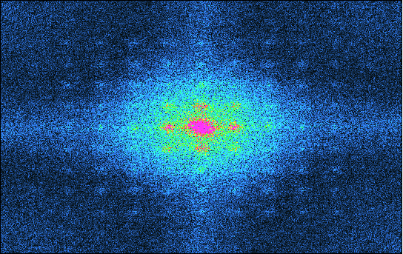
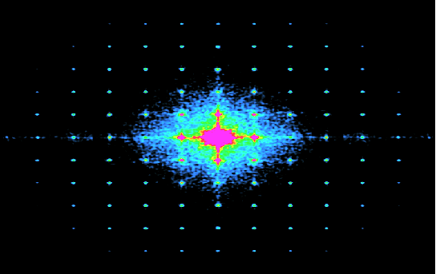
k_{x}-k_{y} transforms
of amplitude slice
of filtered coherence slice
+25
Magnitude
Maximum
0
0
k_{y} (cycles/kft)
-25
-25
0
+25
-25
0
+25
k_{x} (cycles/kft)
k_{x} (cycles/kft)
(Alali et al., 2016)
Notes:
Time slices at t = 0.45 s through the k_{x}-k_{y} transform of (a) the seismic amplitude volume, and (b) the coherence volume after application of a vertical median filter to enhance footprint. Since coherence sharpens edges it exhibits a much stronger response at shorter wavelengths than the amplitude data. Time slices through seismic amplitude exhibit a “sliced onion appearance” which may be periodic. Because coherence is computed along structural dip it does not exhibit this periodicity. A single, planar fault would be represented by a weak line in the k_{x}-k_{y} domain. Periodic footprint anomalies appear as a suite of strong points. The high magnitude blob about k_{x}=0 and k_{y=}0 corresponds to smoothly varying amplitudes in (a) and coherence in (b) associated with flatter reflectors. (c) Application of a Laplacian of a Gaussian filter to coherence results in a sharper k_{x}-k_{y} amenable to construction of a k_{x}-k_{y} pedestal filter. Seismic data courtesy of Marathon Oil Co. After Figure 2 of Alali et al. (2016). Used by permission.

Slide 38
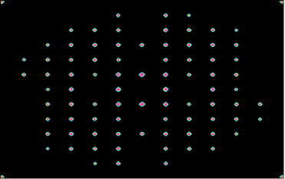
k_{x}-k_{y} transforms
of Laplacian of a Gaussian applied to
filtered coherence slice
of amplitude slice
+25
Magnitude
Maximum
Build a pedestal filter at each location
0
0
k_{y} (cycles/kft)
-25
-25
0
+25
-25
0
+25
k_{x} (cycles/kft)
k_{x} (cycles/kft)
(Alali et al., 2016)

Slide 39
Footprint suppression using k_{x}-k_{y} filters
2 mi
Amplitude
Positive
0
Negative
Rejected Noise (t= 0.45 s)
(Alali et al., 2016)
Notes:
Time slice at t = 0.45 s through (a) the rejected noise obtained using the pedestal filter shown in Figure 15c. (b) Filtered data obtained by adaptably subtracting the data shown in (b) from the original data shown in Figure 14a. (c) An alternative filtering approach based on 2D continuous wavelet transforms in the (x, k_{x}, y, k_{y}) domain. Seismic data courtesy of Marathon Oil Co.. (c) After Figure 10 of Alali et al. (2016). Used by permission.

Slide 40
Footprint suppression using k_{x}-k_{y} filters
Amplitude
Positive
2 mi
0
Negative
Amplitude Slice after Footprint Suppression (t= 0.45 s)
(Alali et al., 2016)

Slide 41
Amplitude Slice after Footprint Suppression (t= 0.45 s)
Footprint suppression using 2D CWTs
2 mi
Amplitude
Positive
2 mi
0
Negative
(Alali et al., 2016)

Slide 42
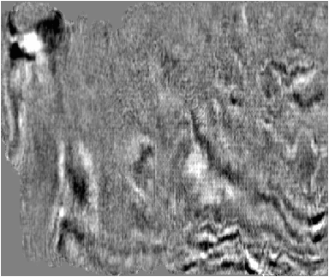
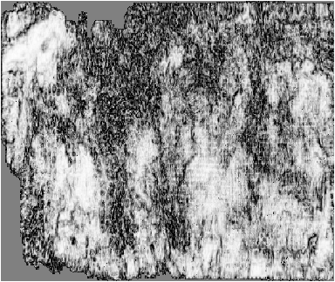
Footprint suppression using 2D CWTs
(Chicontepec Basin)
^{4 km}
N
Before footprint suppression using x-y wavelet transforms
(Cvetkovic et al., 2008)
Notes:
In this example Cvetkovic et al. (2007) applied 2D x-y wavelet transforms to the data. This 2D transform is basically a space-variant kx-ky transform.

Slide 43
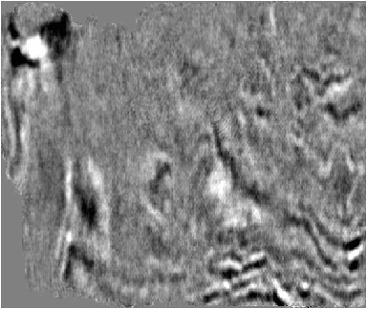
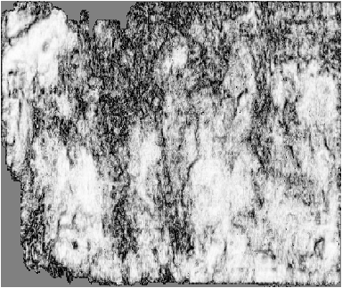
Footprint suppression using 2D CWTs
(Chicontepec Basin)
^{4 km}
N
b)
After footprint suppression
(Cvetkovic et al., 2008)
Notes:
High amplitude noise components were muted and the data reconstruction, resulting in very nice lineament preservation.

Slide 44
Post Migration Poststack Data Conditioning
In Summary:
Periodic acquisition programs often generate periodic acquisition footprint. For reasonably flat overburden, the periodic pattern can be attenuated through k_{x}-k_{y} filtering
The 2D CWT can adapt to footprint that changes pattern due to the velocity overburden or due to different acquisition patterns seen in merged surveys,
Dense acquisition is the best way to avoid acquisition footprint. For wide azimuth land acquisition, increasing the number of traces per km² by a factor of four does not increase the cost of acquisition by four
5D interpolation is a partial solution to footprint prior to impedance inversion; however, edges in the data are often smeared
Notes:
Summary comments on post-migration data conditioning of post-stack data

