Slide 1


Seismic Attributes - from Interactive Interpretation to Machine Learning
Kurt J. Marfurt (The University of Oklahoma)
Prestack Data Conditioning
Notes:
The quality of any seismic inversion is only as good as the data that is provided to it. Common errors include incorrect velocities resulting in residual moveout errors, crossing noise, migration stretch, and multiples.

Slide 2
Prestack Data Conditioning
After this section you should be able to:
  Identify moveout errors and design a workflow to correct them
  Evaluate the use of prestack structure-oriented filter as a means of improving inversion and velocity analysis
  Recognize negative effects of migration operator aliasing
  Use 5D interpolation to minimize acquisition footprint
  Design filters to be applied to migrated gathers that may improve least-squares migrated images
Notes:
Learner objectives for this lecture.

Slide 3
Prestack Data Conditioning Workflows to Preserve Amplitude Fidelity
Correction for residual moveout
    Repicking velocities with a better understanding of the geology
    Accounting for non-hyperbolic moveout
Non-stretch Normal Moveout (NMO)
Prestack structure-oriented filtering
5D interpolation
Least-squares migration
Notes:
Learner objectives for this lecture.

Slide 4
Residual velocity analysis
Migrated gathers
Migration velocities
Migrated gathers
Inverse NMO
Trim statics
Uncorrected gathers
Velocity scan
Improved data
Semblance panels
(nonstretch) NMO
Repick velocities
Stack
Improved data
(Marfurt, 2018)
Notes:
In general, the processing center uses state-of-the art software, often including tomography, to pick velocities that provide the sharpest, most coherent seismic image in the time allotted. (a) Interpreters often apply trim statics to migrated gathers prior to prestack impedance inversion, where the improved alignment also improves the vertical resolution of the stacked data. (b) Some interpreters and most oil company technology groups also have the ability to perform conventional semblance-based velocity spectra. In addition they have access to sensitive well control that allows them to evaluate alternative hypotheses as to which event is a primary reflector and which may be an interbed multiple. Although time consuming, such interpreter-driven velocity analysis can provide significant improvements in data fidelity and seismic resolution in the target zone of interest. (After Marfurt, 2018).

Slide 5
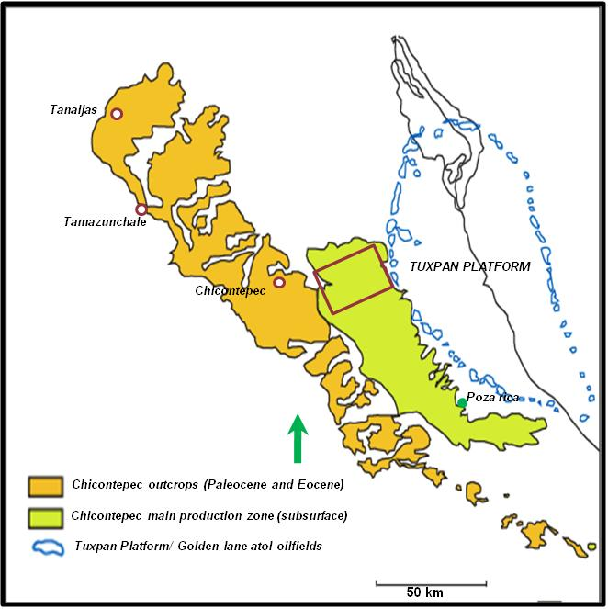
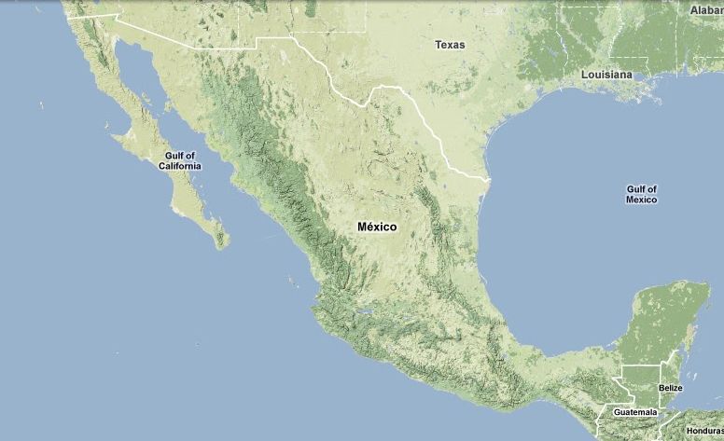
Chicontepec Basin, Mexico
Sierra Madre Oriental
Paleocene and Eocene Chicontepec outcrops
Chicontepec subsurface production area
Tuxpan platform/ Golden lane atoll oilfields
Visited outcrops
5
Notes:
Location of the Chicontepec Basin, Mexico. Traditionally, the target has been tight sandstones in the Chicontepec formation, requiring hydraulic fracturing. At present, the deeper Pimienta source rock is being evaluated as an unconventional resource play.

Slide 6
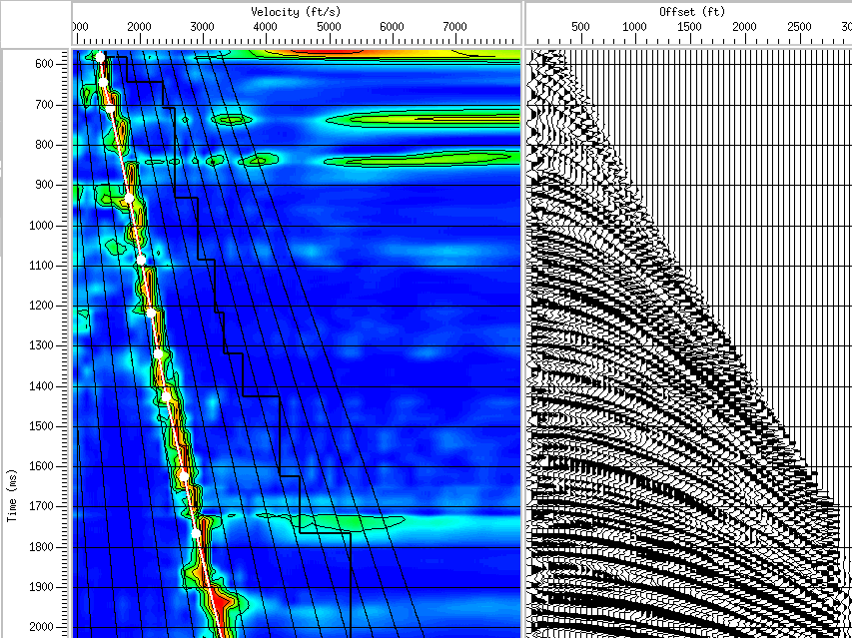
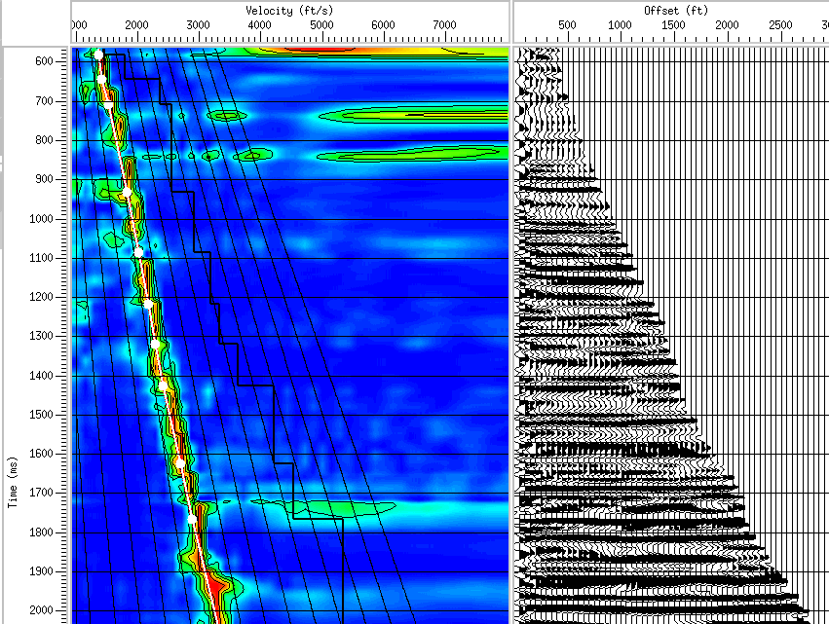
Using Conditioned Gathers to Fine Tune Stacking Velocities
Velocity (m/s)
Offset (m)
Offset (m)
1000
2000
3000
4000
5000
6000
500
1000
1500
2000
2500
3000
500
1000
1500
2000
2500
3000
600
1000
Time(ms)
1500
2000
Velocity analysis of migrated gather after reverse NMO
Gather after reverse NMO
Gather corrected with new velocity
(Sarkar et al., 2011)
Notes:
The data were originally migrated using 3D Kirchhoff prestack time migration resulting in gathers consisting of 60 traces with an offset interval of 50 m. The migrated data were then subjected to inverse NMO, and the velocity analysis repeated, providing a residual velocity analysis. (After Sarkar et al., 2011).

Slide 7
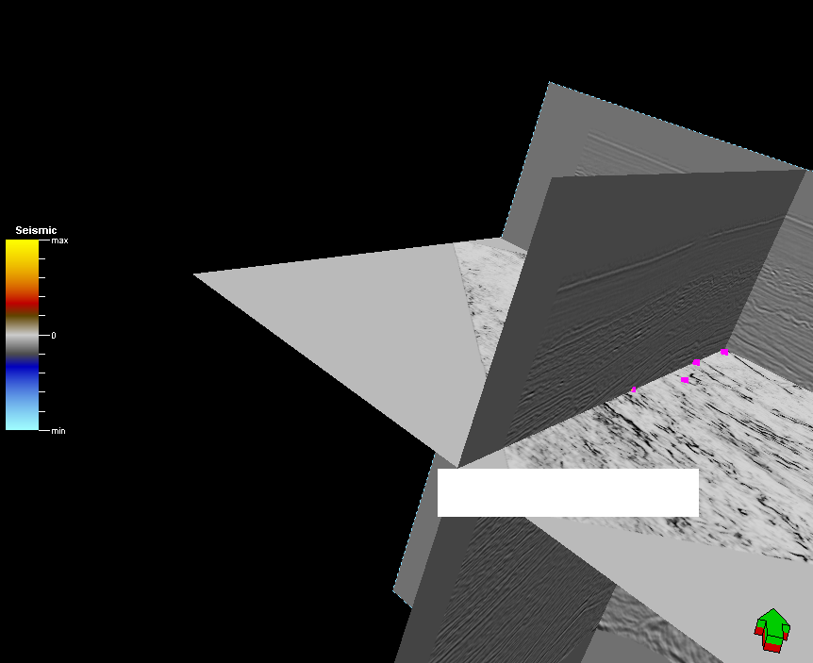
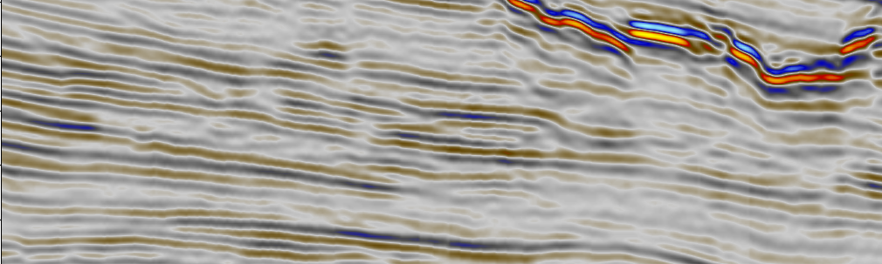
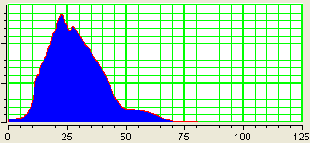
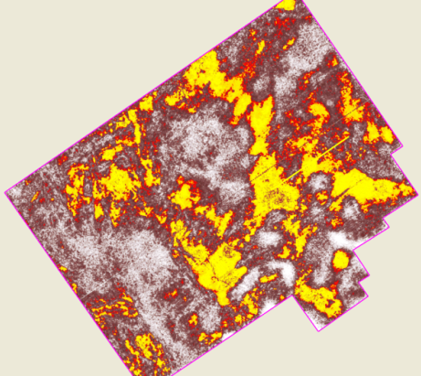
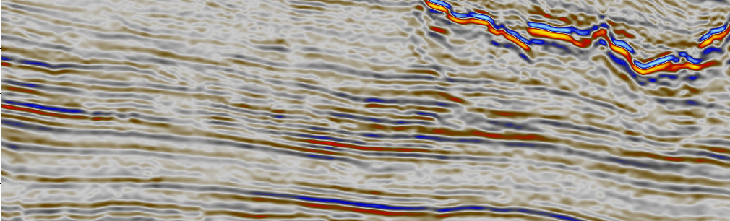
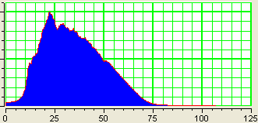
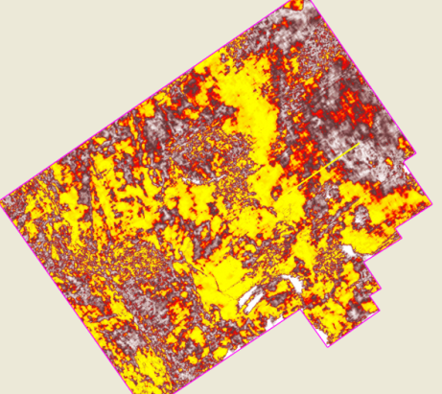
Velocity analysis on previously migrated data gathers
Negative
Energy
1.1
Sill
High
A
A’
1.2
A’
Time (s)
0
1.3
A
1.4
2 km
1.5
Positive
5 km
Amplitude
0
25
50
75
Low
f (Hz)
1.1
A
Sill
A’
1.2
Time (s)
A’
1.3
1.4
A
1.5
2 km
5 km
0
25
50
75
f (Hz)
(Sarkar et al., 2011)
Notes:
One of several maximum flooding surfaces within the Chicontepec formation (yellow pick) that formed continuous horizons across the survey. Vertical slices through the data (a) after original processing and (d) after prestack SOF-filtering and a post migration velocity analysis data conditioning. Note the improvement in spectral content seen in (b) the original data after (e) data conditioning. Multiple volcanic sills generated interbed multiples that were stronger than the underlying sedimentary reflectors and were inadvertently picked in the processing shop. Well control coupled with a sequence stratigraphic model provided the additional information needed to avoid this velocity analysis pitfall. These improvements provide a more focused image of the higher energy turbidites seen on horizon slices through (c) the original data and (f) the precondition data. After Figure 10 of Sarkar et al. (2016). Used by permission.

Slide 8
Prestack Data Conditioning Workflows to Preserve Amplitude Fidelity
Correction for residual moveout
    Repicking velocities with a better understanding of the geology
    Accounting for non-hyperbolic moveout
Non-stretch Normal Moveout (NMO)
Prestack structure-oriented filtering
5D interpolation
Least-squares migration
Notes:
Learner objectives for this lecture.

Slide 9


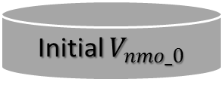

Example of a high resolution velocity analysis workflow
Seismic gathers
Horizons
Initial $V_{nmo_0}$
Calculate the interval velocity $v_{nmo_0}$ from $V_{nmo_0}$
Compute discontinuity attribute
Generate a suite of initial target models
m($v_{nmo}$, $η_{int}$ )
Mutation and crossover to get a set of new trial
interval velocity and anellipticity models.
Compare the stacking power of trial and target models,
Better models survive to next generation
No
Flat events?
Yes
Flattened gathers
New $v_{nmo}$
New $η_{int}$
(Zhang et al., 2014)
Notes:
Flowchart showing the automated nonhyperbolic velocity analysis. The model is consisted of interval NMO velocity and anellipticity, the objective is to search a model that gives the maximum stacking power. The researching algorithm is a direct, global optimization strategy called differential evolution.

Slide 10
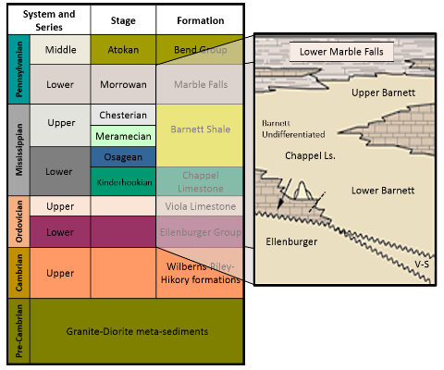
Stratigraphic column of Fort Worth Basin, TX
(Silva, 2013)
Notes:
Simplified stratigraphic column of the Fort Worth Basin in Wise County (Silva, 2013). The Barnett Shale lies between two prominent limestone and it lies directly on the Viola Limestone in our testing survey.

Slide 11
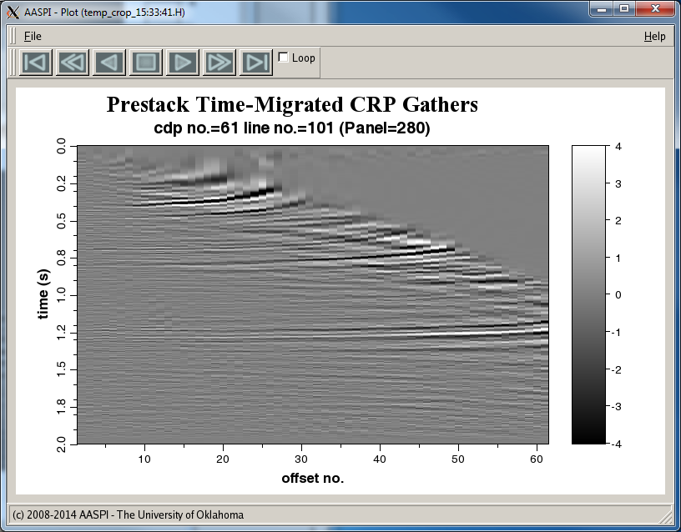
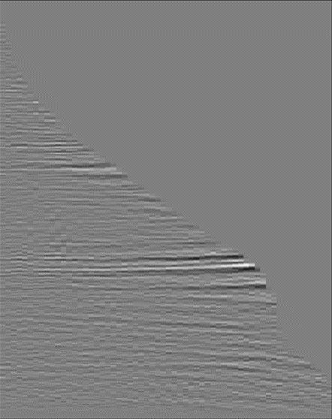
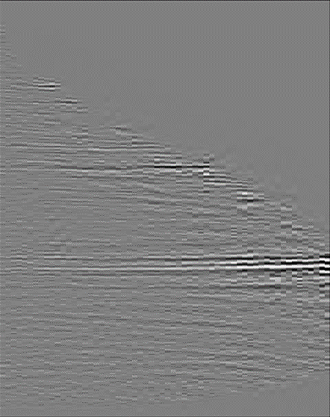
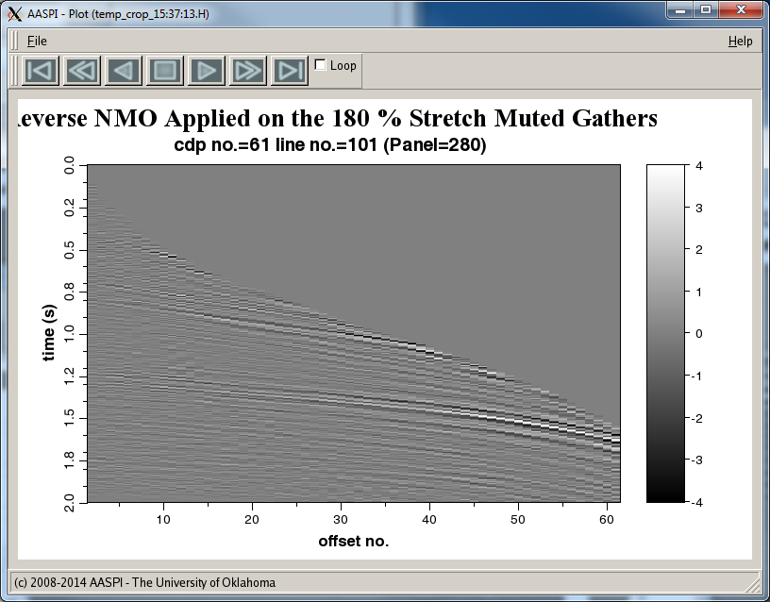
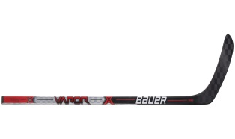


Anisotropy and nonstretch non-hyperbolic moveout
Offset - x(ft)
Offset - x(ft)
Offset - x(ft)
0
6900
13800
0
6900
13800
0
6900
13800
0.0
0.0
0.0
4
2
0.5
0.5
0.5
0
-2
t₀ (s)
t₀ (s)
t₀ (s)
1.0
1.0
1.0
-4
1.5
1.5
1.5
2.0
2.0
2.0
Migrated gather
Muted gather
Non-hyperbolic moveout and nonstretch NMO
(Zhang et al., 2014)
Notes:
(a) A representative isotropic prestack time-migrated gather over a Barnett Shale play. Target depth is at t=1.2 s. Vertical transverse isotropy gives rise to hockey stick move at the far offset. velocities increase with the angle of incidence. (b) The most common way of dealing with anisotropy is to simply mute the farthest offsets. (c) By correcting the input data for anisotropy and using a non-hyperbolic non-stretch NMO correction, one can preserve both the information content and the resolution of the farther offset traces. (After Zhang et al., 2014).

Slide 12
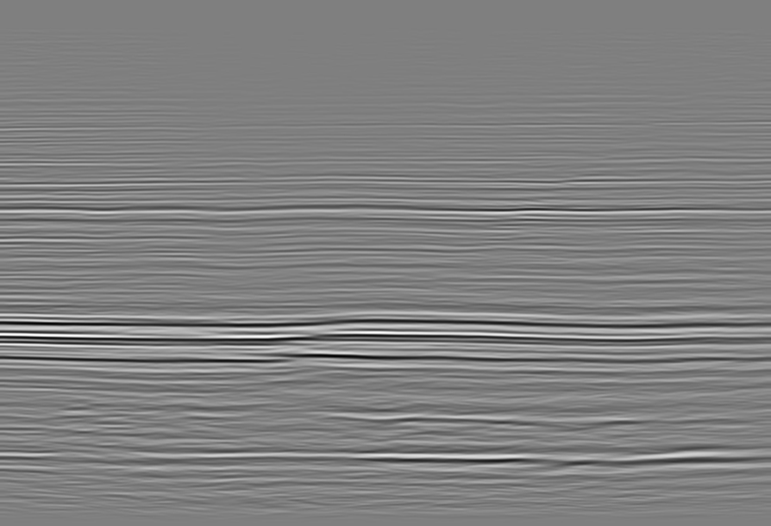
Stack of the muted prestack migrated gathers
CDP Number
1
30
60
90
120
Amplitude
0.0
70
35
0.5
0
-35
t₀ (s)
1.0
-70
1.5
2.0
(Zhang et al., 2014)

Slide 13
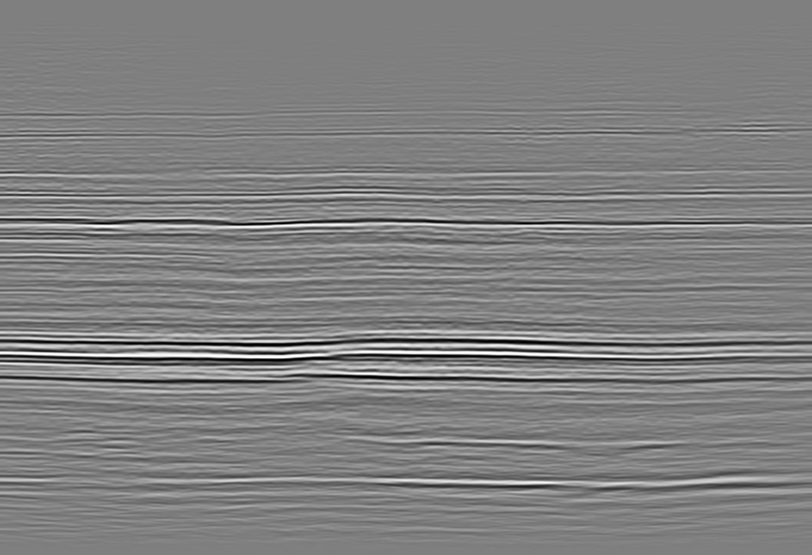
Stack using high resolution velocity analysis and non-stretch NMO
CDP Number
1
30
60
90
120
Amplitude
0.0
70
35
0.5
0
-35
t₀ (s)
1.0
-70
1.5
2.0
(Zhang et al., 2014)
Notes:
Stacked sections after (a) conventional migrated gathers with 130% muting criteria and (b) the same gathers after nonhyperbolic moveout corrects and nonstretch NMO correction. The target Barnett Shale lies between t=1.1s and t=1.3s. Note the improved stacking power indicated by red arrows and time resolution indicated by yellow arrow. (After Zhang et al., 2014).

Slide 14

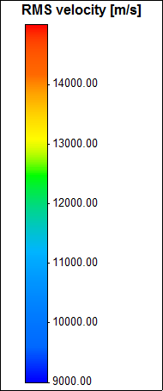
Conventional velocity analysis of migrated gathers (20 x 20 grid)
CDP Number
1
30
60
90
120
0.0
ft/s
0.5
15000
t₀ (s)
12000
1.0
9000
1.5
2.0
(Zhang et al., 2014)
Notes:
Velocity analysis results performed on the coarse grid (20x20) super gathers. (a) Stacking velocity from hyperbolic velocity analysis on the offset truncated gathers

Slide 15
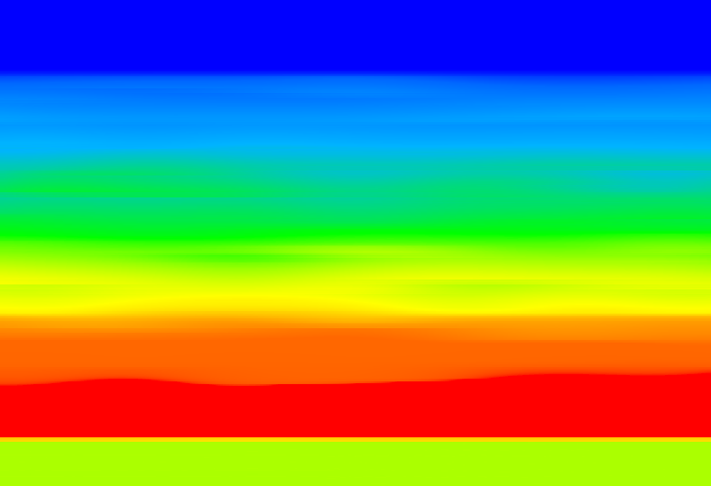
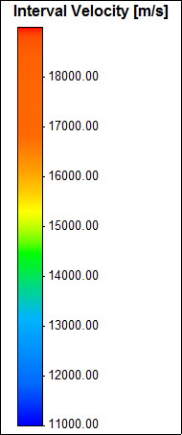
Corresponding interval velocity
CDP Number
1
30
60
90
120
0.0
ft/s
0.5
19000
t₀ (s)
15000
1.0
11000
1.5
2.0
(Zhang et al., 2014)
Notes:
interval velocity converted from stacking velocity. The interval velocity is used for generating the initial target interval velocity and the initial interval anellipticity is set 0.

Slide 16
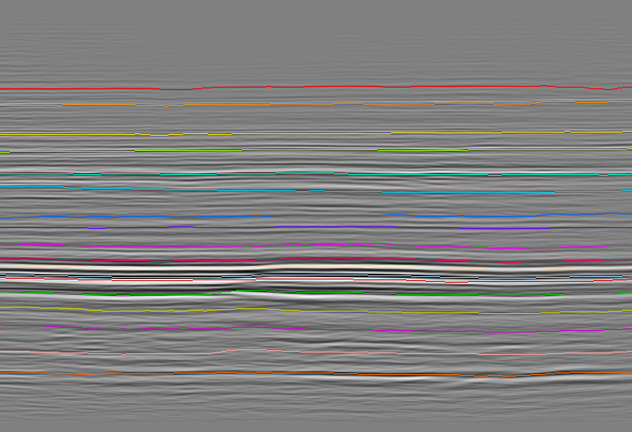
Detailed interpretation to construct a background model (18 horizons)
CDP Number
1
30
60
90
120
0.0
0.5
70
35
t₀ (s)
0
1.0
-35
-70
1.5
2.0
(Zhang et al., 2014)
Notes:
Horizons used for parameterizing the model. There are 18 horizons in our testing, and we interpret those horizons on the stacked section that just use the near offset data (Figure 4) in the time migrated gathers.

Slide 17
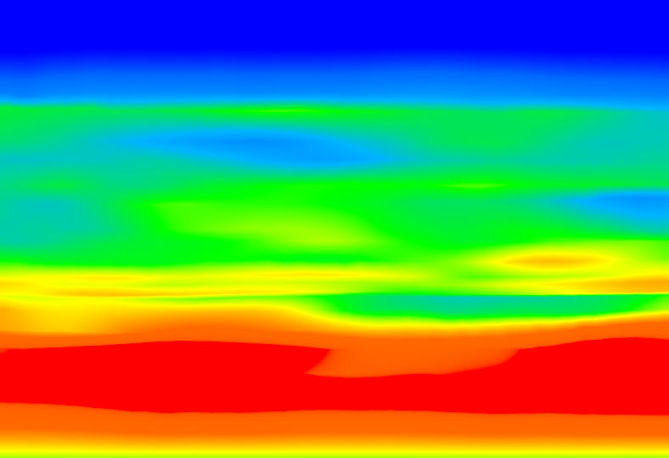
Resulting high resolution interval velocity model
CDP Number
1
30
60
90
120
0.0
ft/s
0.5
19000
t₀ (s)
15000
1.0
11000
1.5
2.0
(Zhang et al., 2014)
Notes:
Optimized model results using the workflow shown in Figure 1. During the optimization procedure, we first update interval NMO velocity (a) $v_{nmo}$ and (b) $η_{int}$, . Note optimal interval velocity has higher resolution compared to that of initial interval velocity.

Slide 18
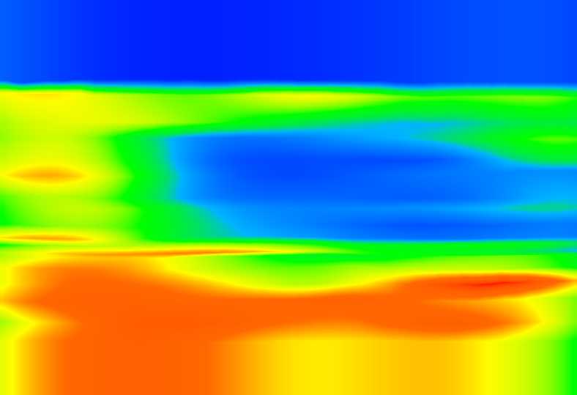
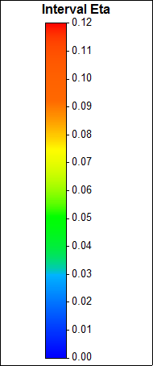

Resulting high resolution interval anellipticity $η_{int}$ model
CDP Number
1
30
60
90
120
0.0
0.5
0.12
t₀ (s)
0.08
1.0
0.04
0.0
1.5
2.0
(Zhang et al., 2014)
Notes:
Optimized model results using the workflow shown in Figure 1. During the optimization procedure, we first update interval NMO velocity (a) $v_{nmo}$ and (b) $η_{int}$,

Slide 19

Resulting stacking velocity model
CDP Number
1
30
60
90
120
0.0
ft/s
0.5
15000
t₀ (s)
12000
1.0
9000
1.5
2.0
(Zhang et al., 2014)
Notes:
Stacking velocity from high resolution velocity analysis.

Slide 20
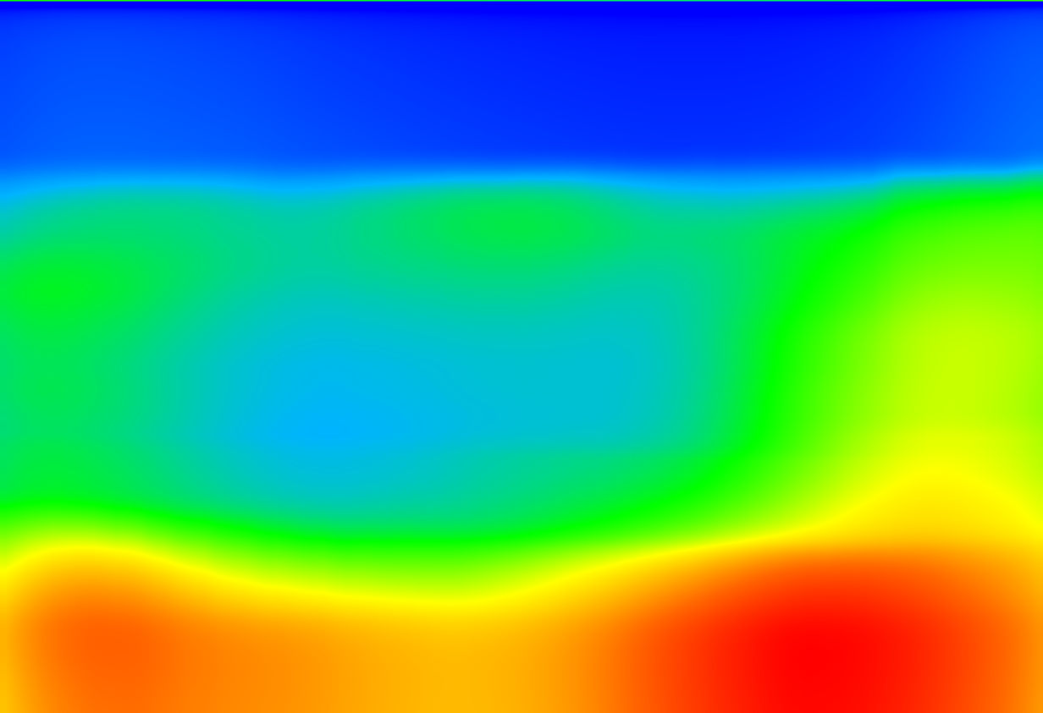

Resulting stacking anellipticity $η_{int}$ model
CDP Number
1
30
60
90
120
0.0
0.5
0.12
0.08
t₀ (s)
1.0
0.04
0.0
1.5
2.0
(Zhang et al., 2014)
Notes:
Stacking anellipticity from high resolution velocity analysis.

Slide 21
Prestack Data Conditioning Workflows to Preserve Amplitude Fidelity
Correction for residual moveout
    Repicking velocities with a better understanding of the geology
    Accounting for non-hyperbolic moveout
Non-stretch Normal Moveout (NMO)
Prestack structure-oriented filtering
5D interpolation
Least-squares migration
Notes:
Learner objectives for this lecture.

Slide 22
Non-stretch NMO workflow
d(t, h)
V(t₀, h)
Pre-compute analytic seismic wavelet library, w(f)
j=0
Set residual and moveout results as:
Generate analytic seismic trace of residual data, calculate the instantaneous envelope, e(t) and instantaneous frequency, f(t)
Pick the K strongest envelopes and least-squares fit to obtain the amplitude, a_{j}(t_{k}) and phase φ_{j}(t_{k}) of the analytic wavelet, w[f(t_{k}), φ_{j}(t_{k})]
Compute t₀(t, h)from travel time, t , and offset, h, and velocity, V
Update:
Residual energy < threshold value?
Yes
No
j=j+1
Output
Notes:
A non-stretch NMO procedure using a matching pursuit algorithm. In this model, the wavelet is considered to carry information about the travel time and amplitude of the reflection coefficient spikes. The envelope of the source wavelet is assumed to be centered around these spikes. Thus, one first computes the envelopes and their times on the uncorrected data. These time of the reflections spikes are then corrected, and the wavelets moved as a whole, without stretching, along with it.
The process begins with the strongest wavelets, leaving a residual. At the next iteration, one moves the strongest wavelet on the residual, continuing until the some user-defined percentage of the energy (e.g. 99.9%) has been corrected.

Slide 23
Conventional vs. non-stretch NMO
Time-migrated gather after inverse NMO
(Zhang et al., 2011)
Notes:
A time-migrated gather after application of reverse moveout.

Slide 24
Conventional vs. non-stretch NMO
Conventional NMO-corrected gather
(Zhang et al., 2011)
Notes:
The NMO-corrected gather. The larger offsets exceed 50% stretch and have been muted.

Slide 25
Conventional vs. non-stretch NMO
Nonstretch NMO-corrected gather
(Zhang et al., 2011)
Notes:
The nonstretch NMO gather. Note that the larger offsets no longer need to be muted.

Slide 26
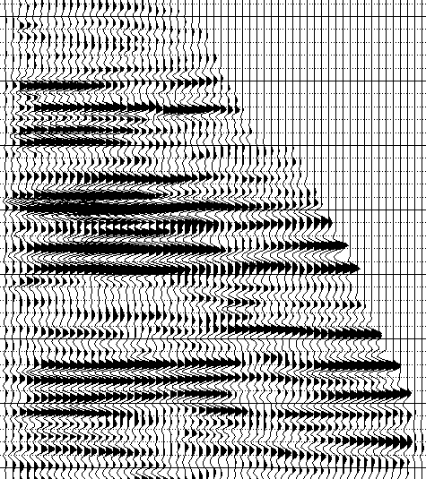
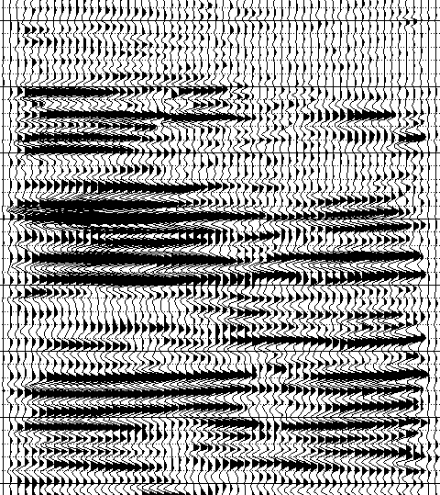
Residual moveout and nonstretch NMO
Offset (km)
Offset (km)
0
1
2
3
0
1
2
3
1.0
Stretch mute
1.2
Time (s)
1.4
1.6
(Mutlu and Marfurt, 2015)
Notes:
(a) Original migrated data with a 30% stretch mute. (b) The same gather after RNMO followed by MPNMO showing the increase in far-offset information. (After Mutlu and Marfurt, 2015).

Slide 27
Effect of residual moveout and nonstretch NMO
(Mutlu and Marfurt, 2015)
Notes:
Frequency spectrum of the stacked original “final product” prestack time-migrated data (in blue) and after detailed velocity analysis and an MPNMO correction (in orange). The overlap area appears as purple. No postmigration spectral balancing has been applied to either volume such that the differences are due to better event alignment and reduction of migration stretch.

Slide 28
Prestack Data Conditioning Workflows to Preserve Amplitude Fidelity
Correction for residual moveout
    Repicking velocities with a better understanding of the geology
    Accounting for non-hyperbolic moveout
Non-stretch Normal Moveout (NMO)
Prestack structure-oriented filtering
5D interpolation
Least-squares migration
Notes:
Learner objectives for this lecture.

Slide 29
Prestack Structural Oriented Filtering Workflow
Start
Original or filtered amplitude gathers
Stacked amplitude
Stack
Dip estimation
Crossline dip
Inline dip
Compute coherence
Prestack SOF
Coherence
Filtered amplitude data
Iterate?
yes
no
Stop
Notes:
The prestack structure-oriented filtering workflow. The algorithm is similar to poststack SOF. However, instead of filtering 9 adjacent traces, one might filter 9 adjacent traces from 3 adjacent offsets, or 27 traces at a time. The algorithm can also work on azimuthally limited migrated gathers.

Slide 30
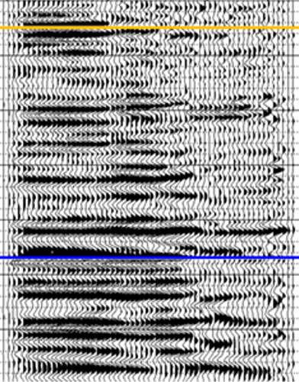
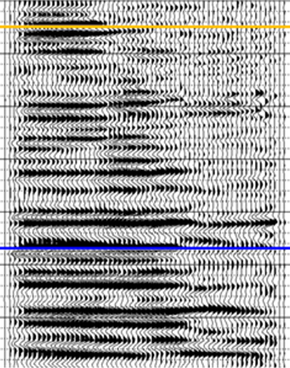
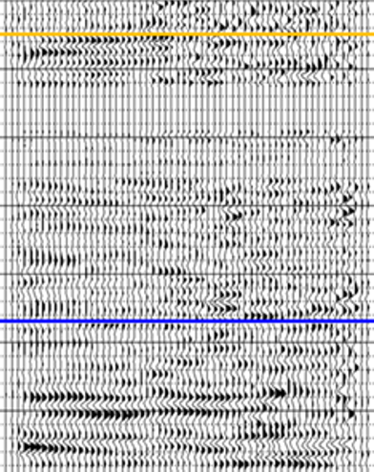
Prestack structure-oriented filtering
Offset (km)
Offset (km)
Offset (km)
0
1
2
3
0
1
2
3
0
1
2
3
1.0
1.2
Time (s)
1.4
1.6
(Mutlu and Marfurt, 2015)
Notes:
Migrated common reflection point gathers (a) before, and (b) after edge-preserving prestack structure-oriented filtering. (c) The rejected noise plotted at the same scale. The Chicontepec reservoir falls between the orange and blue picks. Note the improve signal-to-noise ratio after prestack SOF. (After Mutlu and Marfurt, 2015)

Slide 31
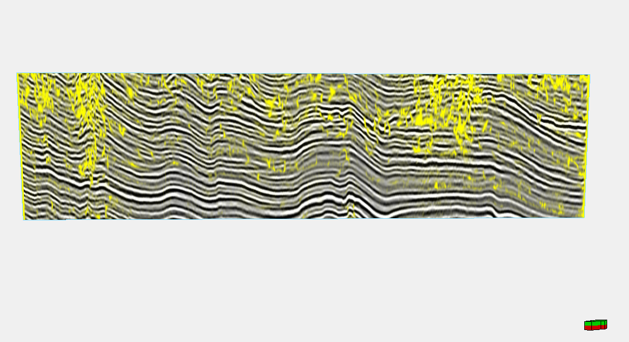
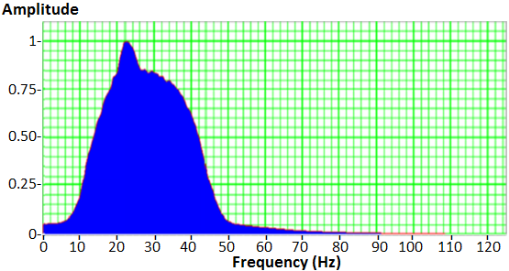
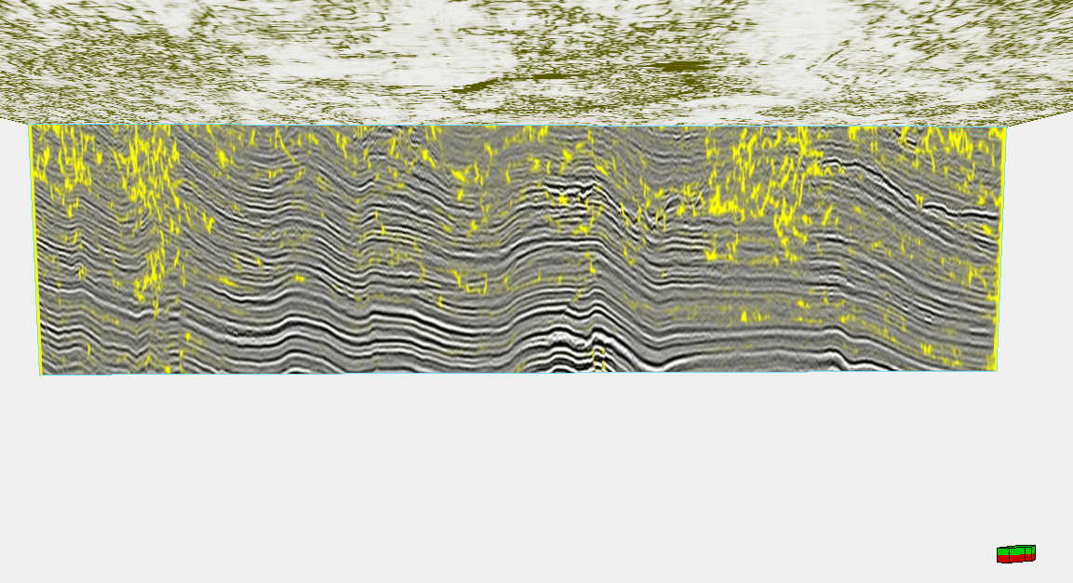
Improvements due to residual velocity analysis, prestack SOF, and non-stretch NMO
B
B’
Amp
1.0
0.8
Before
Positive
Before
Magnitude
0
0.5
After
1.2
Time (s)
Negative
0
0
50
100
Frequency (Hz)
1.4
Coh
0.8
1
After
1.2
Time (s)
0.7
0
Opacity
1
1.4
(Mutlu and Marfurt, 2015)
Notes:
A seismic line through (a) the original prestack time-migrated data volume, and (b) after improved velocity analysis and nonstretch NMO. (c) Vertical resolution is improved and faults are better imaged. (After Mutlu and Marfurt, 2015).

Slide 32
Improvement resolution of S impedance
(Mutlu and Marfurt, 2015)
Notes:
A representative line through the (a) P-impedance and (b) S-impedance volumes computed from the conditioned data volume. The Chicontepec sandstones appear as high-impedance, purple lenses within the lower impedance shales. Note the excellent shear impedance well tie. Because of the rock properties, the S-impedance provides better discrimination between sands and shales than

Slide 33
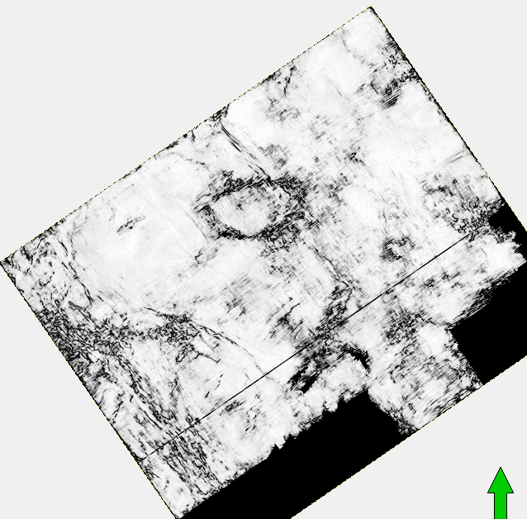
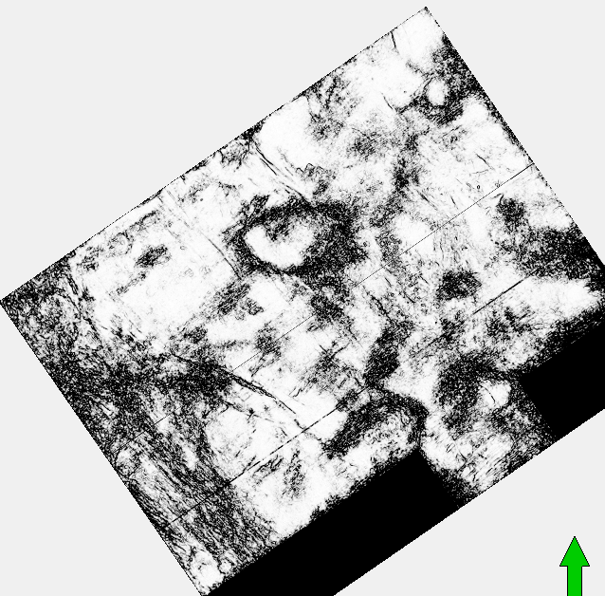
Improvements due to residual velocity analysis, prestack SOF, and non-stretch NMO
Coh
Before
After
1.0
B’
B’
B
B
0.7
N
N
(Mutlu and Marfurt, 2015)
Notes:
Coherence slices computed from (Left) the original data and (Right) preconditioned data. Counterintuitively, improved lateral resolution and reduced smearing results in a less coherent image, delineating more edges.

Slide 34
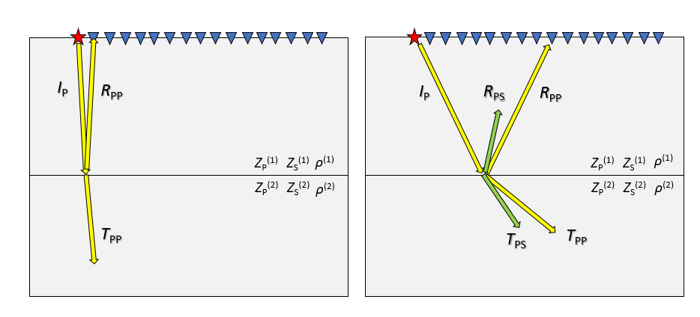
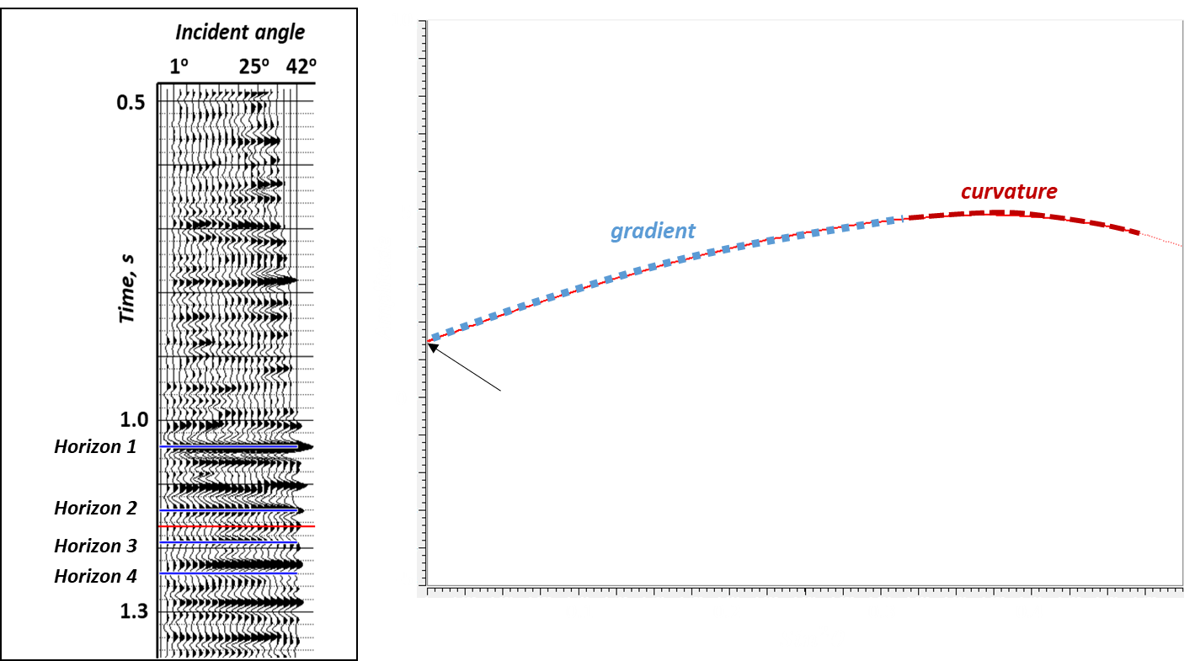
Review of P-wave measurements
R_{PP}
R_{PP}
intercept
(Patel and Marfurt, 2020)
Notes:
For a flat-layered geology and vertical incidence almost 100% of the near-offset reflected energy consists of PP reflections. At farther offset, the P wave energy is converted to PP and PS reflections and transmissions which leads to the PP reflection at far offset sensitive to both Z_{S} and ρ. Unless we acquire multicomponent data, we do not directly measure the PS reflection events. Rather, it is the sensitivity of the PP reflection events to incident angle that allows us to invert for Z_{S} and ρ, . The three-term approximation of the Zoeppritz’s equations developed by Aki and Richards (1980) show that Z_{P}, Z_{S} and ρ can be estimated from the coefficients (intercept, gradient and curvature) of the three-term approximation equations which are calculated from ‘PP’ reflected waves as a function of incident angles (Figure 6). The intercept is the zero-angle reflection coefficient (Figure 5b1a) which is related to the acoustic impedance contrast across the reflector. The gradient is related to both the shear and acoustic impedance contrast across the interface. The third coefficient (curvature) which measures the curvature of the amplitude near the critical angle is greatly influenced by the density contrast across the interface. Because the offset is small, the recorded seismic wavefield does not suffer from migration stretch. At farther offsets (Figure 5b1b), the PP reflected event now suffers from migration stretch. Since the farther offset are sensitive to Z_{S} and ρ, the lower resolution of Z_{S} and ρ compared to that of Z_{P} is attributed to migration stretch and not to attenuation.

Slide 35
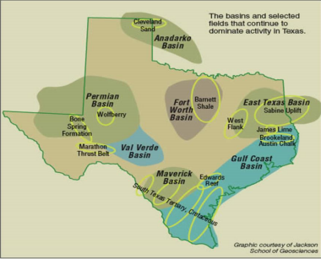
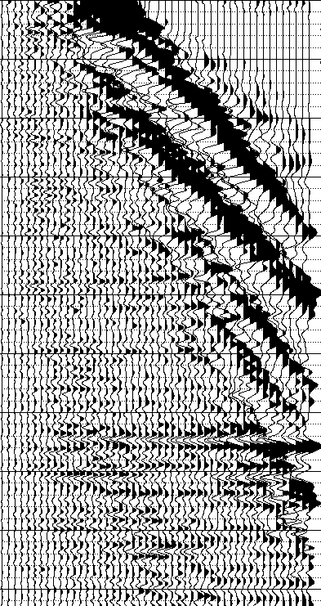
The Fort Worth Basin, TX
Offset, ft
2420
6820
10340
X.5
Time, s
X.0
Event A
Event B
X.5
(Patel and Marfurt, 2020)
Notes:
We have a methodology to compensate for migration stretch using data located in the fortworth basin. The red start shows approximate location of the data. To elaborate the concept of migration stretch, I have shown two events. The red line shows the location of the reflector in time before pre-stack time migration. After the migration, we try to relocate all the offset data to zero offset causing stretching of the wavelet which is proportional to distant from zero offset. Hence, farther the offset, more the stretching. And this causes decrease in resolution of S-impedance and density.

Slide 36
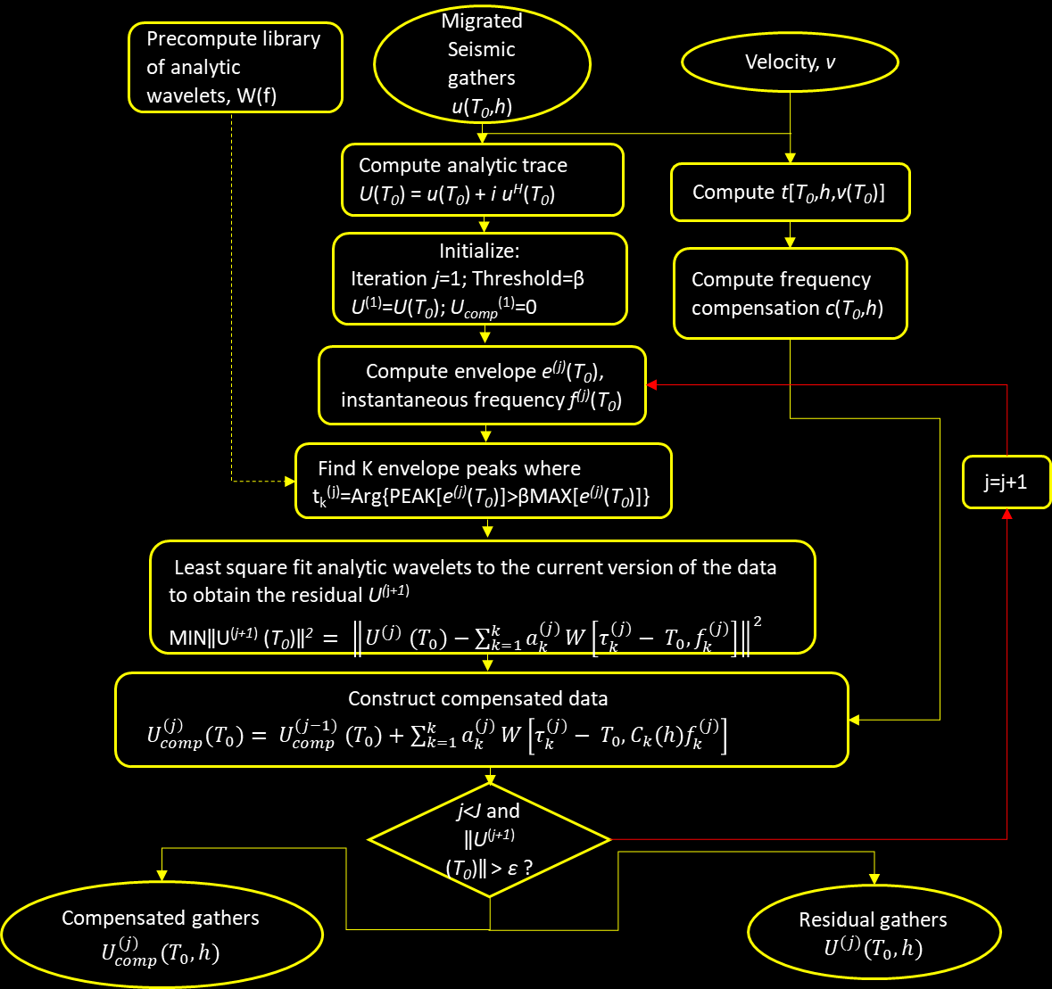
Computation flow chart
Acknowledgement
(Patel and Marfurt, 2020)
Notes:
We show a algorithm flow chart explaining the steps involved computation. The input to the algorithm is unmuted prestack time migrated gather and RMS or migration velocity volume of equal size. and the outcome is Optional output files include the residual gathers, the correction factor, and the wavelet dictionary used in the matching pursuit algorithm. The algorithm computes reverse NMO internally. We compensate for migration stretch by computing a wavelet compression factor, c, by mapping wavelet at any particular offset of reflector with zero offset wavelet of that reflector which can then be used to scale the wavelets to generate the compensated trace. We use a matching pursuit algorithm to estimate the location of the reflection’s spikes, fit wavelets to the data and then compensate for migration stretch.

Slide 37
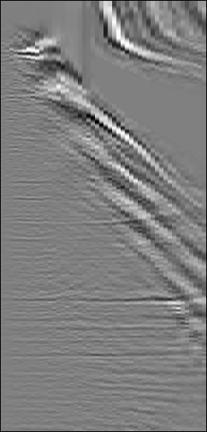
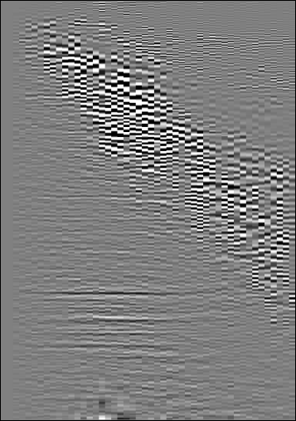
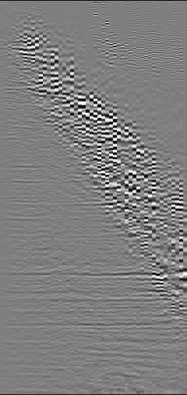
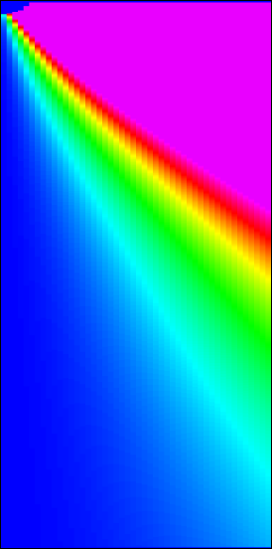
The result of stretch compensation algorithm
Original gather after PSTM
Stretch compensated gather
Compensation factor
Offset, ft
Offset, ft
Offset, ft
2420
6820
10340
2420
6820
10340
2420
6820
10340
X.5
X.5
X.5
Time, s
Time, s
Amplitude
Time, s
150
200%
X.0
X.0
X.0
-150
0%
X.5
X.5
X.5
(Patel and Marfurt, 2020)
Notes:
We show the original gather on the left hand side, migration stretch compensated gather in the middle and compensation factor on the rightmost side. One can see improvement on the far offset data after the migration stretch. The compensation factor increase with offset and decreases with depth. For the near offset data, the compensation is zero which should be.

Slide 38
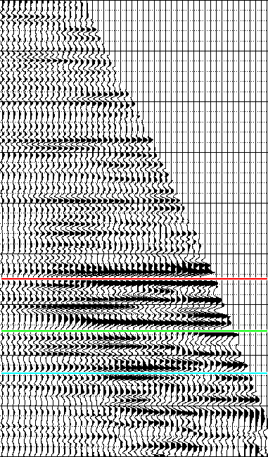
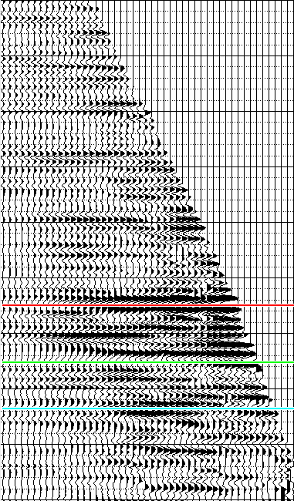
Data after conditioning
Original
After stretch correction
Offset, ft
Offset, ft
1540
6820
10340
1540
6820
10340
X.5
X.5
Time, s
Time, s
X.0
X.0
Horizon 1
Horizon 2
Horizon 3
(Patel and Marfurt, 2020)
X.4
X.4
Notes:
The same data shown in the previous slide but after data conditioning. We applied muting, radon transform and trim statics. One can see improvement in the far offset data. A zoom in view of the yellow box is shown in the next slide.

Slide 39
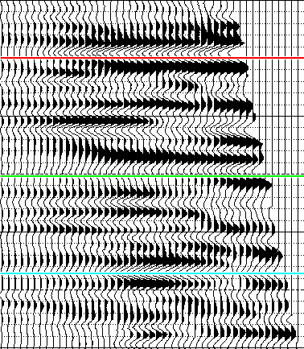

Effect of stretch compensation on AVO
Original
After stretch correction
Offset, ft
Offset, ft
1540
6820
10340
1540
6820
10340
X.0
Horizon 1
Time, s
Horizon 2
Horizon 3
X.3
(Patel and Marfurt, 2020)
Notes:
Other than increase in resolution of far offset data, we also see change in Amplitude signature at far offset. The phase reversal shown by the arrows is actually due to stretching. This can lead to misinterpretation of AVO. A quantitative change in AVO is shown in next slide.

Slide 40

Stretch compensation causing changes to AVO
Original gather
Stretch compensated
X.9
Horizon 1
Horizon 1
X.1
Horizon 2
Horizon 2
Horizon 3
Horizon 3
X.29
(Patel and Marfurt, 2020)
Notes:
The reflectors which gradually disappear at far offset due to interference of over- and under-lying reflectors caused by stretching appear stronger after the compensation shown by red and blue line. In the original gather, it appears that phase reversal occurs at farther offset. In reality, after compensation we can observe that there is no phase reversal. The phase reversal signature is because of the interference of the top and bottom negative reflector encompassing the positive amplitude reflector.

Slide 41



Effect of stretch compensation on the amplitude spectrum
Near Angle stack 0º-20º
Mid Angle stack 21º-33º
Far Angle stack 34º-42º
(Patel and Marfurt, 2020)
Notes:
In this slide we show the amplitude spectrum of near, mid and far angle stack data. We can see that after the compensation we observe a boost in the higher frequency at the farther angles leading increase in the resolution of the far angle stack data. The compensation has insignificant effect on the near angle data.

Slide 42



Effect of stretch compensation on P-impedance Z_{P}
X.9
Horizon 1
Horizon 1
X.1
Horizon 2
Horizon 2
Time (s)
Horizon 3
Horizon 3
X.3
Well
Well
X.9
Difference
Z_{P}
(ft/s* g/cm³)
(ft/s* g/cm³)
Horizon 1
3500
52500
X.1
Horizon 2
Time (s)
Horizon 3
X.3
Well
-3500
14000
(Patel and Marfurt, 2020)
1.33 miles
Notes:
We performed prestack simultaneous inversion on original gather and compensated gather so see any change in resolution. The maximum usable incident angle of 42º at the Barnett Shale target allowed us to estimate ρ from inversion. Angles beyond 42° were contaminated by strong linear noise from the shallow section; they also fall beyond the critical angle and are not useful for inversion. A good match between the Z_{P}^{log} and Z_{P}^{seismic} confirms the fidelity of the inversion. The difference between Z_{P}^{original} and Z_{p}^{compensated} highlights the area of significant change. Maximum change in Z_{P} occurs near the fast rocks (limestone and basement). During prestack inversion Z_{P} is not independently estimated from zero offset traces, rather it is calculated from the coefficients of the three-term linear approximation equation. Stretch compensation causes change in the values of those coefficients by changing the AVO response. Such a change in AVO response exemplifies when there is significant change in velocity across reflectors. Hence, we observe maximum change in Z_{P} near the fast rocks.

Slide 43



Effect of stretch compensation on shear impedance Z_{S}
X.9
Horizon 1
Horizon 1
X.1
Horizon 2
Horizon 2
Time (s)
Horizon 3
Horizon 3
X.3
Well
Well
0.9
Difference
Z_{s}
(ft/s* g/cm³)
(ft/s* g/cm³)
1.0
Horizon 1
2300
30000
1.1
Horizon 2
Time (s)
1.2
Horizon 3
1.3
Well
-2300
9000
1.4
(Patel and Marfurt, 2020)
1.33 miles
Notes:
shows Z_{S} from prestack simultaneous inversion for original and compensated gather. The black arrows highlight the areas of maximum change. These changes can be attributed to both a change in the AVO response and an increase in resolution. The grey arrows indicate areas where an increase in resolution is observed. A significant increase in resolution is obtained in the shallower zone than the deeper. This is because wavelet compensation factor applied in the methodology decreases with depth and increases with angle of incidence.

Slide 44



Effect of stretch compensation on density ρ
X.9
Horizon 1
Horizon 1
X.1
Horizon 2
Horizon 2
Time (s)
Horizon 3
Horizon 3
X.3
Well
Well
X.9
Difference
ρ
( g/cm³)
(g/cm³)
Horizon 1
0.03
2.8
X.1
Horizon 2
Time (s)
Horizon 3
X.3
Well
-0.03
2.3
(Patel and Marfurt, 2020)
1.33 miles
Notes:
The ρ results for the original and compensated gathers is shown in Figure. The black arrows in the difference volume indicate areas near the fast reflectors where the maximum change in ρ is observed. We attribute these changes to change in AVO response and an increase in resolution. The gray arrows indicate areas away from the faster reflectors where the change in density is attributed to increase in resolution. As with the Z_{S} images, the improvement in resolution is higher for the shallower zone than the deeper zone because compensation factor is higher for shallower zone. Compared to Zs, we observe maximum increase in resolution in density which is in context with the AVO that density is most sensitive to farther angles.

Slide 45




Limitations of migration stretch compensation algorithm
Elastic Model
After migration stretch compensation
After prestack time migration
(Patel and Marfurt, 2020)
Notes:
A simple model constructed to show the change of tuning with offset. Layer A is 50 m thick while Layer B is 150 m thick. The thickness of the event A is just above the quarter wavelength of source wavelet. The Z_{P} of both the event is 7200 (m/s * g/cm³) while the Z_{P} of the background model is 6900 (m/s * g/cm³). The figure in the left bottom show Prestack time migrated CMP gather of the 2D elastic modelling response of the model. The yellow arrow indicates the offset where it is difficult to resolve event A due to stretching of the top and bottom reflector of the event. The figure on the right bottom show Migration stretch compensated CMP gather of the 2D elastic modelling response of the model. The yellow arrow indicates artifacts caused due to incorrect representation of the composite wavelet for the event. The wavelet in time and frequency domain are shown on the top right.

Slide 46
Limitations of migration stretch compensation algorithm
The algorithm is based on the assumption that stretch from prestack time migration approximates that due to NMO. It is valid only for most of the resource play which dips no more than 10°.
The migration stretch compensation algorithm described here (and most commercial inversion software) will not work on steeply dipping reservoirs located on salt flanks and other tectonically complex terrains.
Stretch compensation applied on 2D elastic response of the model suggest that resolution improvement using bandwidth extension methods based on the location of energy peaks such as matching pursuit cannot extend the resolution of poorly resolved spectral components. A potential solution to this approach is a double spike inversion approach described by Puryear and Castagna (2006).
(Patel and Marfurt, 2020)

Slide 47

Trim statics, prestack SOF, and muting
Amplitude
Before
After
Positive
3.0
0
3.1
Negative
AVO reflectivity
Time
3.2
Raw Gather
Conditioned Gather
0
3.3
-20
-40
5
10
30
35
45
15
20
25
40
3.4
1
11
21
31
41
1
11
21
31
41
Trace No.
Trace No.
Trace No.
(Singleton, 2009))
Notes:
A representative (a) original and (b) conditioned gather showing the reservoir zone between the blue and green lines. (c) AVO reflectivity at the top of the reservoir interval. (After Singleton et al., 2009).

Slide 48



Effect of data conditioning on facies analysis clusters
Z_{P} (g/cm³-m/s)
Z_{P} (g/cm³-m/s)
3000
4000
5000
3000
4000
5000
No. pairs
3000
0
Results from original data
Results from conditioned data
10
2000
Z_{S} (g/cm³-m/s)
20
30
1000
(Singleton, 2009)
Notes:
P-wave impedance, Z_{P} versus S-wave impedance, Z_{S} crossplots (Top) before and (Bottom) after data conditioning. The color bar represents the number of (Z_{P} ,Z_{S}) pairs at any crossplot location. The pay capture polygons derived from the upscaled well logs are shown with their hits filled in (magenta for highest porosity zone, cyan for next highest porosity zone). Black ovals within the data cloud indicate separate lithology and/or porosity clusters within the volume. Notice that noisy data in (a) extend outside of the black ovals (b). In particular, note the data contamination in the high-porosity portion of the reservoir capture. (After Singleton, 2009).

Slide 49
Prestack SOF: Sierra Madre Oriental, Tabasco, Mexico
49
Notes:
Location of the of 3D survey acquired in the Tabasco area of Mexico over carbonate washes of the Sierra Madre Oriental.

Slide 50




Prestack data conditioning
Original PSTM gathers
Offset (m)
100
600
1200
1800
2400
3000
3600
100
600
1200
1800
2400
3000
3600
100
600
1200
1800
2400
3000
3600
100
600
1200
1800
2400
3000
3600
1900
2000
2100
Time (ms)
2200
2300
2400
2400
Amplitude spectrum of stacked original PSTM gathers
0
-10
-20
Amplitude (db)
-30
-40
N
-50
2km
0
10
20
30
40
50
60
70
80
90
100
110
120
(Romero-Pelaez, 2012)
Frequency (Hz)
Notes:
Offset PSTM unconditioned gathers. Red arrows indicate the horizon that correlates with the main unconformity. The orange arrow in the map indicates the position of the shown gathers.
The data available for seismic inversion consist of 10 km2 of prestack time migrated common reflection point amplitude gathers after normal move-out (NMO) correction. The conditioning of seismic data for prestack seismic inversion has an important influence on inverted results. I concentrate in enhancement of signal to noise ratio and flattening of gathers.

Slide 51

Prestack data conditioning
PSTM gathers after prestack-SOF
Offset (m)
100
600
1200
1800
2400
3000
3600
100
600
1200
1800
2400
3000
3600
100
600
1200
1800
2400
3000
3600
100
600
1200
1800
2400
3000
3600
1900
2000
2100
Time (ms)
2200
2300
2400
Amplitude spectrum of stacked SOF gathers
-10
-20
Amplitude (db)
-30
-40
N
-50
2km
0
10
20
30
40
50
60
70
80
90
100
110
120
(Romero-Pelaez, 2012)
Frequency (Hz)
Notes:
Offset PSTM gathers after two iterations of prestack-SOF. Red arrows indicate the horizon that correlates with the main unconformity. The orange arrow in the map indicates the position of the shown gathers.
First, I run two iterations of prestack-SOF using the workflow suggested by Davogustto et al., (2011). SOF attenuates cross-cutting random and coherent noise while preserving amplitudes and enhancing signal to noise ratio (Zhang, 2010).

Slide 52

Prestack data conditioning
Rejected noise
Offset (m)
100
600
1200
1800
2400
3000
3600
100
600
1200
1800
2400
3000
3600
100
600
1200
1800
2400
3000
3600
100
600
1200
1800
2400
3000
3600
1900
2000
2100
Time (ms)
2200
2300
2400
N
2km
(Romero-Pelaez, 2012)
Notes:
Offset PSTM gathers: (a) (c) Rejected noise computed as the difference between unconditioned and prestack-SOF gathers. The orange arrow in the map indicates the position of the shown gathers.

Slide 53


Prestack data conditioning
Angle gathers after prestack-SOF
Angle
0
4
8
12
20
28
34
40
0
4
8
12
20
28
34
40
0
4
8
12
20
28
34
40
0
4
8
1800
12
20
28
34
40
1900
Main unconformity
2000
Main unconformity
Time (ms)
2100
2200
2300
2400
2500
2600
N
(Romero-Pelaez, 2012)
2km
Notes:
After SOF, I convert the common reflection point gathers from offset to angle domain using the smoothed RMS migration velocity field.

Slide 54


Prestack data conditioning
Angle gathers after trim statics
Angle
0
4
8
12
20
28
34
40
0
4
8
12
20
28
34
40
0
4
8
12
20
28
34
40
0
4
8
1800
12
20
28
34
40
1900
2000
Main unconformity
Time (ms)
2100
2200
2300
2400
2500
2600
Spectrum amplitude of stacked PSTM gathers after trim statics
0
-10
-20
Amplitude (db)
-30
-40
N
-50
(Romero-Pelaez, 2012)
2km
0
10
20
30
40
50
60
70
80
90
100
110
120
Frequency (Hz)
Notes:
Finally, I applied trim statics to obtain flattened aligned gathers. Trim statics calculates an optimal shift by crosscorrelating a reference stacked volume with the gather traces to correct for miss alignment in time or residual moveout. I stack the prestack-SOF gathers to use that volume as my reference and I use a 350 ms window length from the main unconformity, which separates the Miocene shale from the Eocene carbonate conglomerates for trim statics.

Slide 55
Prestack Data Conditioning Workflows to Preserve Amplitude Fidelity
Correction for residual moveout
    Repicking velocities with a better understanding of the geology
    Accounting for non-hyperbolic moveout
Non-stretch Normal Moveout (NMO)
Prestack structure-oriented filtering
5D interpolation
Least-squares migration
Notes:
Learner objectives for this lecture.

Slide 56


Conventional 5D interpolation
(Example showing double the number of receiver lines)
Acquisition after interpolation
Acquisition before interpolation
( Trad,2005)
Notes:
Seismic acquisition is expensive, older surveys were acquired with limited recording capacity, and sometimes obstacles during acquisition can cause gaps, unbalanced fold and unequal offset-azimuth distribution. 5D interpolation can be used to interpolate source and receiver pairs to better balance the seismic acquisition. (After Trad, 2005).

Slide 57

Conventional 5D interpolation workflow
Unmigrated supergather
NMO
Residual statics
Flattened supergather
(t,x,y,h,φ)
Specular reflections are well interpolated. Diffractions are not!
Fourier transform to (t,k_{x},k_{y},k_{h},k_{φ})
no
Large components?
Convergence?
yes
reject
no
yes
Inverse Fourier transform to (t,x,y,h,φ)
Inverse NMO
Interpolated supergather
Notes:
A simplified flow chart of the 5D interpolation workflow. After statics and NMO, one computes the 4D Fourier transform of the flattened data. Spectral components that fall above a user-specified threshold are used to reconstruct the missing traces. These reconstructed traces are inserted into the supergather with the original flattened data traces. At this point, one recomputes the Fourier components, and repeats the process until convergence is achieved. At the end, one removes the original NMO correction to provide an interpolated gather.

Slide 58
Accuracy of 5D interpolation and its impact on prestack impedance inversion
Original data.
Δx_{s}= Δx_{g} = 60 m
Recorded, “dense” survey
¼ no. of traces
¼ no. of traces
Remove every other shot and receiver station
Remove every other shot and receiver LINE
(Bellman, 2014)
Notes:
(Top) Shot and receiver locations of the actual survey, and (bottom) two decimated versions. The data in the bottom survey will be 5D interpolated in an attempt to reconstruct geometries similar to the dense survey shown on the top. The first depopulated survey (V1) had every second shot and receiver station removed, doubling the trace spacing and creating a dataset with one-quarter the original fold. The second depopulated survey (V2) also created a dataset with one-quarter the original fold, this time by removing every second shot and receiver line, thereby altering the distance to the nearest offset.
Each of the depopulated volumes was then interpolated using a pre-stack interpolation algorithm to recreate a version of the original data with its original fold restored. In addition, the original volume was also interpolated creating a volume with four times the original fold. In total, therefore, six real data volumes were processed and compared at all stages of the QI workflow.

Slide 59

Horizon slice through P-impedance
Original no. of traces
Original no. of traces
Interpolated to orig. no. of traces
Interpolate to orig. no. traces
(Bellman, 2014)
Notes:
P-impedance slices at target zone from original (top right and left), interpolated decimated versions (2nd), decimated versions (3rd) and interpolated original compared to original (bottom). Comparisons between the derived P-impedance from each of the five additional volumes for comparison to that
of the original acquisition geometry. All attributes were generated and compared in this way, and then were used separately to predict facies and fluids for each geometry and interpolation test dataset.

Slide 60

Horizon slice through P-impedance
¼ no. of traces
¼ no. of traces
Orig. no. of traces
4X no. of traces
(Bellman, 2014)
Notes:
These images show that 5D interpolation applied to the decimated data reproduces most of the details of the original data. Carrying this one step further, Bellman interpolates the original data by a factor of four, resulting in greater lateral resolution.

Slide 61
Classification templates
(Bellman, 2014)
Notes:
Templates for classification were determined using computed attributes from well logs. This figure shows the two crossplots used to classify each set of derived attributes. The density vs. μρ crossplot shows effective separation between sand and shale, and the λρ vs. μρ crossplot highlights the further separation of sand facies into fluid types.

Slide 62
Match to well control
Best match
OK
Worst match
OK
(Bellman, 2014)
Notes:
Predicted facies and fluids for each test dataset. Gamma-ray log superimposed at a well location. While general trends are all similar between classified volumes, comparisons of the details and the match with the gamma-ray log at one of the wells evaluated show significant variation. There is an obvious degradation in continuity and resolution (and accuracy) of the depopulated data versions (V1 and V2) compared with the original volume. Encouragingly, however, the interpolated decimated versions are both very close to the original, providing confidence in the integrity of the interpolated data. This similarity with the facies and fluids predicted by the original data is especially true for interpolated version 1. The less accurate interpolated version is the version that represented the decimation of near offsets (increasing the spacing between shot and receiver lines). Given the importance of the near offsets highlighted by the model analysis above, one can say that the interpolation did improve upon the results achieved without interpolation, but it is not perfect. Overall though, the best match at the well location is the interpolated original, which displays the best prediction of the shale thickness at the top of the reservoir zone and the gas that is present at the top of the sand. These empirical results imply that even well-sampled acquisition can be improved upon with a pre-stack interpolation.

Slide 63

Data conditioning for prestack inversion
Z_{P}
(ft/s-g/cm³)
35000
30000
25000
Prestack estimate of Z_{P} from original data volume
4 mi
Horizon slice along Red Fork
(Peery, 2017)
Notes:
Horizon slice along in the Red Fork formation through P-wave impedance volumes computed from the prestack migrated data volume (a) without and (b) with 5D interpolation. The 5D interpolated image provides a better tie to the well logs and better delineation of the sand-filled low-impedance channels. (After Peery, 2017).

Slide 64

Data conditioning for prestack inversion
Z_{P}
(ft/s-g/cm³)
35000
30000
25000
Prestack estimate of Z_{P} from 5D interpolated data volume
4 mi
Horizon slice along Red Fork
(Peery, 2017)

Slide 65




Improved prediction of net sand using 5D interpolation
a)
b)
100
(472 of 6279 wells)
50
Net Sand Thickness (ft)
0
20000
25000
35000
20000
25000
30000
35000
30000
Z_{P} (ft/s-g/cm³)
Z_{P} (ft/s-g/cm³)
from original
data volume
from 5D interpolated
data volume
(Peery, 2017)
Notes:
Net sand thickness measured from raster logs vs. average Z_{P} within the Red Fork interval computed from (a) the original prestack migrated data, and (b) 5D interpolated prestack migrated data. Sand thickness estimated from 472 of 6279 raster wells that fell within the survey boundaries. The correlation using the 5D interpolated data volume improves from -0.31 to -0.60. (After Peery, 2017).

Slide 66

Data conditioning for coherence
Coherence computed from original
data volume
Horizon slice along Red Fork
(Peery, 2017)
Notes:
Horizon slice along in the Red Fork formation through P-wave impedance volumes computed from the prestack migrated data volume (a) without and (b) with 5D interpolation. Red boxes indicate EW-trending faults, and yellow arrows narrow channels that are better delineated on the original data, without 5D interpolation. Green boxes show areas of decreased signal-to-noise ratio after 5D interpolation, due to low fold at the edge of the survey. While 5D interpolation provides significant improvement for prestack inversion, it appears to harm the edges delineated by coherence. (After Peery, 2017).

Slide 67

Data conditioning for coherence
Coherence computed from 5D interpolated
data volume
Horizon slice along Red Fork
(Peery, 2017)

Slide 68


Dead traces and inaccurate amplitudes due to missing data
Amplitude
Positive
0
A
2 km
A’
A
Negative
A’
860 ms
Migrated image without 5D interpolation
Migrated image with 5D interpolation
(Chopra and Marfurt, 2013)
Notes:
Vertical slices through the seismic amplitude volume (left) before, and (right) after 5D interpolation. (After Chopra and Marfurt, 2013).

Slide 69


Impact of dead traces and inaccurate amplitudes on coherence
Coherence
High
Low
A
A’
2 km
Migrated image without 5D interpolation
Migrated image with 5D interpolation
(Chopra and Marfurt, 2013)
Notes:
Phantom horizon slices 32 ms below the yellow horizon shown in the previous figure through coherence volumes computed from amplitude data (left) before, and (after) after 5D interpolation. While the spots due to dead traces are corrected (yellow ellipses) and the distributary system more continuous (red arrows), we have lost a little lateral resolution through interpolation. (After Chopra and Marfurt, 2013).

Slide 70


Impact of dead traces and inaccurate amplitudes on most-positive principal curvature
Curvature
Positive
0
Negative
A
A’
2 km
Migrated image without 5D interpolation
Migrated image with 5D interpolation
(Chopra and Marfurt, 2013)
Notes:
Phantom horizon slices 32 ms below the yellow horizon shown previously through long-wavelength most-positive principal curvature volumes computed from seismic amplitude data (left) before, and (right) after 5D interpolation. Note the speckles due to missing traces are removed through interpolation (yellow ellipses) although there is some loss in lateral resolution through the interpolation process (yellow arrows). (After Chopra and Marfurt, 2013).

Slide 71


Impact of dead traces and inaccurate amplitudes on most-negative principal curvature
Curvature
Positive
0
Negative
A
A’
2 km
Migrated image without 5D interpolation
Migrated image with 5D interpolation
(Chopra and Marfurt, 2013)
Notes:
Phantom horizon slices 32 ms below the yellow horizon shown previously through long-wavelength most-negative principal curvature volumes computed from seismic amplitude data (left) before, and (right) after 5D interpolation. (After Chopra and Marfurt, 2013).

Slide 72


Address loss of lateral resolution due to 5D interpolation by using short-wavelength curvature
Curvature
Positive
0
Negative
A
A’
2 km
Most-positive principal curvature
Most-negative principal curvature
(Chopra and Marfurt, 2013)
Notes:
Stratal slices 32 ms below the yellow horizon shown in a previous figure through short-wavelength (left) most-positive and (right) most-negative principal curvatures volumes run on input data with 5D interpolation. (After Chopra and Marfurt, 2013).

Slide 73


Example 2: 5D interpolation and curvature
N
2 km
Migrated image without 5D interpolation
Migrated image with 5D interpolation
(Chopra and Marfurt, 2013)
Notes:
Time slices at 158 ms through coherence volumes computed from amplitude data (a) before, and (b) after 5D interpolation. (After Chopra and Marfurt, 2013).

Slide 74




Example 2: 5D interpolation and curvature
Curvature
Positive
0
N
Negative
2 km
Migrated image without 5D interpolation
Migrated image with 5D interpolation
(Chopra and Marfurt, 2013)
Notes:
Time slices in the shallow section at 158 ms through long wavelength (top left) most-positive and (bottom left) most-negative principal curvature volumes computed from the uninterpolated data. Note the strong NE-SW trending acquisition footprint. The corresponding images (top right and bottom right) computed from the 5D-interpolated data . (After Chopra and Marfurt, 2013).

Slide 75


5D Interpolation to Finer CDP Bins
2 km
10 m by 10 m bins
20 m by 20 m bins
(Chopra and Marfurt, 2013b)
Notes:
Stratal slices through coherence volumes close to a shallow marker horizon at t=600 ms generated from 5D interpolated data at (a) nominal 20 m by 20 m and (b) finer 10 m by 10 m bin size. Red arrows indicate a pervasive footprint. Yellow arrows indicate features at higher resolution. (After Chopra and Marfurt, 2013).

Slide 76


5D Interpolation to Finer CDP Bins
1 km
110 ms
10 m by 10 m bins
20 m by 20 m bins
(Chopra and Marfurt, 2013b)
Notes:
Vertical slice corresponding to the blue dotted line shown in Figure 3 through seismic amplitude volumes generated using 5D interpolation generated from 5D interpolated data at (first) nominal 20 m by 20 m and (second) finer 10 m by 10 m bin size. Black box indicates channels delineated by coherence in Figure 3.

Slide 77


5D Interpolation to Finer CDP Bins
2 km
10 m by 10 m bins
20 m by 20 m bins
(Chopra and Marfurt, 2013b)
Notes:
Phantom horizon slices 20 ms below the green horizon shown in Figure 2 through coherence volumes generated from 5D interpolated data at (first) nominal 20 m by 20 m and (second) finer 10 m by 10 m bin size. Blue line corresponds to vertical slice shown in the previous Figure. Notice the crisp definition of the limbs of the distributary channel system.

Slide 78
Prestack Data Conditioning Workflows to Preserve Amplitude Fidelity
Correction for residual moveout
    Repicking velocities with a better understanding of the geology
    Accounting for non-hyperbolic moveout
Non-stretch Normal Moveout (NMO)
Prestack structure-oriented filtering
5D interpolation
Least-squares migration
Notes:
Learner objectives for this lecture.

Slide 79
Preconditioned least-squares migration (PLSM)
Poor surface sampling gives rise to both data and operator aliasing.
If these aliases are not aligned in migrated common reflection gathers, we can filter them using prestack SOF
Demigration from finally sampled image points to coarsely spaced surface points does not suffer from aliasing.
Least-squares migration preconditioned with SOF provides a means to reduce operator aliasing
Demigration of misaligned noise may allow us to better characterize and filter the data prior to migration.
Notes:
Motivation of preconditioned least-squares migration

Slide 80
Preconditioned least-squares migration (PLSM)
Conventional Kirchhoff migration
Kirchhoff migration can serve as the adjoint of operator of Kirchhoff modeling (Claerbout, 1992) in least-squares migration
Least-squares migration
We can express modeling (demigration) in matrix form :
where, L: The forward modeling operator (demigration),
L^{T} : The adjoint operator (migration),
m′ : The conventional migrated image
Notes:
The arithmetic of migration and demigration (part 1)

Slide 81
Preconditioned least-squares migration (PLSM)
Schuster (1997) observed that migration artifacts can be attenuated by making L L^{T} more closely approximate the identity matrix. Using a constraint matrix
misfit function
constraint matrix
Minimizing ε gives
Giving rise to conjugate gradient least-squares migration (Schuster, 1997).
Notes:
The arithmetic of migration and demigration (part 2)

Slide 82

Example 1: Ness Co., Kansas
(Mississippi Lime)
Preconditioned least-squares migration (PLSM)
82
(Nissen and Marfurt, 2009)
Notes:
Dickman field, located in northern County, Kansas, is a typical super mature Mississippian reservoir. In the field the Pennsylvanian strata unconformity overlie Mississippian reservoir rocks. The Mississippian reservoir in Dickman field is composed of shallow-shelf carbonates and it is characterized by Karst features .

Slide 83

Generalized stratigraphic column
(Cansler, 2000)
Notes:
Stratigraphic section for Dickman Field.

Slide 84


Time structure map of top Mississippi Lime
A
A’
Vertical slice along the AA’
(Courtesy Shiguang Guo, OU)
Notes:
Time structure map and a representative vertical slice showing the top Mississippi Lime unconformity.

Slide 85

Stacked volume after conventional prestack time migration
A
A’
400
600
Time(ms)
800
1000
(Courtesy Shiguang Guo, OU)
Notes:
Vertical slice AA’ plotted as a variable area display through the seismic data volume after conventional prestack time migration. Red arrows indicate karst collapse at the top of the unconformity.

Slide 86

Stacked volume after 2nd iteration of PLSM
A
A’
400
600
Time(ms)
800
1000
(Courtesy Shiguang Guo, OU)
Notes:
Vertical slice AA’ after two passes of preconditioned least-squares migration. Red arrows indicate karst collapse at the top of the unconformity. Some of the aliased noise has been suppressed.
The first iteration of precondition least-squares migration is visually almost identical to least-squares migration, but with amplitudes that better predict the surface data when demigrated.

Slide 87

Stacked volume after 3rd iteration of PLSM
A
A’
400
600
Time(ms)
800
1000
(Courtesy Shiguang Guo, OU)
Notes:
Vertical slice AA’ after three passes of preconditioned least-squares migration. Red arrows indicate karst collapse at the top of the unconformity.

Slide 88

Time slice through amplitude after conventional migration
Near top Mississippi Lime. t=0.87 s
(Courtesy Shiguang Guo, OU)
Notes:
Time slice near top Mississippi Lime through the seismic data volume after conventional prestack time migration.

Slide 89

Time slice through amplitude after 2nd iteration of PLSM
Near top Mississippi Lime. t=0.87 s
(Courtesy Shiguang Guo, OU)
Notes:
Time slice near top Mississippi Lime through the seismic data volume after the 2nd iteration of PLSM. Lateral “footprint’ artifacts are somewhat suppressed.

Slide 90

Time slice through amplitude after 3rd iteration of PLSM
Near top Mississippi Lime. t=0.87 s
(Courtesy Shiguang Guo, OU)
Notes:
Time slice near top Mississippi Lime through the seismic data volume after the 2nd iteration of PLSM. Lateral “footprint’ artifacts are further suppressed.

Slide 91

Horizon slice through coherence computed from conventional migration
Gilmore City Horizon
(Courtesy Shiguang Guo, OU)
Notes:
Horizon slice along the Gilmore City through the coherence volume computed from seismic amplitude generated using conventional prestack time migration. Red arrows indicate collapse features.

Slide 92

Horizon slice through coherence computed from PLSM amplitude (2 iterations)
Gilmore City Horizon
(Courtesy Shiguang Guo, OU)
Notes:
Horizon slice along the Gilmore City through the coherence volume computed from seismic amplitude computed from amplitude after 2 iterations of PLSM. Red arrows indicate collapse features. Note that the fuzziness due to aliased noise is decreasing but the discontinuities associated with karst geology are preserved.

Slide 93

Horizon slice through coherence computed from PLSM amplitude (3 iterations)
Gilmore City Horizon
(Courtesy Shiguang Guo, OU)
Notes:
Horizon slice along the Gilmore City through the coherence volume computed from seismic amplitude computed from amplitude after 3 iterations of PLSM. Red arrows indicate collapse features. Note that the fuzziness due to aliased noise is further reduced but the discontinuities associated with karst geology are preserved.

Slide 94

Horizon slice through coherent energy and EW energy gradient computed from conventional migration amplitude (3 iterations)
Gilmore City Horizon
(Courtesy Shiguang Guo, OU)
Notes:
Horizon slice along the Gilmore City through the coherent energy and its EW gradient volume computed from seismic amplitude generated using conventional prestack time migration. Red arrows indicate collapse features. Note the high frequency chattered associated with aliased noise.

Slide 95

Horizon slice through coherent energy and EW energy gradient computed from PLSM amplitude (3 iterations)
Gilmore City Horizon
(Courtesy Shiguang Guo, OU)
Notes:
Horizon slice along the Gilmore City through the coherent energy and its EW gradient volume computed from seismic amplitude generated 3 iterations of PLSM. Red arrows indicate collapse features. Note the high frequency chattered associated with aliased noise has been suppressed. The NS lineament in the middle of the survey remains and is associated with different acquisition programs.

Slide 96


Representative shot gathers from original data volume
(head wave mute applied)
Trace number
100000
100250
0
0.4
0.8
Time (s)
1.2
1.6
(Courtesy Shiguang Guo, OU)
Notes:
Representative shot gathers from original data volume showing 250 traces. A head wave mute has been applied as part of the conventional time processing. Red arrow indicates a reflection near top Mississippi Lime.

Slide 97

Demigrated shot gathers after 3 iterations of PLSM
Trace number
100000
100250
0
0.4
0.8
Time(s)
1.2
1.6
(Courtesy Shiguang Guo, OU)
Notes:
The same five shot gathers after demigration of 3rd iteration of PLSM. The emergence angle of 30⁰ within the Kirchhoff migration applies an additional mute. Note the improved continuity of the reflectors. Only wavenumbers consistent with the migration operator (i.e. those traveling from reflectors and diffractors with the P wave velocity) are passed by the migration/demigration filter. Furthermore, the data have been subjected to prestack structure-oriented filtering of the migrated images, further favoring coherent reflection and diffraction events. Red arrow indicates a reflection near top Mississippi Lime.

Slide 98
Using preconditioned least-squares migration to interpolate reflection and diffraction events
Conventional 5D interpolation works on CMP gathers that have undergone careful statics and velocity analysis.
(Near hyperbolic) Specular reflections are aligned and can be accurately interpolated, reducing acquisition footprint
Diffractions follow a more complicated “Cheops Pyramid” moveout curve. They are not accurately interpolated resulting in images with reduced lateral resolution.
PLSM provides an engine to interpolate in the image domain where both specular reflections and diffractions should be aligned for an accurate velocity model.
Notes:
Motivation of 5D interpolation using preconditioned least-squares migration

Slide 99
Migration-driven 5D interpolation workflow
Unmigrated gathers
Migrate
no
Coherent event?
Interpolated
unmigrated gathers
Convergence?
reject
no
yes
Demigrate
yes
Migrated gathers
Notes:
A simplified flow chart of the 5D migration-driven interpolation workflow. Instead of a Fourier or Radon transform pairs, we use the migration-demigration transform pairs. Acceptable migrated events are those that appear as coherent reflectors and edges, and are passed by a prestack structure-oriented filter.

Slide 100

PLSM-based 5D interpolation
(Example showing infill of missing offset and azimuth bins)
(Courtesy Shiguang Guo, OU)
Notes:
I will apply 5D interpolation in the CDP domain. In the left figure observe that just two source receiver pairs fall within the CDP gather, with all but two of the eight offset-azimuth bins being empty. The goal of 5D interpolation is to fill each offset and azimuth bin, giving a more balanced coverage and more uniform amplitudes.

Slide 101
Demigration is not aliased
PLSM-based 5D interpolation
Surface data are poorly sampled
Subsurface data are densely sampled
(Courtesy Shiguang Guo, OU)

Slide 102

PLSM-based 5D interpolation
Original fold map
Fold map after 5D interpolation
(Courtesy Shiguang Guo, OU)
Notes:
Fold before and after 5D interpolation for the Kansas survey shown earlier.

Slide 103

PLSM-based 5D interpolation
No interpolation
No interpolation
PLSM interpolation
PLSM interpolation
(Courtesy Shiguang Guo, OU)
Notes:
Vertical slices generated with and without PLSM interpolation. One of the advantages of PLSM is amplitude balancing. The least-squares objective is to find a reflectivity that when forward model (demigrated) best represents the data measured on the surface. If more than one trace falls within a demigrated bin, the result is an increase in the number of constraints and hence confidence in our result, and not an increase in the amplitude of the subsurface event.

Slide 104



Coherence computed from amplitude volumes without interpolation
(a)
(b)
2 km
2 km
(Courtesy Shiguang Guo, OU)
Notes:
Coherence computed from amplitude volumes without interpolation. The edges are somewhat diffuse.

Slide 105


Coherence computed from amplitude volumes with PLSM interpolation
(a)
(b)
2 km
2 km
(Courtesy Shiguang Guo, OU)
Notes:
Coherence computed from amplitude volumes generated with PLSM interpolation. The edges are sharper and acquisition footprint is minimized.

Slide 106
Prestack Data Conditioning
In Summary:
More careful velocity analysis provides increased seismic bandwidth and interbed multiple suppression
Increased S/N in seismic gathers allows for improved pre-stack attributes such as Z_{P}, Z_{S}, and AVAz.
Non-stretch NMO improves the resolution of shear-impedance and density estimates
5D interpolation suppresses acquisition footprint but may misinterpolate diffractions (resulting in loss of resolution) and multiples (which will then be harder to recognize)
Least-squares migration increases the migration compute time by a factor of six, but may be able to both suppress aliasing and preserve subsurface diffractors of interest

Slide 107

Data Conditioning
In Summary:
Structure-oriented filtering can be applied to common offset or common azimuth volumes to suppress cross cutting noise
Increased S/N in seismic gathers allows for improved pre-stack attributes such as Z_{P}, Z_{S}, and AVAz.
More careful velocity analysis provides increased seismic bandwidth and interbed multiple suppression
CMP-based 5D interpolation suppresses acquisition footprint but may misinterpolate diffractions (resulting in loss of resolution) and multiples (which will then be harder to recognize)
Least-squares migration allows the application of filters in the “geologic” image domain and preserves amplitudes from irregularly sampled surface data
¡Luchando contra el ruido!
Notes:
Good images require wrestling with the data. You may also wish to hide your identity. Imagen cortesia de Alfredo Ferndadez.

