Slide 1


Seismic Attributes - from Interactive Interpretation to Machine Learning
Kurt J. Marfurt (The University of Oklahoma)
Image Enhancement of Faults

Slide 2
Image enhancement of faults
After this section you should be able to:
  Apply simple filters to coherence or other edge-sensitive attributes enhance faults and suppress stratigraphic features parallel to stratigraphy
  Estimate the orientation, and for some algorithms, the heave of individual faults
Notes:
Learner objectives for this lecture. Conventional seismic processing and data conditioning are applied to the seismic amplitude data volumes. In this section we apply image processing filters to seismic attribute volumes to smooth or sharpen faults.

Slide 3
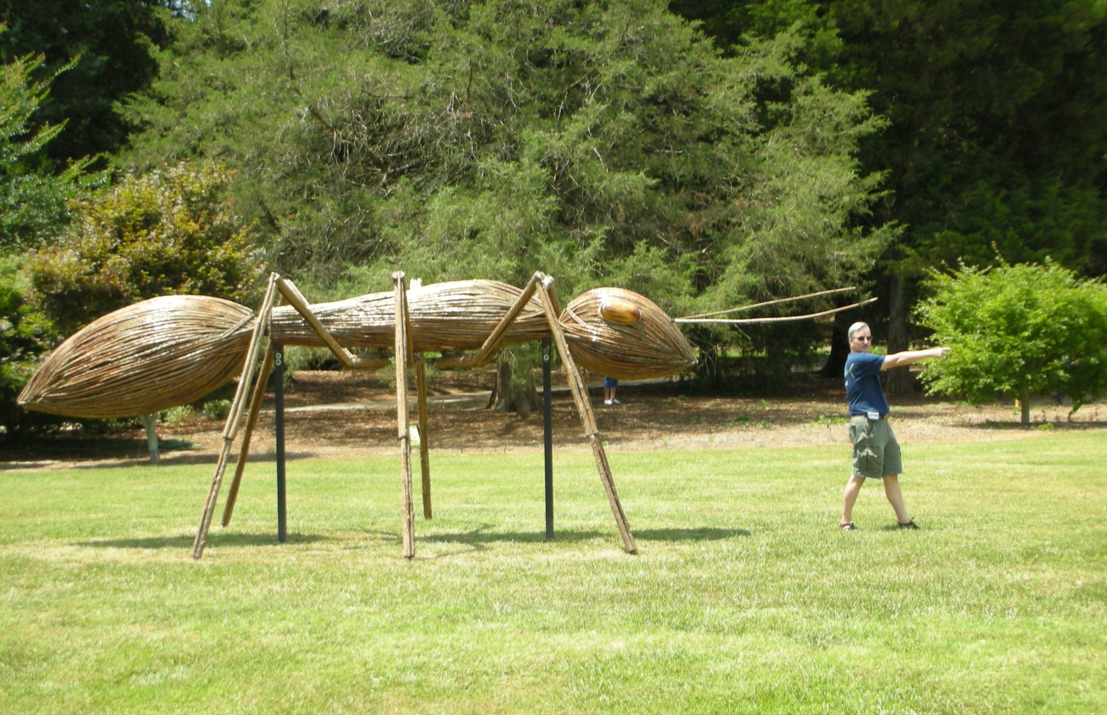
Ant-tracking
(Marfurt, 2018)
Notes:
While Marfurt is not a proven leader of men, he has been known to be followed by children, dogs, and even large insects (such as his graduate student apartment in New York City).

Slide 4
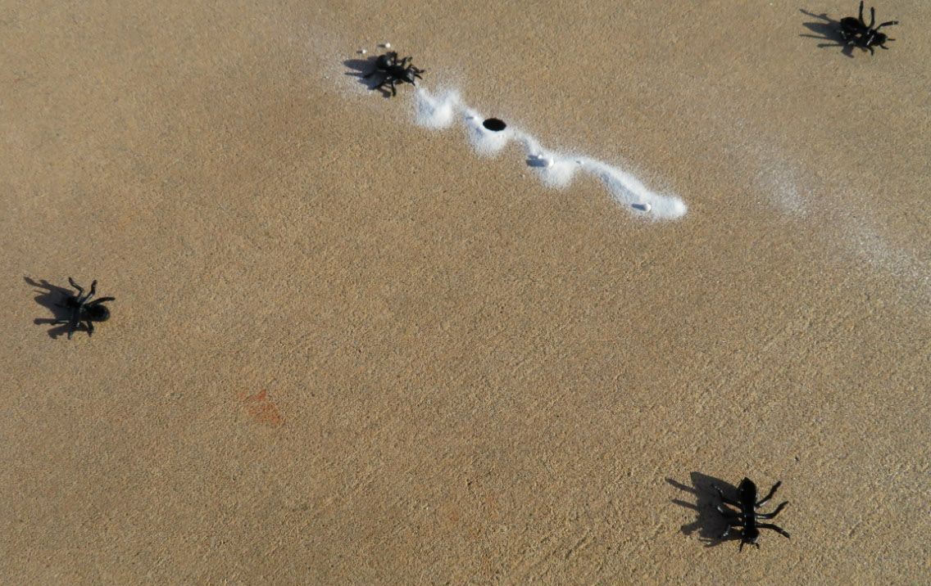
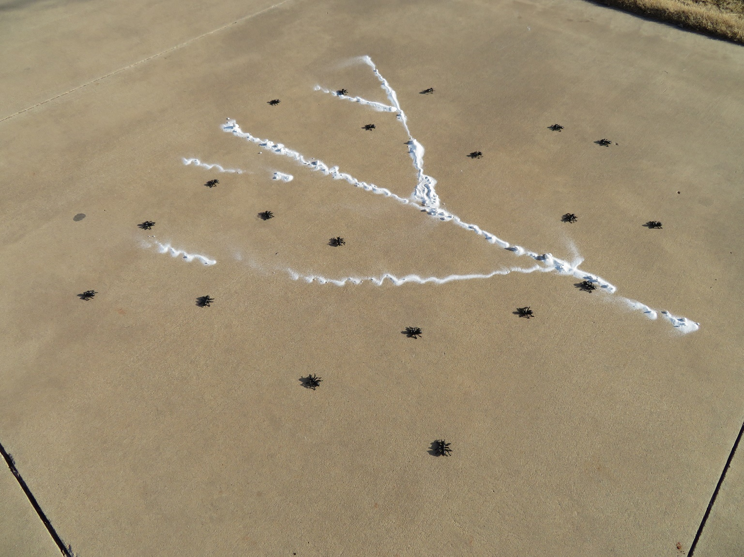
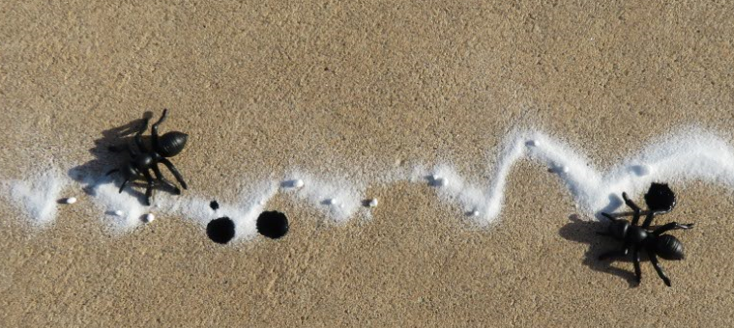
Swarm intelligence and mapping faults
X
X
X
Ants that don’t find sugar, die!
Ants are scattered randomly over the area to be explored. Each ant can make 6*10 steps.
Ants that do find sugar, drop pheromones
(Marfurt, 2018)
Notes:
Illustration of swarm intelligence such as implemented in Schlumberger’s ant-tracker software. An edge-sensitive attribute such as coherence is considered to be sugar. The edges may be smeared laterally and disjoint vertically. In the first step, a suite of ants are dropped into the image. Each ant has sufficient energy to take n random steps. If the ant does not find sugar (a coherence anomaly), she dies. However those ants who do find sugar can not only take more steps, but leave pheromones (purple stains) indicating the trail they have followed, leading other ants to the sugar. (Photos by the author).

Slide 5
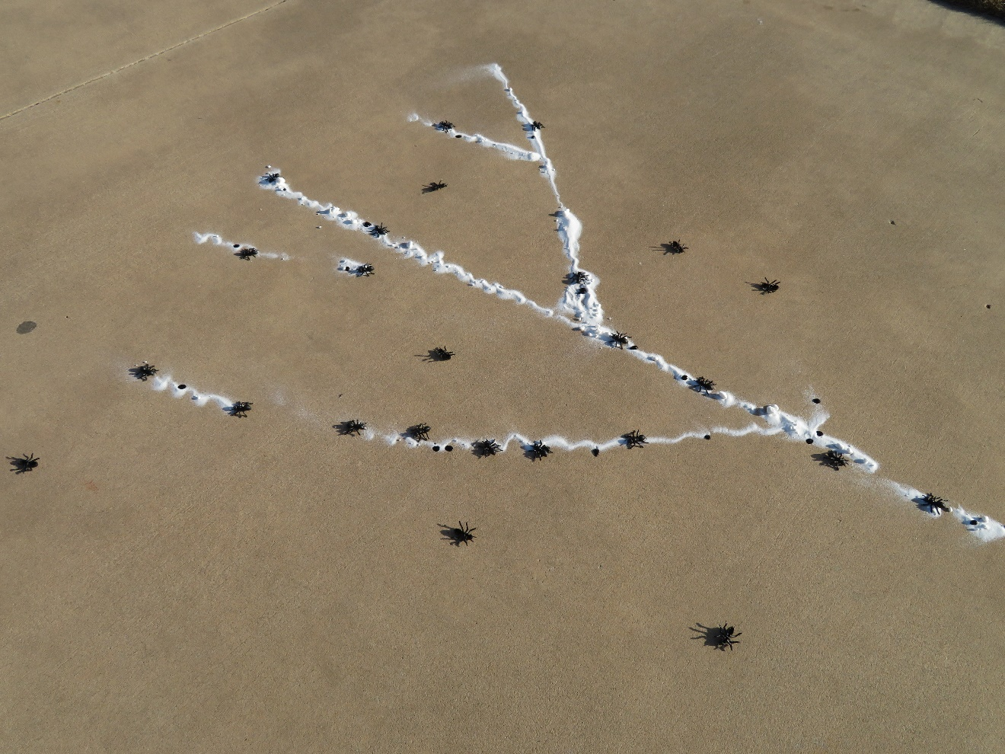
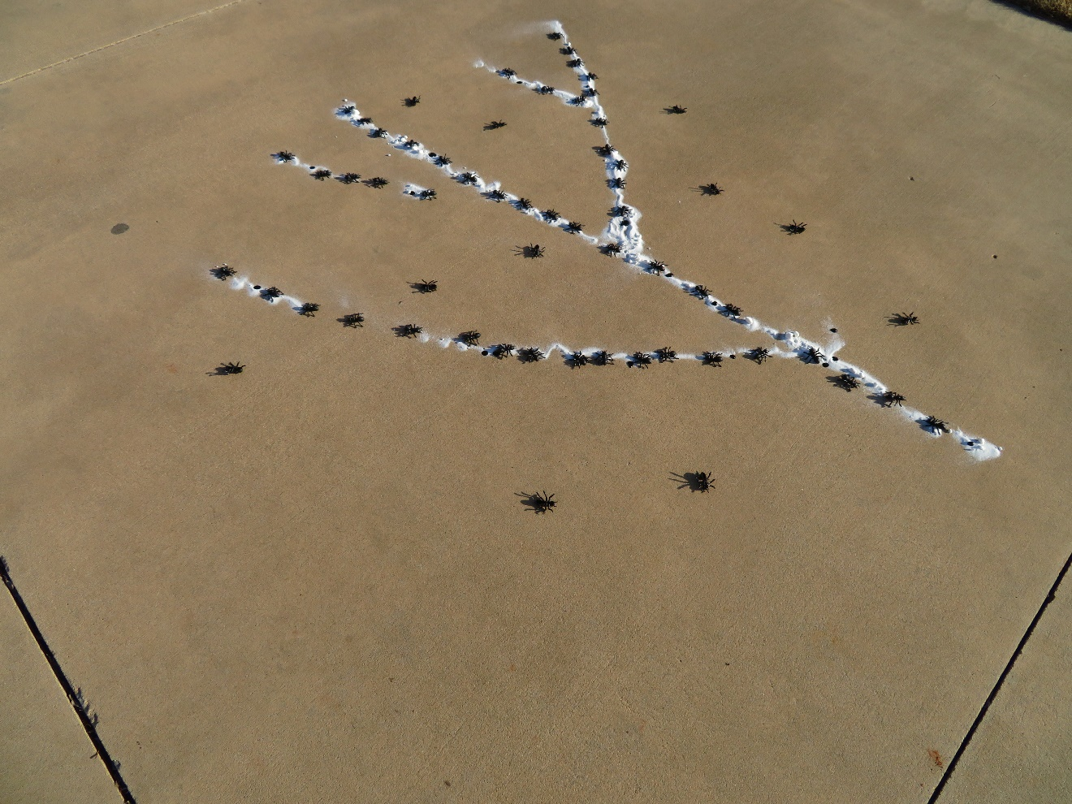
Swarm intelligence and mapping faults
X
X
X
X
X
X
X
X
X
X
X
X
X
X
X
X
X
More ants arrive. Those who follow the pheromones and find sugar, live and leave more pheromones. Those that don’t die after n steps.
X
The process continues until the trail is well marked
(Marfurt, 2018)
Notes:
The process continues with more ants being drawn to the sugar. Those that wander off, die, and leave minimal pheromones behind, those that follow the pheromones and find more sugar continue the process, thereby mapping out a distinct trail. (Photos by the author)

Slide 6
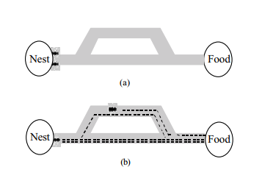
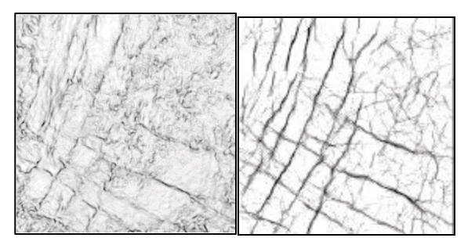
Ant-tracking
(Pedersen et al., 2002)
Notes:
(a)Two ants start at the same time at the nest. (b) The ant choosing the shorter path will arrive at the nest before the ant choosing the longer path. The shorter path will thus be marked with more pheromone than the longer path, and hence the next ant, influenced by the pheromone, is more likely to choose the shorter path.
By encoding fault properties expectations as behavior of intelligent software agents, we are able to enhance and extract fault-like responses in the attribute. An agent will act very similar to an ant in the foraging situation described above, by making decisions based on its pre-coded behavior and emitting “electronic pheromone” along its trail. The idea is to distribute a large number of agents in the volume, and let each agent move along what appears to be a fault surface while emitting pheromone.
Agents deployed at points where there is no surface, only unstructured noise, or where there is a surface which does not fulfill the conditions for a fault (e.g. remains of a reflector), will be terminated shortly or immediately after their deployment. Agents deployed on a fault, on the other hand, should be able to trace the fault surface for a while upon being terminated. We expect that surfaces fulfilling our expectations for faults will be traced by many agents deployed at different positions in the volume, and hence be strongly marked by “pheromone”. Noise and surfaces unlikely to be faults should be unmarked or weakly marked, and will be removed by thresholding

Slide 7
Fault enhancement using ant-tracking
(Silva et al., 2005)
Notes:
Original discontinuity image using a coherence (variance) algorithm and fault enhancement after ant-tracking. (After Silva et al., 2005).

Slide 8
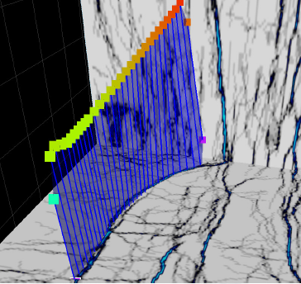
Ant-tracking workflow
Digitize seed points
Extract fault patches
Merge
Convert to pillars or fault segments
(Petrel documentation)
Notes:
Software workflow to convert enhanced faults from ant-tracking into seismic objects. In turn, these objects are converted to pillars or fault segments.

Slide 9
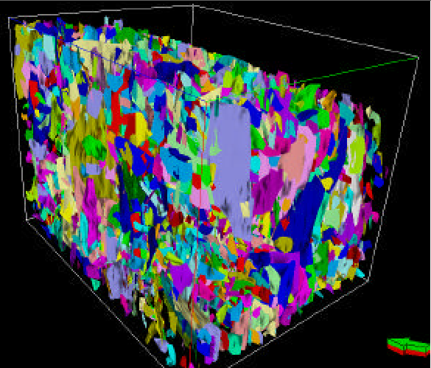
Ant-tracking workflow
All fault patches extracted using
ant-tracking
(Silva et al., 2005)
Notes:
Fault Surfaces created during the Ant Tracking attribute calculation. (After Silva et al., 2005).

Slide 10
Ant-tracking workflow
Fault patch artifacts associated with acquisition footprint
(Silva et al., 2005)
Notes:
Left: Fault surfaces oriented along inline direction (effect of seismic acquisition/processing). Right: Stereonet diagram used to filter fault surfaces aligned with inline and crossline directions. Each point represents one fault surface and those plotted in the grayed areas were filtered out. (After Silva et al., 2005).
Stereo net with projected fault orientations. Fault systems can be seen as dense clusters on the net. The azimuth of the normal can be read along the perimeter and the dip is the distance from the center. The normal of horizontal surface would be plotted in the center of the net, and a vertical surface would be plotted somewhere along the perimeter depending on its strike.

Slide 11
Ant-tracking workflow
The filtered fault sets
(Silva et al., 2005)
Notes:
Fault Surfaces created during the Ant Tracking attribute calculation. (After Silva et al., 2005).

Slide 12
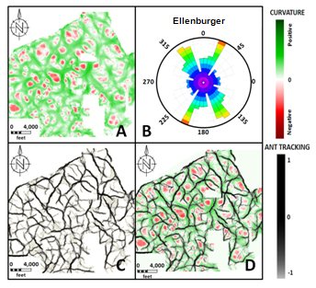
Ant-tracking applied to volumetric curvature
(Baruch et al., 2009)
Notes:
Ant-tracking is an image processing algorithm rather than a fault-detection algorithm and thus can track more than faults. In this case it is used to track axial planes mapped by most-positive curvature. Horizon slice along the top basement through the most-positive curvature volume for a survey in the Fort Worth Basin and its corresponding rose diagram. (Bottom Left) Image enhancement using the ant-tracking algorithm and (Bottom right) superposition of curvature and ant-tracking of the curvature. (After Baruch et al., 2009).

Slide 13
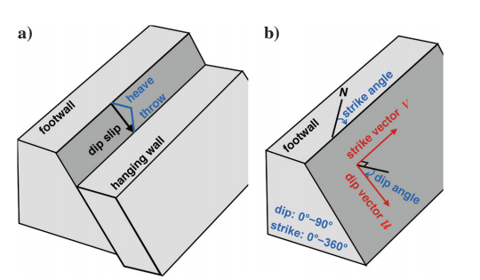
Estimating fault probability, heave, and throw
Computing fault images,
Constructing fault samples,
Constructing fault surfaces,
Estimating fault dip slips,
Unfaulting the seismic image to assess the accuracy of those slip vectors.
(Wu and Hale, 2016)
Notes:
(a) Fault dip slip is a vector representing displacement in the dip direction, of the hanging wall side of a fault surface relative to the footwall side. Fault throw is the vertical component of the slip. Fault strike and dip angles with corresponding unit vectors are defined in panel (b).

Slide 14
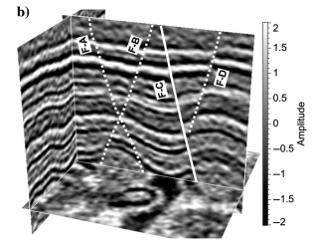
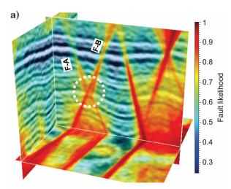
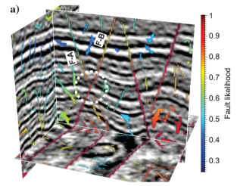
Fault likelihood using predictive error filtering
Interpreted faults
Fault likelihood
Problems with crossing faults and holes
(Wu and Hale, 2016)
Notes:
(Left) Seismic amplitude with interpreted faults. (Center) A fault likelihood volume computed using prediction error filtering. (Right) Skeletonized faults color-coded by fault-likelihood. (After Wu and Hale, 2016).

Slide 15
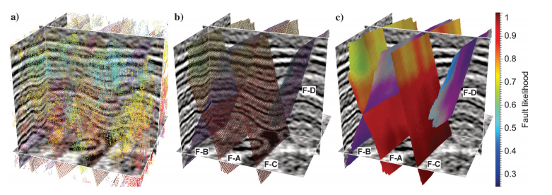
Fault likelihood using predictive error filtering
Fault squares
Linked fault squares
Filling in the holes
(Wu and Hale, 2016)
Notes:
(a) Every voxel is represented by a rectangular surface represented by its fault likelihood, strike, and dip. (b) Links are then built among consistent fault samples, where each set of linked fault samples now appear opaque. (c) Fault samples displayed as larger overlapping squares.

Slide 16
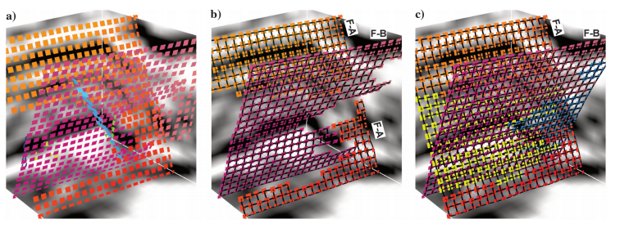
Fault likelihood using predictive error filtering
Fault squares
Linked fault squares
Filling in the holes
(Wu and Hale, 2016)
Notes:
(a) Close-up view of a subset of fault samples from the previous image. (b) Links built among nearby fault samples form three sets of linked samples, which represent three fault surfaces (or patches). Near the intersection of faults F-A and F-B, fault F-A is separated into two independent patches, and fault F-B has a hole. (c) New fault samples (colored with yellow and blue) are created to merge the fault patches and fill the hole to construct more complete intersecting fault surfaces.

Slide 17
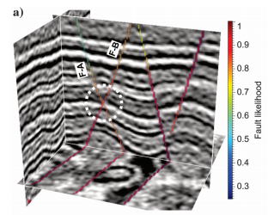
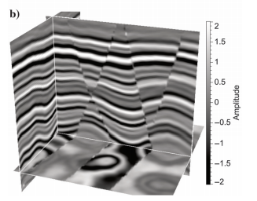
Fault likelihood using predictive error filtering
Fault likelihood
Structure-oriented filtered volume
(Wu and Hale, 2016)
Notes:
Linked fault samples in Figure 6c can be displayed as a fault likelihood image (with mostly zeros) overlaid with the seismic image in panel (a). Compared to the thinned fault likelihood image in Figure 5a, spurious fault samples have been removed. New fault samples are created at the intersection (dashed white circle) of faults A and B when constructing surfaces. This fault image is used to constrain a structure-oriented smoothing filter so that it smooths the seismic image along structures but not across the faults as shown in panel (b).
Figure 9. (a) Fault surfaces and fault throws for a 3D seismic image (b) before and (c) after unfaulting. In all image slices, reflectors are more continuous after unfaulting.

Slide 18
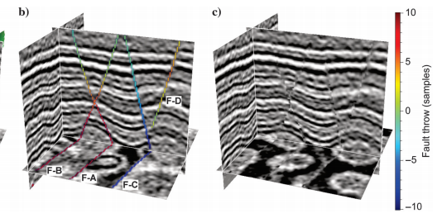
Fault likelihood using predictive error filtering
Fault likelihood
Removed fault displacement
(Wu and Hale, 2016)
Notes:
Fault surfaces and fault throws for a 3D seismic image (Left) before and (Right) after unfaulting. In all image slices, reflectors are more continuous after unfaulting.

Slide 19
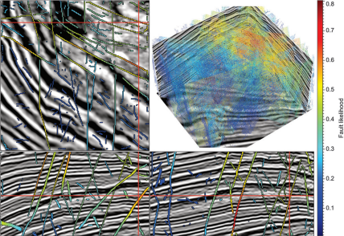
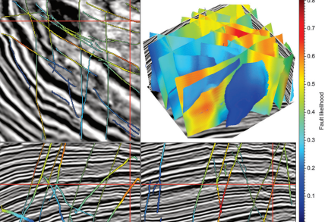
Fault likelihood using predictive error filtering
(Wu and Hale, 2016)
Notes:
1.From this 3D seismic image, images of fault likelihood, strike, and dip are first computed by scanning over a range of possible strikes and dips with a semblance-based filter that highlights locally planar discontinuities.
2.These three fault images are then represented by fault samples, which are displayed as squares oriented by strikes and dips and colored by fault likelihood in the upper right panel of Figure 10a. Remember that each fault sample corresponds to a seismic image sample in the sampling grid of the seismic image; therefore, the same fault samples can be displayed as a fault likelihood image overlaid with the seismic image slices shown in Figure 10a.
3. The oriented fault samples are then linked to form fault surfaces, displayed in the upper right panel of Figure 10b. Many of these fault surfaces intersect each other, and the differences in strikes for these intersecting faults are approximately 60°. These fault surfaces are really just sets of linked fault samples located within the sampling grid of the seismic image; they appear as surfaces only because the squares representing the fault samples are displayed with sizes large enough to overlap with each other. These linked fault samples can also be displayed as a fault likelihood image overlaid with the seismic image in Figure 10b. In the constant-time slice, we observe complicated intersections among the extracted fault surfaces. Compared to the three slices in Figure 10a, some fault samples are removed when constructing surfaces because they cannot be linked to form surfaces with significant sizes. In this example, we discarded fault surfaces with fewer than 2000 samples. In addition, new fault samples are created to fill holes that occur where faults intersect.
4. These fault surfaces of linked fault samples are further used to estimate fault dip slips. Fault throws (vertical component of slips) are displayed on fault surfaces in the upper right panel of Figure 11. After estimating fault slips, the number of fault surfaces is reduced because we keep only fault surfaces for which dip slips are significant. Again, each fault sample in a fault surface corresponds to exactly one sample of the 3D seismic image, so fault throws can be displayed as a 3D image overlaid with the seismic image as in Figure 11a.
5. Using the estimated fault dip slip vectors, the seismic image can be unfaulted as shown in Figure 11b. In the unfaulted image, seismic reflectors in all image slices are more continuous than those in the original image slices shown in Figure 11a. For the fault with large slips highlighted by the red arrow in Figure 11a, footwall and hanging wall sides are moved significantly to align the reflectors on these opposite sides, as shown in Figure 11b.

Slide 20
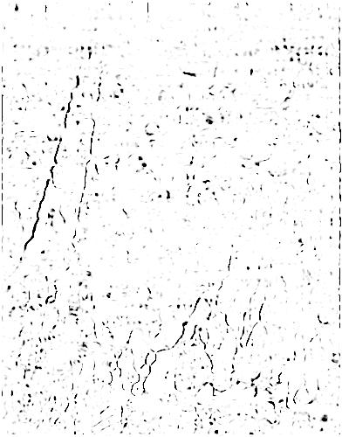
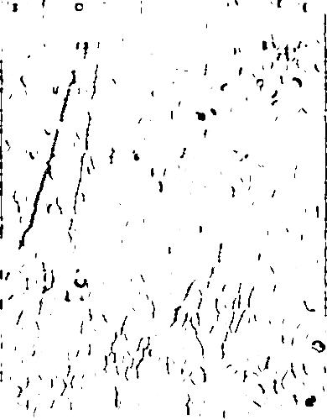
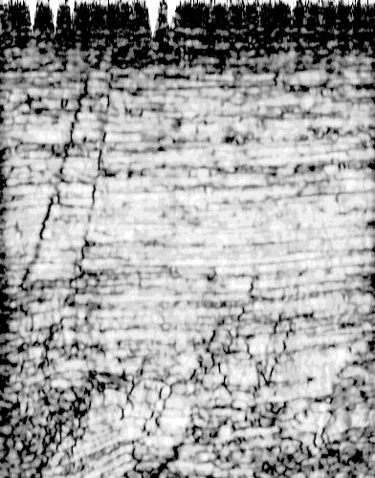
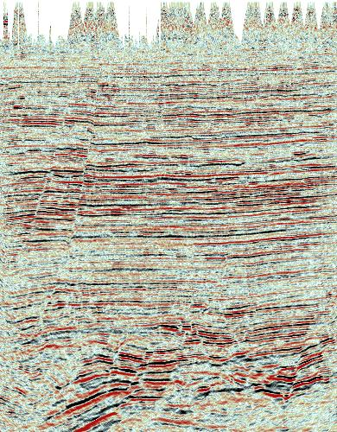
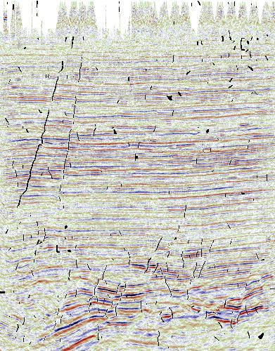
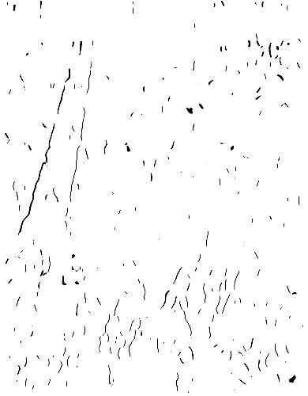
Image enhancement for fault extraction
5 km
G′
G
1. Coherence computation
0.0
2. Suppression of horizontal discontinuities
3. Image dilation
4. Image erosion.
Time (s)
5. Merge with seismic in workstation
4.0
Vertical slices
(Barnes, 2006)
Notes:
Vertical slices through (a) a seismic volume and (b) the corresponding discontinuity volume, for a survey acquired in southern Louisiana, USA. The data are courtesy of Seitel, and the attribute analysis is courtesy of Landmark Graphics. The results of successive filtering of the discontinuity volume shown on the vertical slice displayed in the animation, (a) after suppression of horizontal discontinuities, (b) after image dilation, and (c) after image erosion. (d) A composite image of discontinuity and seismic data. After Barnes (2005).

Slide 21
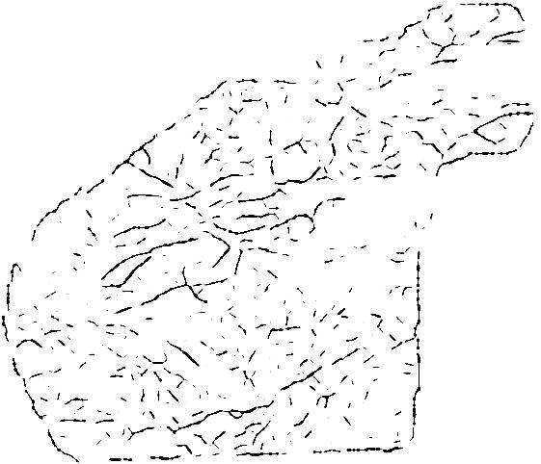
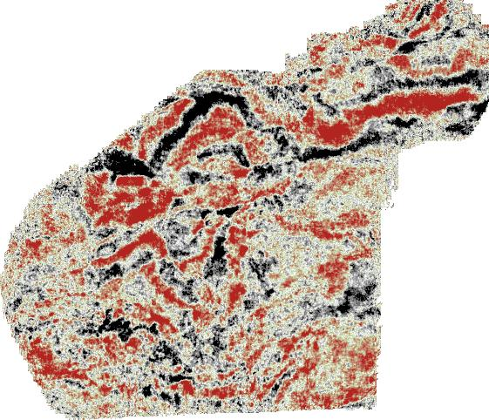
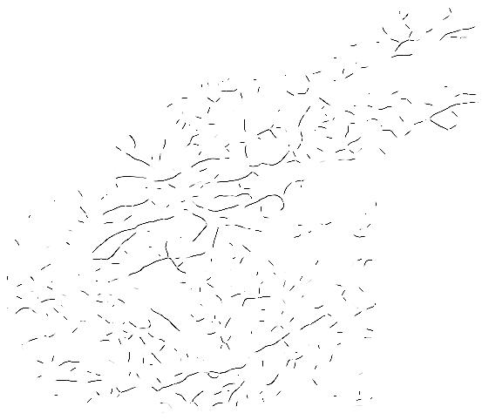
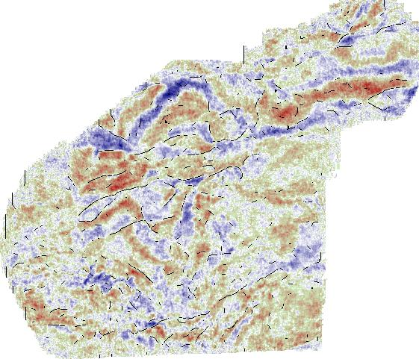
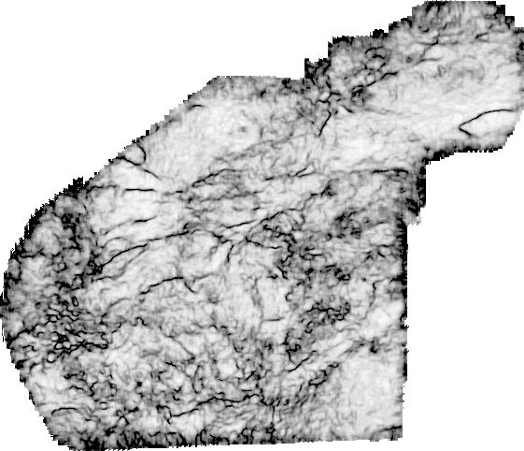
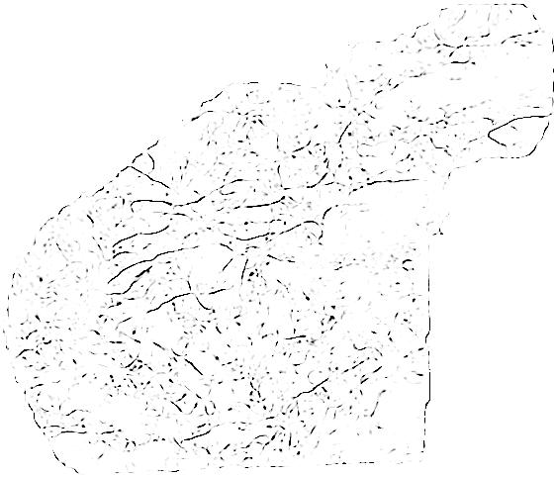
Image enhancement for fault extraction
5 km
G′
Time slices
G
1. Coherence computation
2. Suppression of horizontal discontinuities
3. Image dilation
4. Image erosion.
5. Merge with seismic in workstation
(Barnes, 2006)
Notes:
a) A time slice, at t = 3.000 s, through the seismic data and (b) the corresponding time slice through the discontinuity volume computed from the survey shown in Figure 5.62. The data are courtesy of Seitel, and the attribute analysis is courtesy of Landmark Graphics. After Barnes (2005).
The results of successive filtering of the discontinuity volume shown on the time slice at t = 3.000 s in Figure 5.63b, (a) after suppression of horizontal discontinuities, (b) after image dilation, and (c) after image erosion. (d) A composite image of discontinuity and seismic data. After Barnes (2005).

Slide 22
Fault Enhancement using a directional Laplacian of a Gaussian
Compute a volumetric attribute sensitive to faults or axial planes
Extract a spherical analysis window about each voxel
Compute eigenvectors and eigenvalues of the second moment tensor
Smooth parallel to the fault using a rotated Gaussian
Sharpen perpendicular to the fault using a direction Laplacian of a Gaussian
(Optionally) apply a filter to enhance or reject features parallel or perpendicular to structural dip
Co-render sharpened planar feature with its dip magnitude and dip azimuth
Notes:
Workflow to enhance faults based on a directional Laplacian of a Gaussian

Slide 23
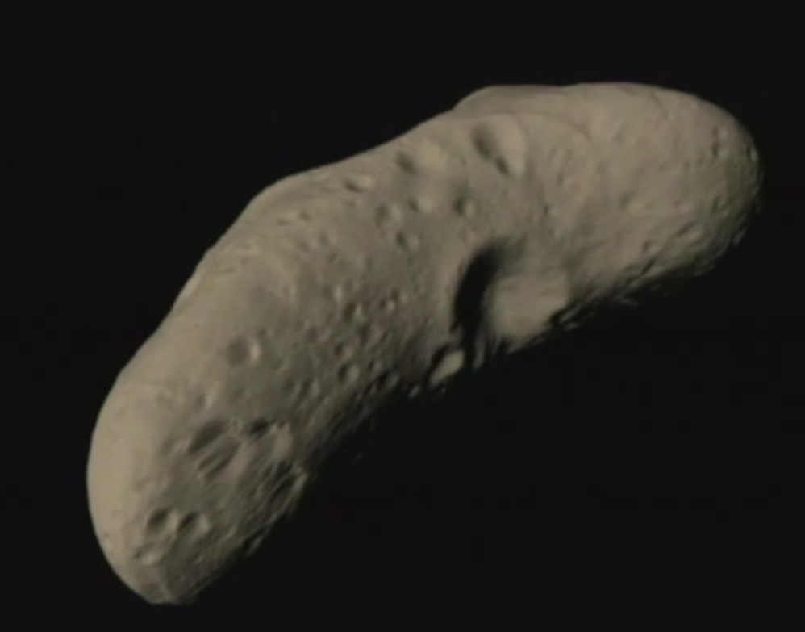
Dynamics of an asteroid
Center of mass, μ:
v₂
v₁
v₃
Inertia tensor, I:
Principal axes of inertia tensor, v_{n}:
(https://svs.gsfc.nasa.gov/2061)
Notes:
The 2nd moment tensors allow us to compute the axes and moments of inertia. In this image from NASA, the asteroid can rotate most easily about axis v⁽¹⁾, next easiest about axis v⁽²⁾, and hardest about axis v⁽³⁾. These three axes are the eigenvalues of the 2nd moment tensor A. (Video and image from https://svs.gsfc.nasa.gov/2061)

Slide 24
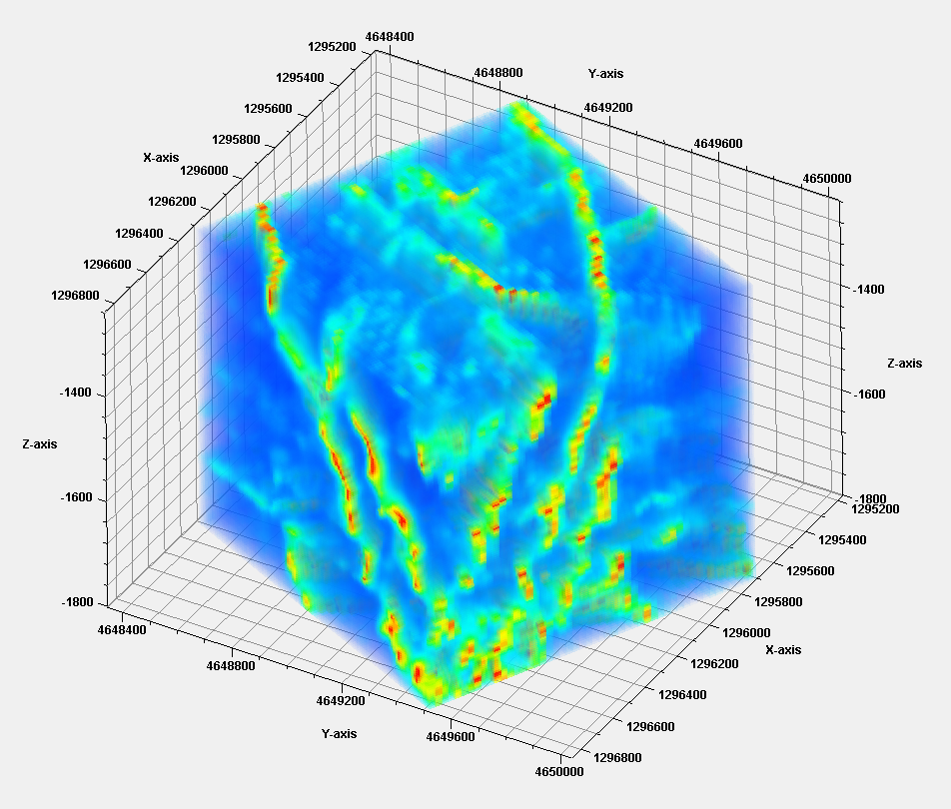

Dynamics of a cloud of energy-weighted fault probability anomalies, ep≡e(1-c)
Center of mass, μ:
Probability
0.7
1 km
Inertia tensor, I:
0.0
0.5 s
Principal axes of inertia tensor, v_{n}:
Notes:
A cloud of fault probability (defined as 1-coherence) voxels. At any voxel, we define an ellipsoidal analysis window, compute its center of mass (probability) and inertia tensor. Where a fault is present, the v₁ and v₂ eigenvectors will align with the local fault plane. The v₃ eigenvector will be perpendicular to the fault plane. (Data from the Great South Basin, courtesy of NZP&M).

Slide 25
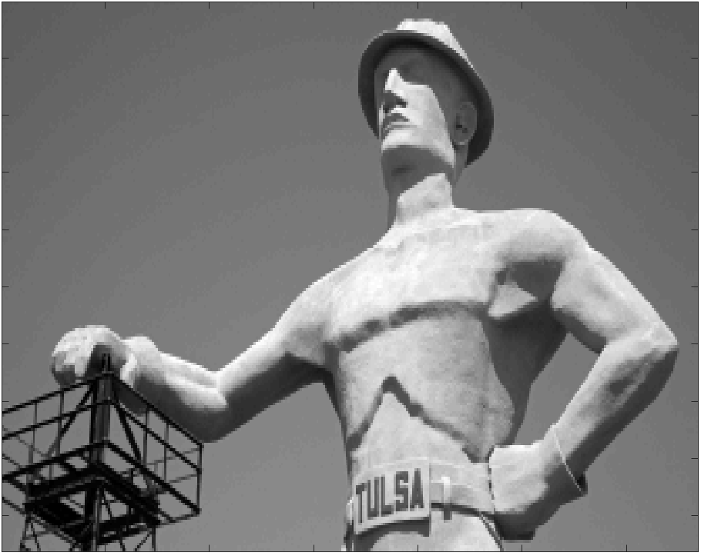
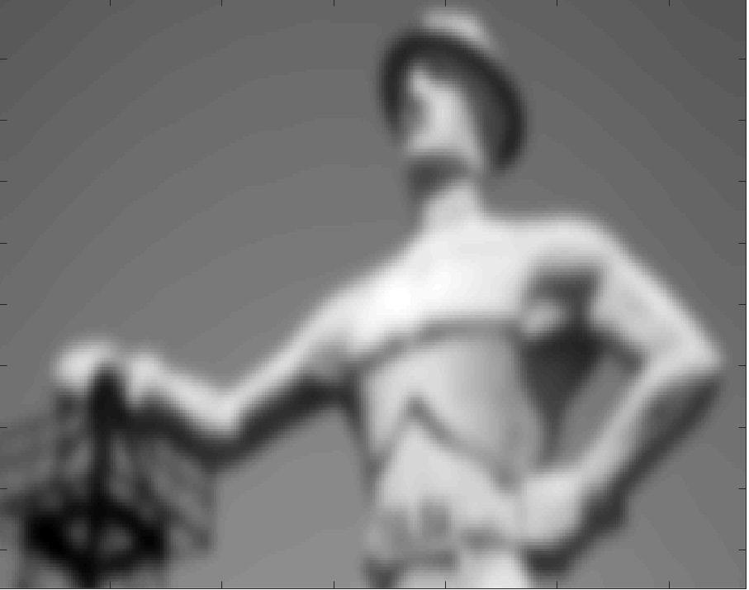
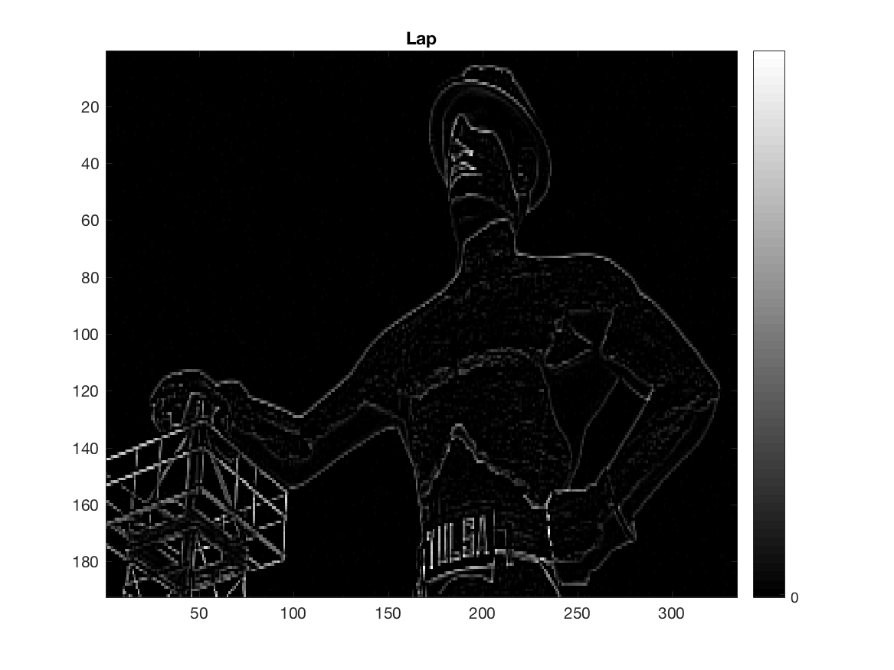
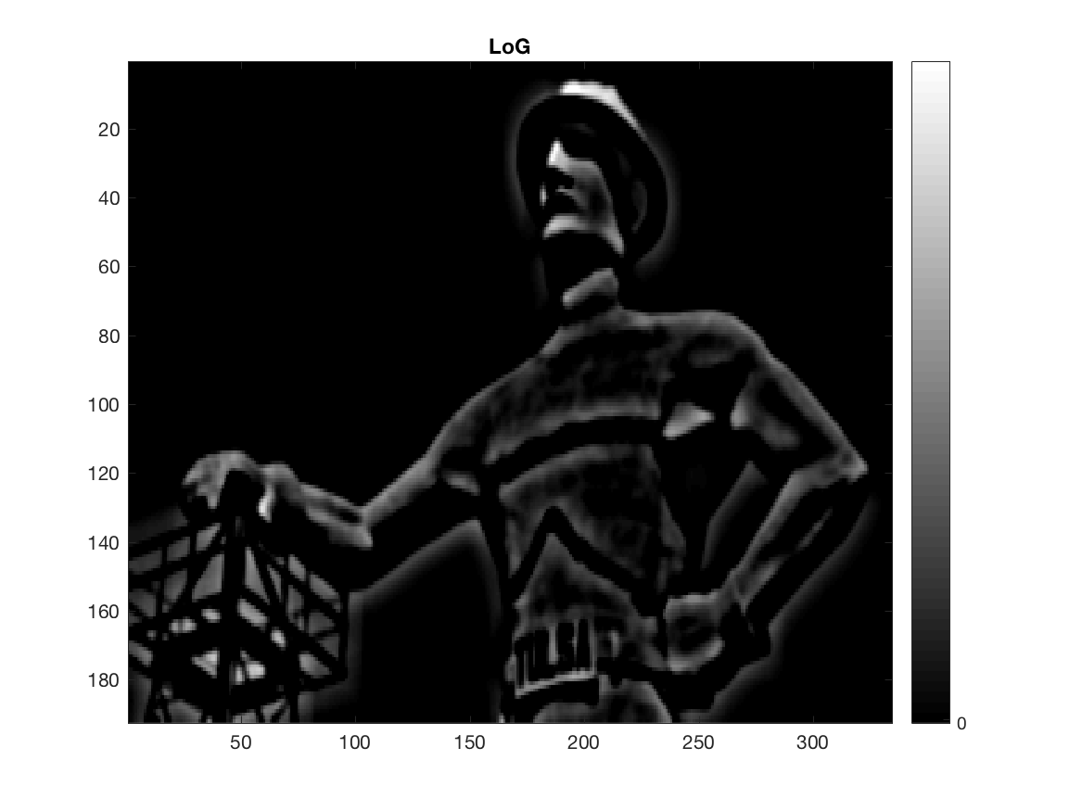
Edge enhancement filters applied to a photo
Original
Gaussian
Laplacian
Laplacian of Gaussian
(Marfurt, 2018)
Notes:
Edge enhancement filters are familiar to anyone who ones a digital camera, with one of the most common being a Laplacian filter. Unfortunately, the Laplacian not only enhances edges, it also enhances point noise, increasing the contribution of the shortest wavelengths. In other cases, one may wish to blur a photo, thereby removing the wrinkles in your face. In this case, one can apply a Gaussian filter, decreasing the contribution of the shortest wavelengths. The Laplacian of a Gaussian filter cascades these two filters, first by filtering point noise but preserving continuous edges, then by enhancing those edges. Photo of the Tulsa Driller and filters courtesy of Abdulmohsen Alali, OU.

Slide 26
Fault enhancement workflow
Seismic amplitude
Coherence
Energy
Compute coherence or other edge attribute
Apply the LoG operator to enhance discontinuous anomalies
Compute fault dip magnitude, and dip azimuth based on second moment tensor method
Skeletonize the LoG -filtered images
Interpolate highest fault probability sample
Structure oriented filtering
Directional Laplacian of a Gaussian filtering
Filtered seismic amplitude
Planar event probability
Planar event dip magnitude
Planar event dip azimuth
Attribute computation
Skeletonization & interpolation
Skeletonized fault, stratigraphic edge, or unconformity
(Qi et al., 2018)
Notes:
We begin our workflow by using principal-component structure-oriented filtering to suppress both random and steeply dipping coherent noise. Then, we compute coherence attribute from the filtered seismic amplitude volumes. Next, we apply a directional LoG filter resulting in a smooth but somewhat blurred image. Finally, we skeletonize the LoG filtered image perpendicular to locally plan features.

Slide 27

The 3D directional Laplacian of a Gaussian operator
dLoG
Positive
Fault
0
v₃
Negative
v₁
v₂
(Marfurt, 2018)
(Marfurt, 2018)
Notes:
Cartoon showing the directional Laplacian of a Gaussian operator applied to a candidate fault. The cloud of coherence values can be defined by the three eigenvectors. If there is a planar event, the first two eigenvalues, λ₁ and λ₂ are significantly greater than the third eigenvalue, λ₃. In this case, eigenvectors v₁ and v₂ define the fault plane while eigenvector v₃ defines its normal. The dLoG operator is constructed so that it sharpens in the v₃ direction but smooths in the v₁ and v₂ directions. (Image courtesy of Gabriel Machado, OU).

Slide 28

Normal fault
N
Fault strike
Dip azimuth $φ$
Footwall
V₃
Fault throw
Hanging wall
E
Dip magnitude θ
Z
Notes:
Cartoon of a normal fault defined by the eigenvector $v_{3}$ perpendicular to the fault plane. The projection of $v_{3}$ on the horizontal plane defines the “fault” dip azimuth $φ$, and angle between $v_{3}$ and the z-axis defines the “fault” dip magnitude.

Slide 29
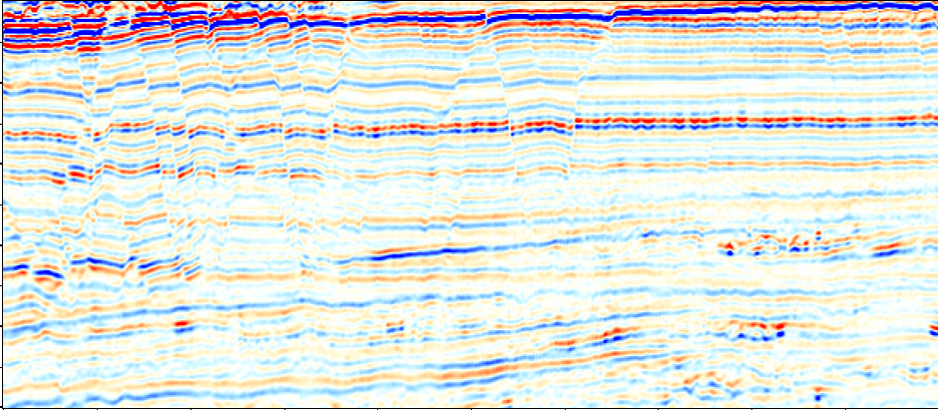
Iterative fault enhancement
1 km
1.2
Amplitude
Positive
1.4
0
1.6
Time (s)
1.8
Negative
2.0
2.2
Seismic amplitude
(Machado et al., 2016)
Notes:
Application of iterative fault enhancement using a directional Laplacian of a Gaussian (dLoG) filter. Vertical slices through (a) seismic amplitude, (b) amplitude co-rendered with coherence, and (c) coherence using a five trace by one complex-sample analysis window. Yellow arrows in (c) indicate low coherence anomalies subparallel to stratigraphy. The same slice after applying the dLoG filter to the coherence volume (d) once, (e) twice, and (f) three times. Yellow arrows indicate the location of anomalies less than 25° to the structural reflector dip previously shown in (c) that have been filtered out. The “thicker” fault anomalies indicated by the magenta arrows are associated with faults that are subparallel rather than perpendicular to the orientation of the vertical slice. (g) co-rendered seismic amplitude shown in (a) with fault probability shown in (f). Compare to (b) to see the improvement. For animation of these seven figures please select DISC2018_Figure_30.video. (Data courtesy of NZPM; After Machado et al., 2016).

Slide 30
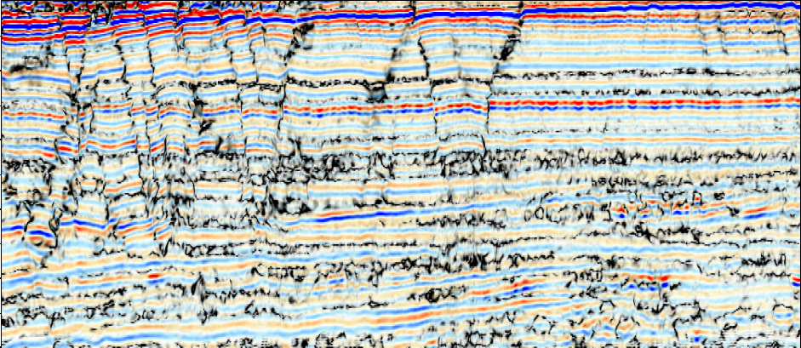
Iterative fault enhancement
1 km
Coherence
1.2
Amplitude
Positive
1.0
1.4
0
1.6
Time (s)
1.8
Negative
0.6
0
100
2.0
Opacity
2.2
Co-rendered seismic amplitude and original coherence
(5 traces, 1 complex sample)
(Machado et al., 2016)

Slide 31
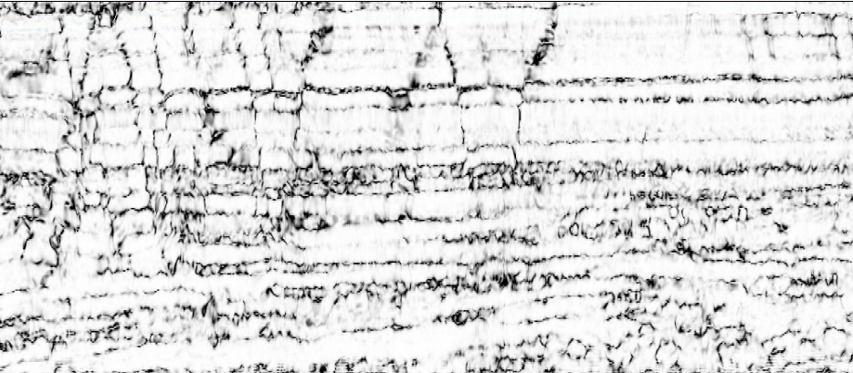
Iterative fault enhancement
1 km
Coherence
1.2
1.0
1.4
1.6
Time (s)
1.8
0.6
2.0
2.2
Original coherence
(5 traces, 1 complex sample)
(Machado et al., 2016)

Slide 32
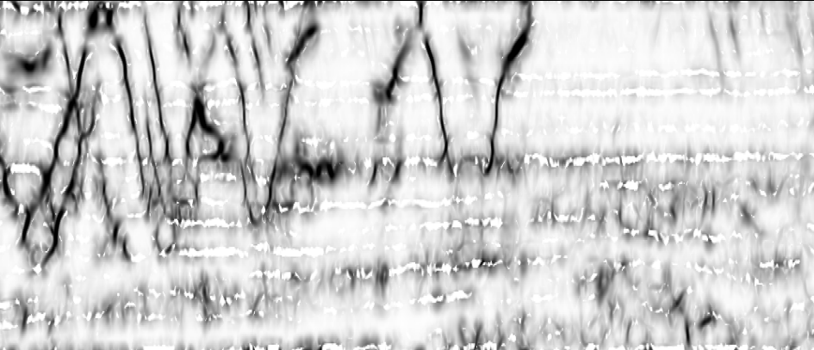
Iterative fault enhancement
1 km
Fault Probability
1.2
High
1.4
1.6
Time (s)
1.8
0.0
2.0
2.2
Fault probability (iteration 1)
(Machado et al., 2016)

Slide 33
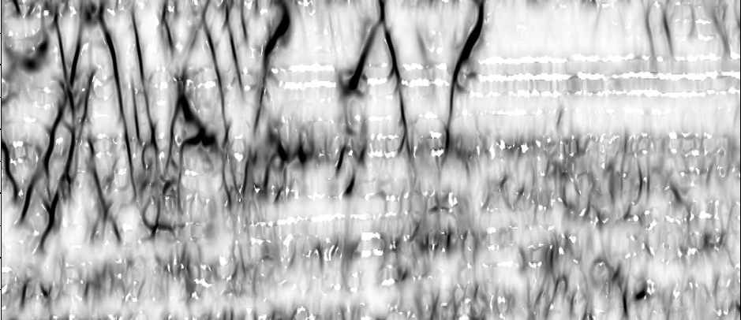
Iterative fault enhancement
1 km
Fault Probability
1.2
High
1.4
1.6
Time (s)
1.8
0.0
2.0
2.2
Fault probability (iteration 2)
(Machado et al., 2016)

Slide 34
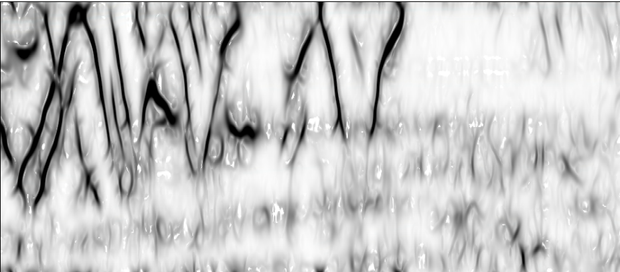
Iterative fault enhancement
1 km
Fault Probability
1.2
High
1.4
1.6
Time (s)
1.8
0.0
2.0
2.2
Fault probability (iteration 3)
(Machado et al., 2016)

Slide 35
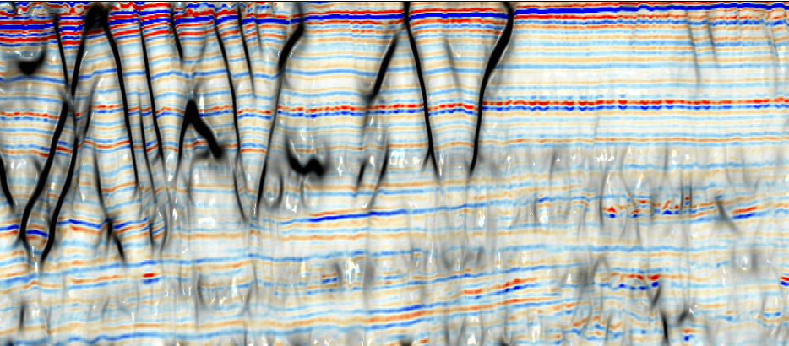
Iterative fault enhancement
1 km
Fault Probability
1.2
Amplitude
Positive
High
1.4
0
1.6
Time (s)
1.8
Negative
0.0
0
100
2.0
Opacity
2.2
Co-rendered seismic amplitude and fault probability iteration 3
(Machado et al., 2016)

Slide 36
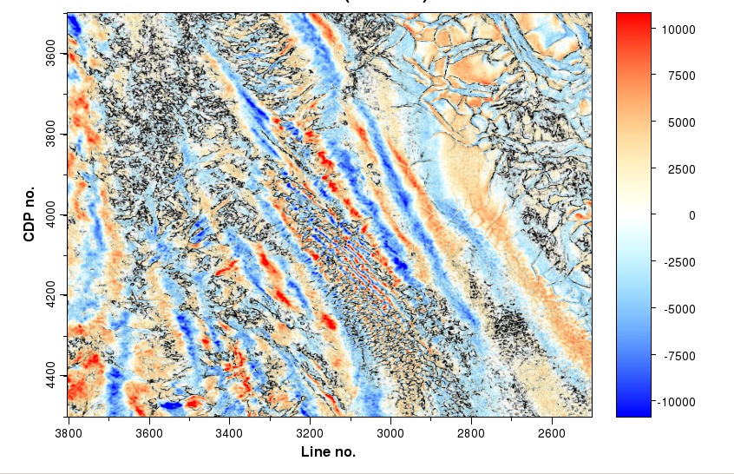
Iterative fault enhancement
Corendered seismic amplitude and original coherence (5 traces, 1 complex sample)
A
A’

Slide 37
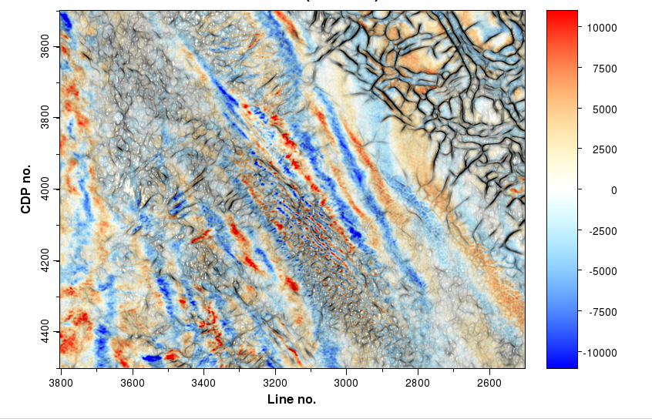
Iterative fault enhancement
Corendered seismic amplitude and fault probability iteration 3
A
A’

Slide 38
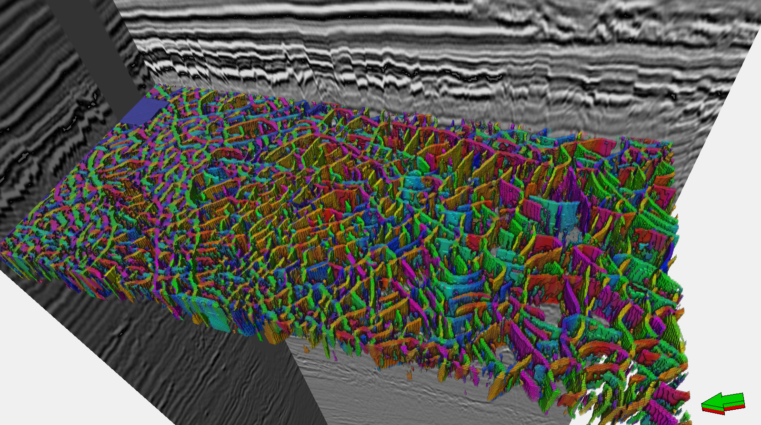

Polygonal faulting (using a box probe)
Fault
dip azimuth
Fault
dip magnitude
+180°
90°
0°
-180°
0°
0
100
Opacity
Fault
probability
High
Fault dip
azimuth
N
N
W
E
0
0
100
Opacity
S
Fault dip
magnitude
(Machado et al., 2016)
Notes:
3D view of two vertical lines through the seismic amplitude volume plotted against a gray scale color bar, and a box probe through co-rendered fault dip azimuth and fault dip magnitude showing polygonal faulting. Hue indicates the azimuth perpendicular to the fault, saturation the dip magnitude and transparency the fault probability. In this manner, areas with a low probability of a fault are rendered transparent. To see animation through the volume, please select DISC2018_Figure3.32.video. (Data courtesy of NZPM: After Machado et al., 2016).

Slide 39

Fault dip and azimuth, (θ,φ)
Fault probability, f_{p}
Skeletonization
Is grid point a peak value?
yes
no
n
Interpolate normal to fault plane
Distribute s_{max} on hexahedron corners
Set s=0
Skeletonized result, s
(Qi et al., 2017)
Notes:
Given the dip and azimuth of any hypothesized fault, construct a filter to skeletonize it
Determine if a given voxel is a local fault probability peak
If so, interpolate fault probability, f_{p}, on either side, normal to the local fault plane
Construct a parabola through the probability values at these three points
Find the location and magnitude of the peak of the parabola, s_{max} (in general, not on a voxel!)
Distribute this magnitude about the 8 nearest neighbors using inverse distance weighting

Slide 40


Limitations of coherence fault images
Seismic amplitude
Coherence
Coherence not only detects faults, but also measure all lateral discontinuities.
Fault anomalies are disconnected. Lateral discontinuities are chaotic.
Faults exhibit the well-known “stair case” artifacts on the vertical slices.
(Courtesy Jie Qi, OU)

Slide 41

Limitations of coherence fault images
Seismic amplitude
Fault enhancement skeletonization result
Coherence
(Courtesy Jie Qi, OU)
Notes:
Stair-step fault artifacts (blue arrows)have been reduced, and anomalies parallel to stratigraphy suppressed.
“Thick” black smears (yellow arrows) correspond to unconformities and condensed sections subparallel to the stratigraphic reflectors

Slide 42

Determining if a fault plane exists near the analysis point
U₃
U₆
Step 1: Interpolate values U_{left} and U_{right}
  Assume the center analysis point U₁₄ is at (0,0,0) and the point U₁ is at (-dx,-dy,-dz)
  $U_{left}≈\left[\begin{matrix}dx−x_{left} & x_{left}\end{matrix}\right]\left[\begin{matrix}U_{11} & U_{12} \\ U_{20} & U_{21}\end{matrix}\right]\left[\begin{matrix}dz−z_{left} \\ z_{left}\end{matrix}\right]$
  ${ U}_{right}≈\left[\begin{matrix}dx−x_{right} & x_{right}\end{matrix}\right]\left[\begin{matrix}U_{7} & U_{8} \\ U_{16} & U_{17}\end{matrix}\right]\left[\begin{matrix}dz−z_{right} \\ z_{right}\end{matrix}\right]$
U₉
U₂
U₅
U₈
U₄
U₇
U₁
U₁₂
U₁₅
U_{right}
U₁₈
V₃
U₁₁
U₁₄
U₁₇
U₁₀
U₁₃
U₁₆
U_{left}
U₂₁
U₂₄
U₂₇
U₂₀
U₂₃
U₂₆
U₁₉
U₂₂
U₂₅
(Courtesy Jie Qi, OU)
Notes:
Cartoon showing details of directional skeletonization. (a) The analysis window about each voxel consisting of eight sub cubes and 26 neighboring voxels. The green plane indicates a locally planar event with center point $U_{14}$. $U_{left}$ and $U_{right}$ define points where the eigenvector $v_{3}$ intersects to the analysis window. The attribute value at $U_{left}$ is interpolated from the corner values of the red square $U_{11}$, $U_{12}$, $U_{20}$, and $U_{21}$. The attribute value at $U_{right}$ is interpolated from the corner values of the blue square $U_{7}$, $U_{8}$, $U_{16}$, and $U_{17}$.

Slide 43

Finding the optimum location and value for the fault
Step 2: If U_{left} < U₁₄ and U_{right} < U₁₄ a “fault” falls near the analysis point
Step 3: Fit a parabola to the three points, U_{left}, U₁₄, and U_{right}
  $u\left(ξ\right)=aξ^{2}+bξ+c$
Step 4: Find the maximum location and value along vector v₃
  $U_{max}=−\frac{b^{2}}{4a}+U_{14}$
  $ξ_{max}=−\frac{b}{2a}$
U_{max}
U₁₄
Max value
U_{right}
V₃
Location of max value
Fault probability
“Fault” dip azimuth
U_{left}
“Fault” dip magnitude
(Courtesy Jie Qi, OU)
Notes:
If the value at the center of the analysis window, $U_{14}<$ $U_{left}$ or $U_{14}<U_{right}$, no fault maximum occurs and we set the skeletonized value to be zero. If the value at the center of the analysis window, $U_{14}≥$ $U_{left}$ and $U_{14}≥U_{right}$, a fault anomaly falls within the window. We fit a parabola of the form:
The maximum value U_{max} and distance $ξ_{max}$ between U₁₄ and location of U_{max} projection on the eigenvector $v_{3}$ is
In general, U_{max} does not fall on the grid point U₁₄, such that we need to distribute the U_{max} value into the eight neighboring grid points and the weights functions $w_{k}$ are based on their distance between the U_{max} and eight neighboring grid points:

Slide 44

Expressing the interpolated fault location and value
Step 5: Compute skeletonized values on 8 neighboring grid points whose weighted average produces the fault probability at the maximum location
  $U_{max}=\frac{w_{k}}{\sum{w_{j}}}U_{k}$
U₃
U₆
U₉
U₂
U₅
U₈
U₁
U₄
U₇
U₁₅
U₁₂
V₃
U₁₈
U_{max}
U₁₁
U₁₄
U₁₇
U₁₀
U₁₃
U₁₆
U₁₂
U₁₄
U₂₁
U₂₄
U₂₇
U₁₁
U₁₃
U₂₀
U₂₃
U₂₆
U₁₉
U₂₂
U₂₅
U_{max}
U₁₆
U₁₈
U₁₅
U₁₇
Notes:
In Figure, U_{max} falls with a sub-cube of the grid analysis window, indicated by the red dashed line.
We compute skeletonized values on 8 neighboring grid points whose weighted average produces the fault probability at the maximum location. Distributed values will be summed, if the values from neighboring analysis window are located on the same grid points. Finally, all skeletonized values on grid points will be output to the skeletonized image.

Slide 45







Example 1: Gulf of Mexico
A
A’
-
=
0.0
0.5
-
=
Time (s)
Amp
1.0
Positive
A
A’
1.5
0
2.0
Negative
Original amplitude
SOF amplitude
Rejected noise
(Courtesy Jie Qi, OU)

Slide 46

Example 1: Gulf of Mexico
Coherence (original)
t=1 s
A
MTC
Salt dome
Salt dome
A’
1 mile
(Courtesy Jie Qi, OU)

Slide 47

Example 1: Gulf of Mexico
Directional skeletonization result
Salt edge
t=1 s
Salt edge
A
MTC edge
Salt edge
MTC
Salt dome
Salt dome
A’
1 mile
(Courtesy Jie Qi, OU)
Notes:
Note that faults after our workflow are more continuous, with higher contract. Other noises are rejected after process. Subtle feature that limit in mass transport complexes are also enhanced. Stair step artifacts in the faults have been reduced, and anomalies parallel to stratigraphy suppressed.

Slide 48


Example 1: Gulf of Mexico
Coherence
Directional LoG skeletonization result
A
A’
0.0
0.5
Time (s)
Prob
1.0
High
Coh
High
1.5
Salt dome
Salt dome
2.0
Low
Low
(Courtesy Jie Qi, OU)
Notes:
Note that faults after our workflow are more continuous, with higher contract. Other noises are rejected after process. Subtle feature that limit in mass transport complexes are also enhanced. Stair step artifacts in the faults have been reduced, and anomalies parallel to stratigraphy suppressed.

Slide 49





Example 1: Gulf of Mexico
Skeletonized fault probability co-rendered with fault dip & azimuth
1 mile
0.0
Dipping North
Dipping North
0.5
Dipping SE
Time (s)
Mag
High
1.0
1.5
Low
N
Dip Azim
Opacity
2.0
Dip Mag
Azim
Prob
Amp
$${180}^{o}$$
High
High
W
E
S
$${−180}^{o}$$
Low
Opacity
Low
Opacity
Opacity
N
(Courtesy Jie Qi, OU)
Notes:
3D view showing several inlines of the direction skeletonization result co-rendered with seismic amplitude by the Hue-Saturation-Lightness (plotted against a 3D color bar). Faults orientation is readily seen. More organized continuity artifacts now appear within the salt. While such pattern are easily recognized by the interpreter, they could also be marked by an attribute that is sensitive to the internal low amplitude reflectivity common to salt

Slide 50

Example 1: Gulf of Mexico
Skeletonized fault probability co-rendered with fault dip & azimuth
1 mile
0.0
Dipping NE
Dipping SW
0.5
Mag
Time (s)
High
Dipping SW
1.0
1.5
Low
N
Dip Azim
Opacity
2.0
Amp
Dip Mag
Azim
Prob
$${180}^{o}$$
High
High
W
E
S
$${−180}^{o}$$
Low
Opacity
Low
Opacity
Opacity
N
(Courtesy Jie Qi, OU)

Slide 51

Example 2: Taranaki Basin
Amp
0.2
High
Time (ms)
0
1.7
Low
(Qi, 2018)

Slide 52




Example 2: Taranaki Basin
Coherence after SOF
Original coherence
Coherence after footprint suppression
Coh
0.2
1
Time (ms)
1.7
0.5
(Qi, 2018)

Slide 53



Example 2: Taranaki Basin
Multispectral coherence
After alpha trim mean filter
The residual
Coh
0.2
1
Time (ms)
1.7
0.5
(Qi, 2018)

Slide 54




Example 2: Taranaki Basin
The residual after 3 iterations of energy-weighted directional LoG
Multispectral coherence after iter directional LOG
Multispectral coherence after Iter energy-weight directional LOG
Multispectral coherence after directional LOG
Coh
0.2
1
Time (ms)
1.7
0.5
(Qi, 2018)

Slide 55


Example 2: Taranaki Basin
Seismic amplitude co-rendered with fault probability
Fault
probability
Amp
0.2
High
High
Time (ms)
0
Low
Low
1.7
(Qi, 2018)

Slide 56

Example 2: Taranaki Basin
Co-rendered fault probability, dip magnitude, and dip azimuth
Fault
dip azimuth
Fault
dip magnitude
Fault
probability
0.2
180
90º
High
Time (ms)
-180
0º
Low
1.7
Opacity
Opacity
(Qi, 2018)

Slide 57




Example 2: Taranaki Basin
Corendered fault probability, dip magnitude and dip azimuth
Coherence
Variance
Fault probability
(Qi, 2018)

Slide 58




Example 2: Taranaki Basin
Automatic fault tracking using ant tracking
Variance followed by Ant Tracking
Automatic fault tracking using fault probability
Fault probability
0.2
0.2
0.2
0.2
Time (ms)
Time (ms)
Time (ms)
Time (ms)
1.7
1.7
1.7
1.7
(Qi, 2018)

Slide 59


Example 2: Taranaki Basin
Interpreter-picked fault sticks
Extracted surfaces from fault probability
(Qi, 2018)

Slide 60
Pitfalls in correlating an engineering or geologic property with cyclical attributes
φ
Cluster 1
Desired Discriminator
Cluster 2
There is no single discriminator !
φ
-180°
+180°
Notes:
The most natural way to define the variation of lithology with direction would be to provide azimuth from an origin as an input attribute. Unfortunately, if the azimuth is defined to range between ±180°, we can not parameterize the problem with a single layer of perceptrons.

Slide 61
Correlating an engineering or geologic property with cyclical attributes
Construct continuous geodetic attributes N=cosφ and E=sinφ
Northing (cosφ)
φ
Easting (sinφ)
Cluster 1
Desired Discriminator
Cluster 2
Notes:
By defining azimuth using two attributes, northing and easting, the problem becomes more easily separable, with a single discriminator being able to correlate desired parameters with any orientation. Similar correlations can be done with North and East components of reflector dip, aberrancy and other cyclical attributes.
Deep neural networks also transform the data, and may be able to figure out that they need to convert azimuths into their north and east components.

Slide 62


Discontinuities when defining a fault plane by its dip and azimuth
Fault plane
North
-45°
+45°
Dip magnitude
n
90°
30°
60°
X (North)
West
0°
East
ψ
a
θ
-135°
+135°
Plane defined by the normal and the z-axis.
South
Y (East)
Two problems:
Faults with azimuths ≈-180° and ≈+180° should fall next to each other
Vertical faults with azimuths φ and φ+180° should fall next to each (and have a similar color mapping)
Z (Down)
Notes:
Because faults are often vertical, the discontinuities associated with dip magnitude and dip azimuth of fault planes are more challenging than those of dipping reflectors which tend to be more horizontal.

Slide 63



Pitfall: Dip azimuth values flip about vertical faults
Vector display using an HSL color model resulting in polarity flips
2 km
1.32
200 ms
1.40
E to W flip
N to S flip
N to S flip
Inline 3101
E to W flip
t=1.32 s
t=1.40 s
Notes:
This image shows a vertical slice and two time slices through what I consider to be a conventional means (OK, the way Marfurt does it!) of displaying the local dip and azimuth of a fault surface. In the yellow box on the time slice and on the time slice at t=1.40 s, note that the fault plane changes orientation from blue (North) to yellow (South). Likewise, in the magenta box, note that the fault on the vertical slice and the time slice at t=1.32 s changes orientation from magenta (Northeast) to cyan (Northwest). Both of these faults are near vertical and the slight “wavering” about the vertical results in a totally different color.

Slide 64



Partial solution: Generate fault orientation components
North strike component: cos(2σ); σ=ψ+90°
2 km
1.32
200 ms
1.40
Inline 3101
t=1.32 s
t=1.40 s

Slide 65


Partial solution: Generate fault orientation components
East strike component: sin(2σ); σ=ψ+90°
2 km
1.32
200 ms
1.40
Inline 3101
t=1.32 s
t=1.40 s

Slide 66




Partial solution: Generate fault orientation components
Horizontal dip component: cos(θ)
2 km
1.32
200 ms
1.40
Inline 3101
t=1.32 s
t=1.40 s

Slide 67



Partial solution: Generate fault orientation components
Vertical dip component: sin(θ)
2 km
1.32
200 ms
1.40
Inline 3101
t=1.32 s
t=1.40 s

Slide 68
Image enhancement of faults
In Summary:
By using iterative application of larger analysis windows, image enhancement filters can
  fill in the holes seen in coherence images when unrelated stratigraphic reflectors correlate across a fault, and
  minimize the stairstep artifacts associated with the seismic wavelet being imaged perpendicular to the reflector.
Eigenvectors of the 2nd moment tensor computed from coherence volumes provides
  estimates of fault dip and azimuth, and
  a means to directionally sharpen or smooth the fault
Skeletonization converts diffuse fault edges into sharper surfaces
Fault enhancement is not limited to coherence images, but can be applied to curvature volumes to better map fold axes
Fault enhancement algorithms can also enhance footprint!
Notes:
Summary comments on image processing

